Slide 1

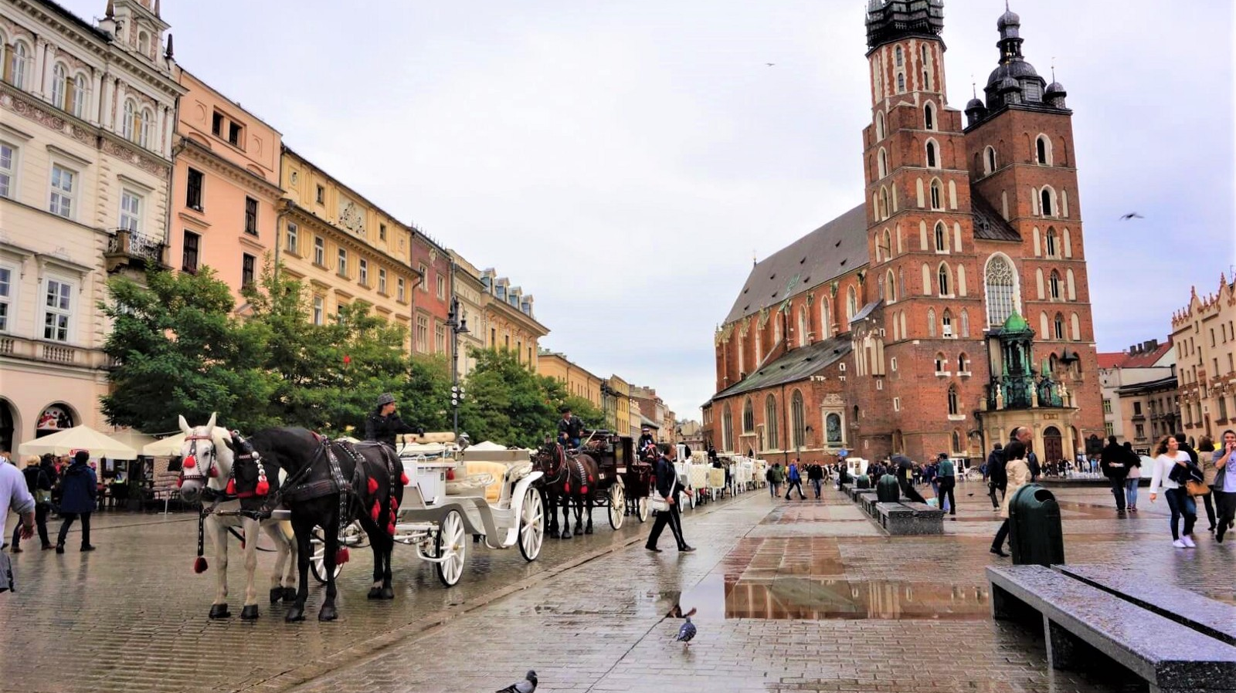
Poland

Slide 2
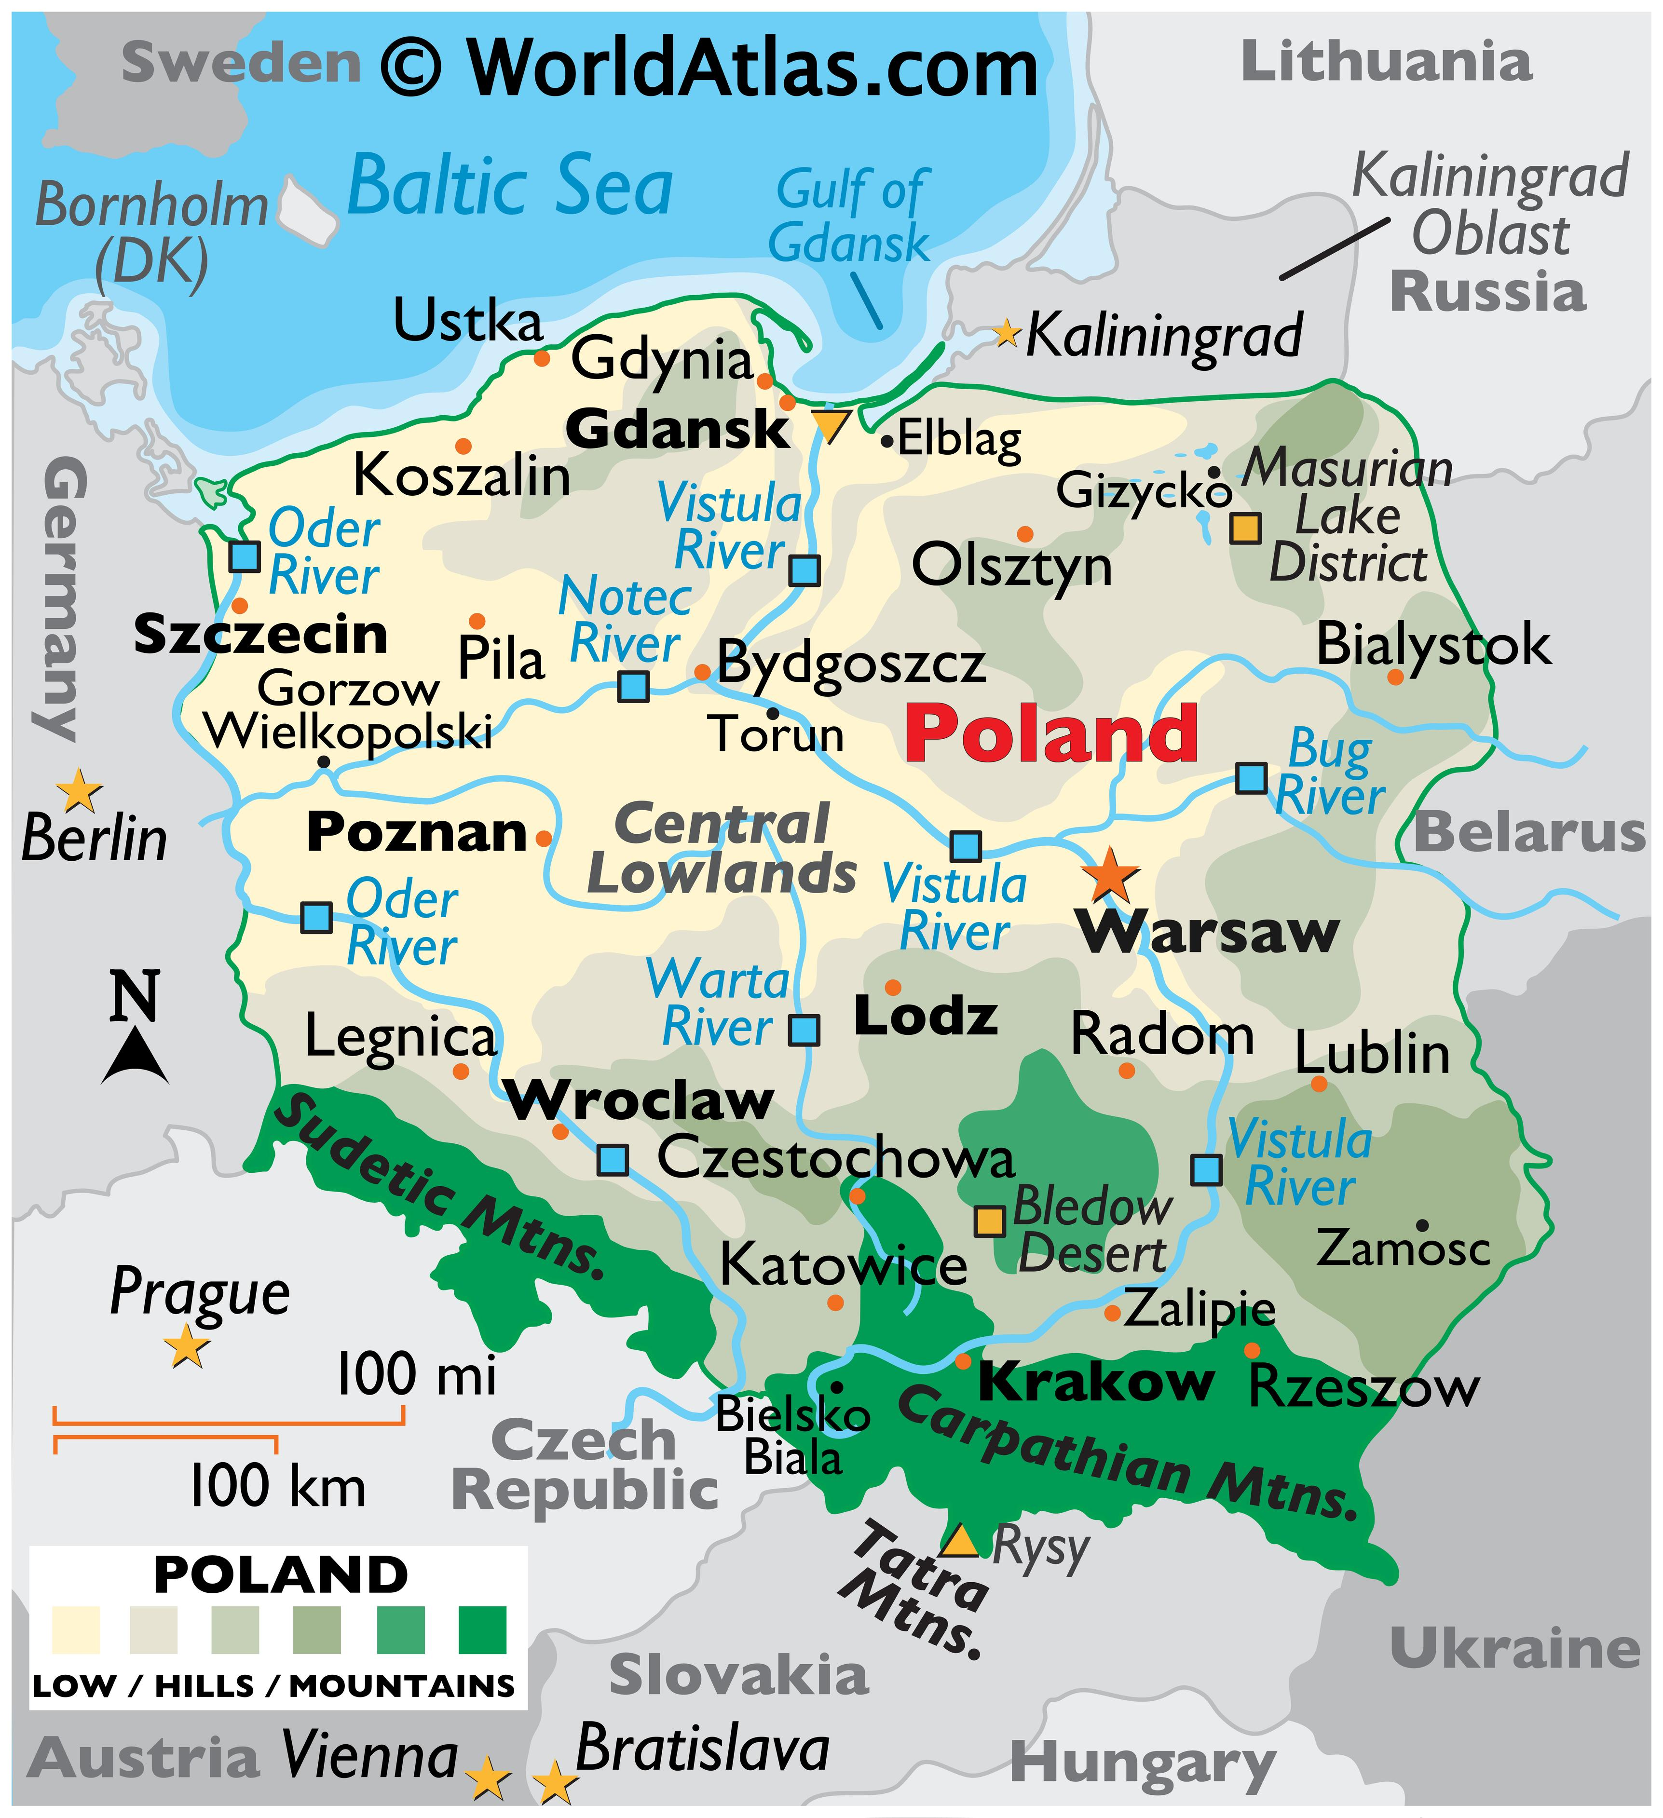
Notes:
Poland is a country in eastern Europe, bordering Germany, Czechia, Slovakia, Ukraine, Belarus, Lithuania, and Russia! Approximately 38 million people live in Poland, with nearly 2 million living in the capital of Warsaw.

Slide 3
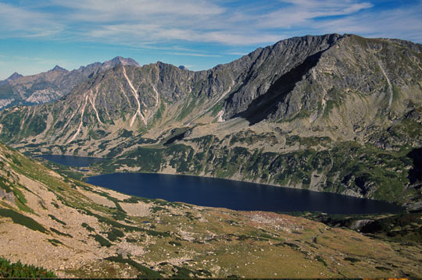
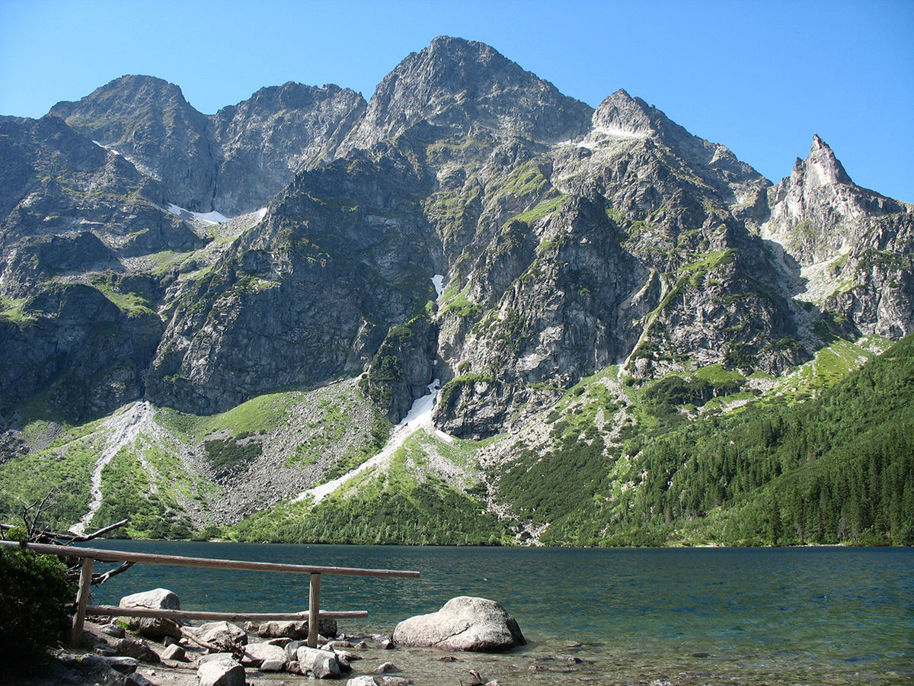
Sudetes
Carpathians
Notes:
Poland is known for its mountain ranges in the south of the country. The Sudetes are on the border with the Czech Republic, and the Carpathians are on the borders with Slovakia and Ukraine. The mountains are popular destinations for hiking and mountain biking in the summer, and skiing and snowboarding in the winter.

Slide 4
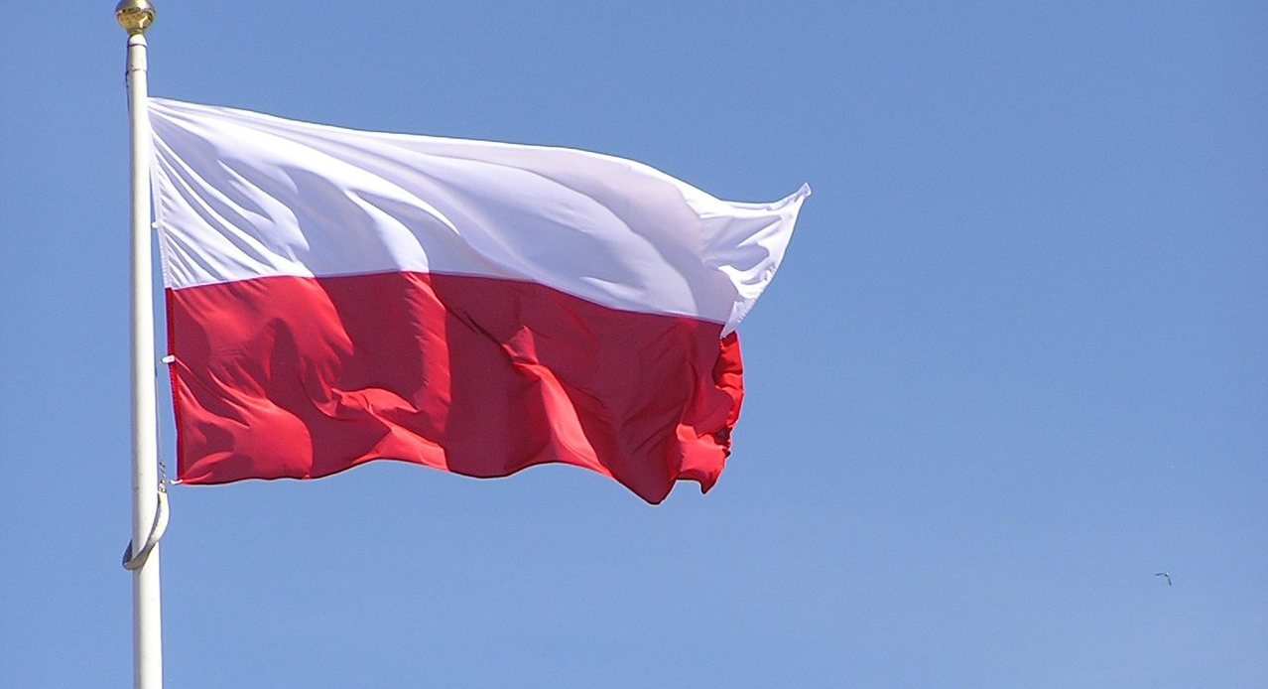
Notes:
The flag of Poland was officially adopted on August 1, 1919. the white represents the hope for peace and the red symbolizes the many struggles for freedom.

Slide 5

Basic phrases in Polish
Hi! → Cześć!
Goodbye! → Do widzenia!
My name is… → Nazywam się…
Notes:
Here are some basic phrases in Polish!
Pronunciation guide: cheshch, do vee-DZEN-yuh, nah-zee-VAHM syawn (the “e” should have a nasal “n” sound at the end as in the French “vin”)

Slide 6
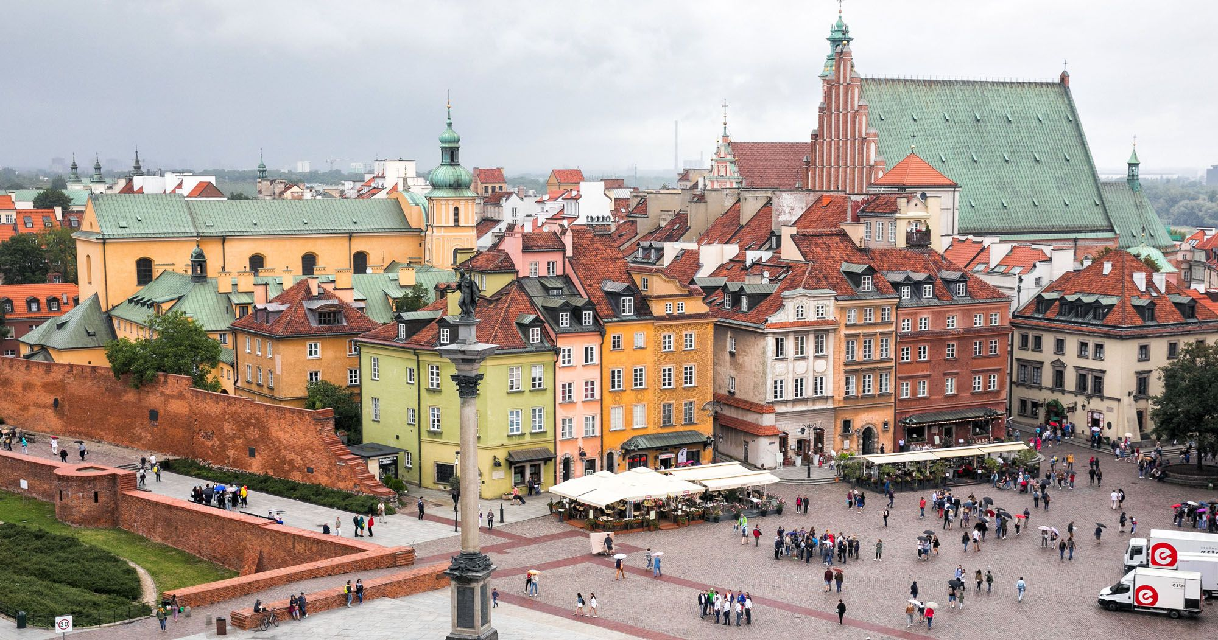
Notes:
Here is the old town of Warsaw, Poland’s capital. These buildings may look very old, but they’re actually pretty new. This is because Old Town Warsaw was almost completely destroyed during World War II, so they had to rebuild it in the 1950s. They were able to make it look just like it used to!

Slide 7
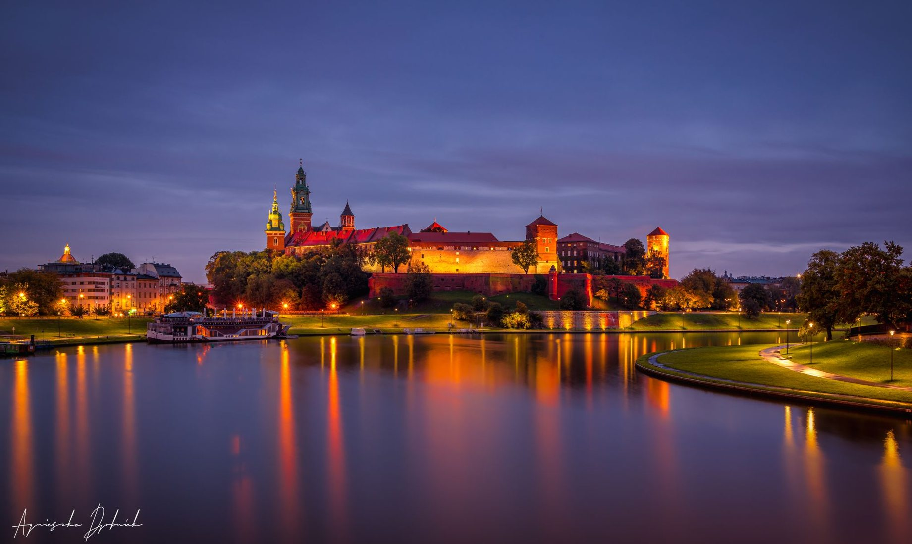
Notes:
And this is a photo of the second largest city in Poland, Krakow. This is the medieval Wawel Castle, which today is home to a museum where you can learn about the history of Krakow, and Poland more broadly.

Slide 8

Notes:
Now it’s time to learn about an old folktale, about a dragon that used to live under the hill that Wawel Castle sits on.

Slide 9
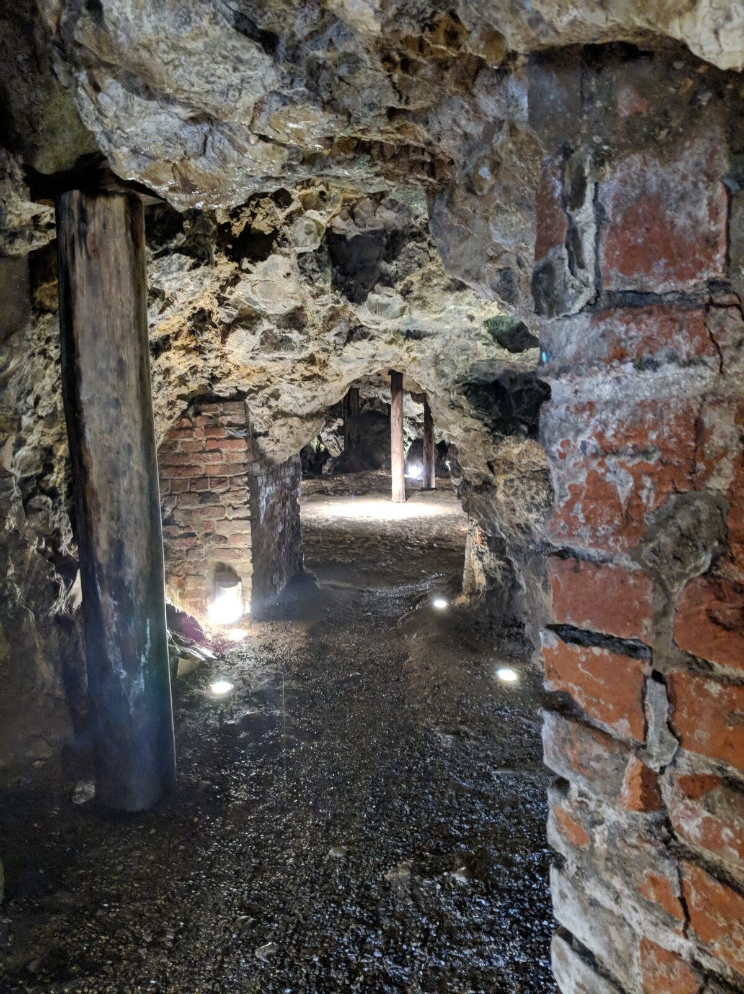
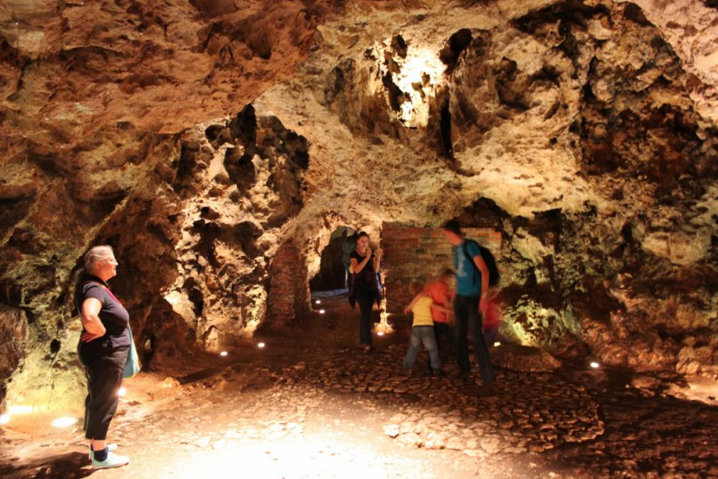
Notes:
In this legend, there was an evil dragon who lived in a cave below the castle when Krakus (the founder of the city) was king. Each day the dragon would destroy the countryside, requiring the people there to give him their food and livestock. Warriors from all over Poland would come to try to defeat the dragon, but no one was able to beat the dragon. Finally, a shoemaker named Skuba came up with a clever plan to win against the dragon. He made a fake lamb and stuffed it with sulfur, which would make the dragon sick if he ate the lamb. The dragon fell for the trick, and Skuba went on to marry the King’s daughter and helped found the city of Krakow. The photos above are the caves that he supposedly lived in!

Slide 10
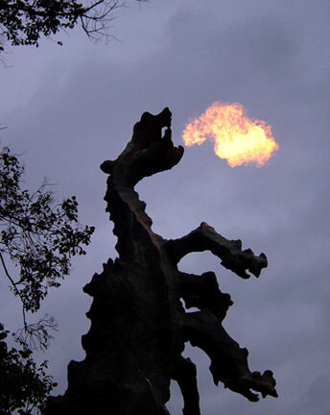
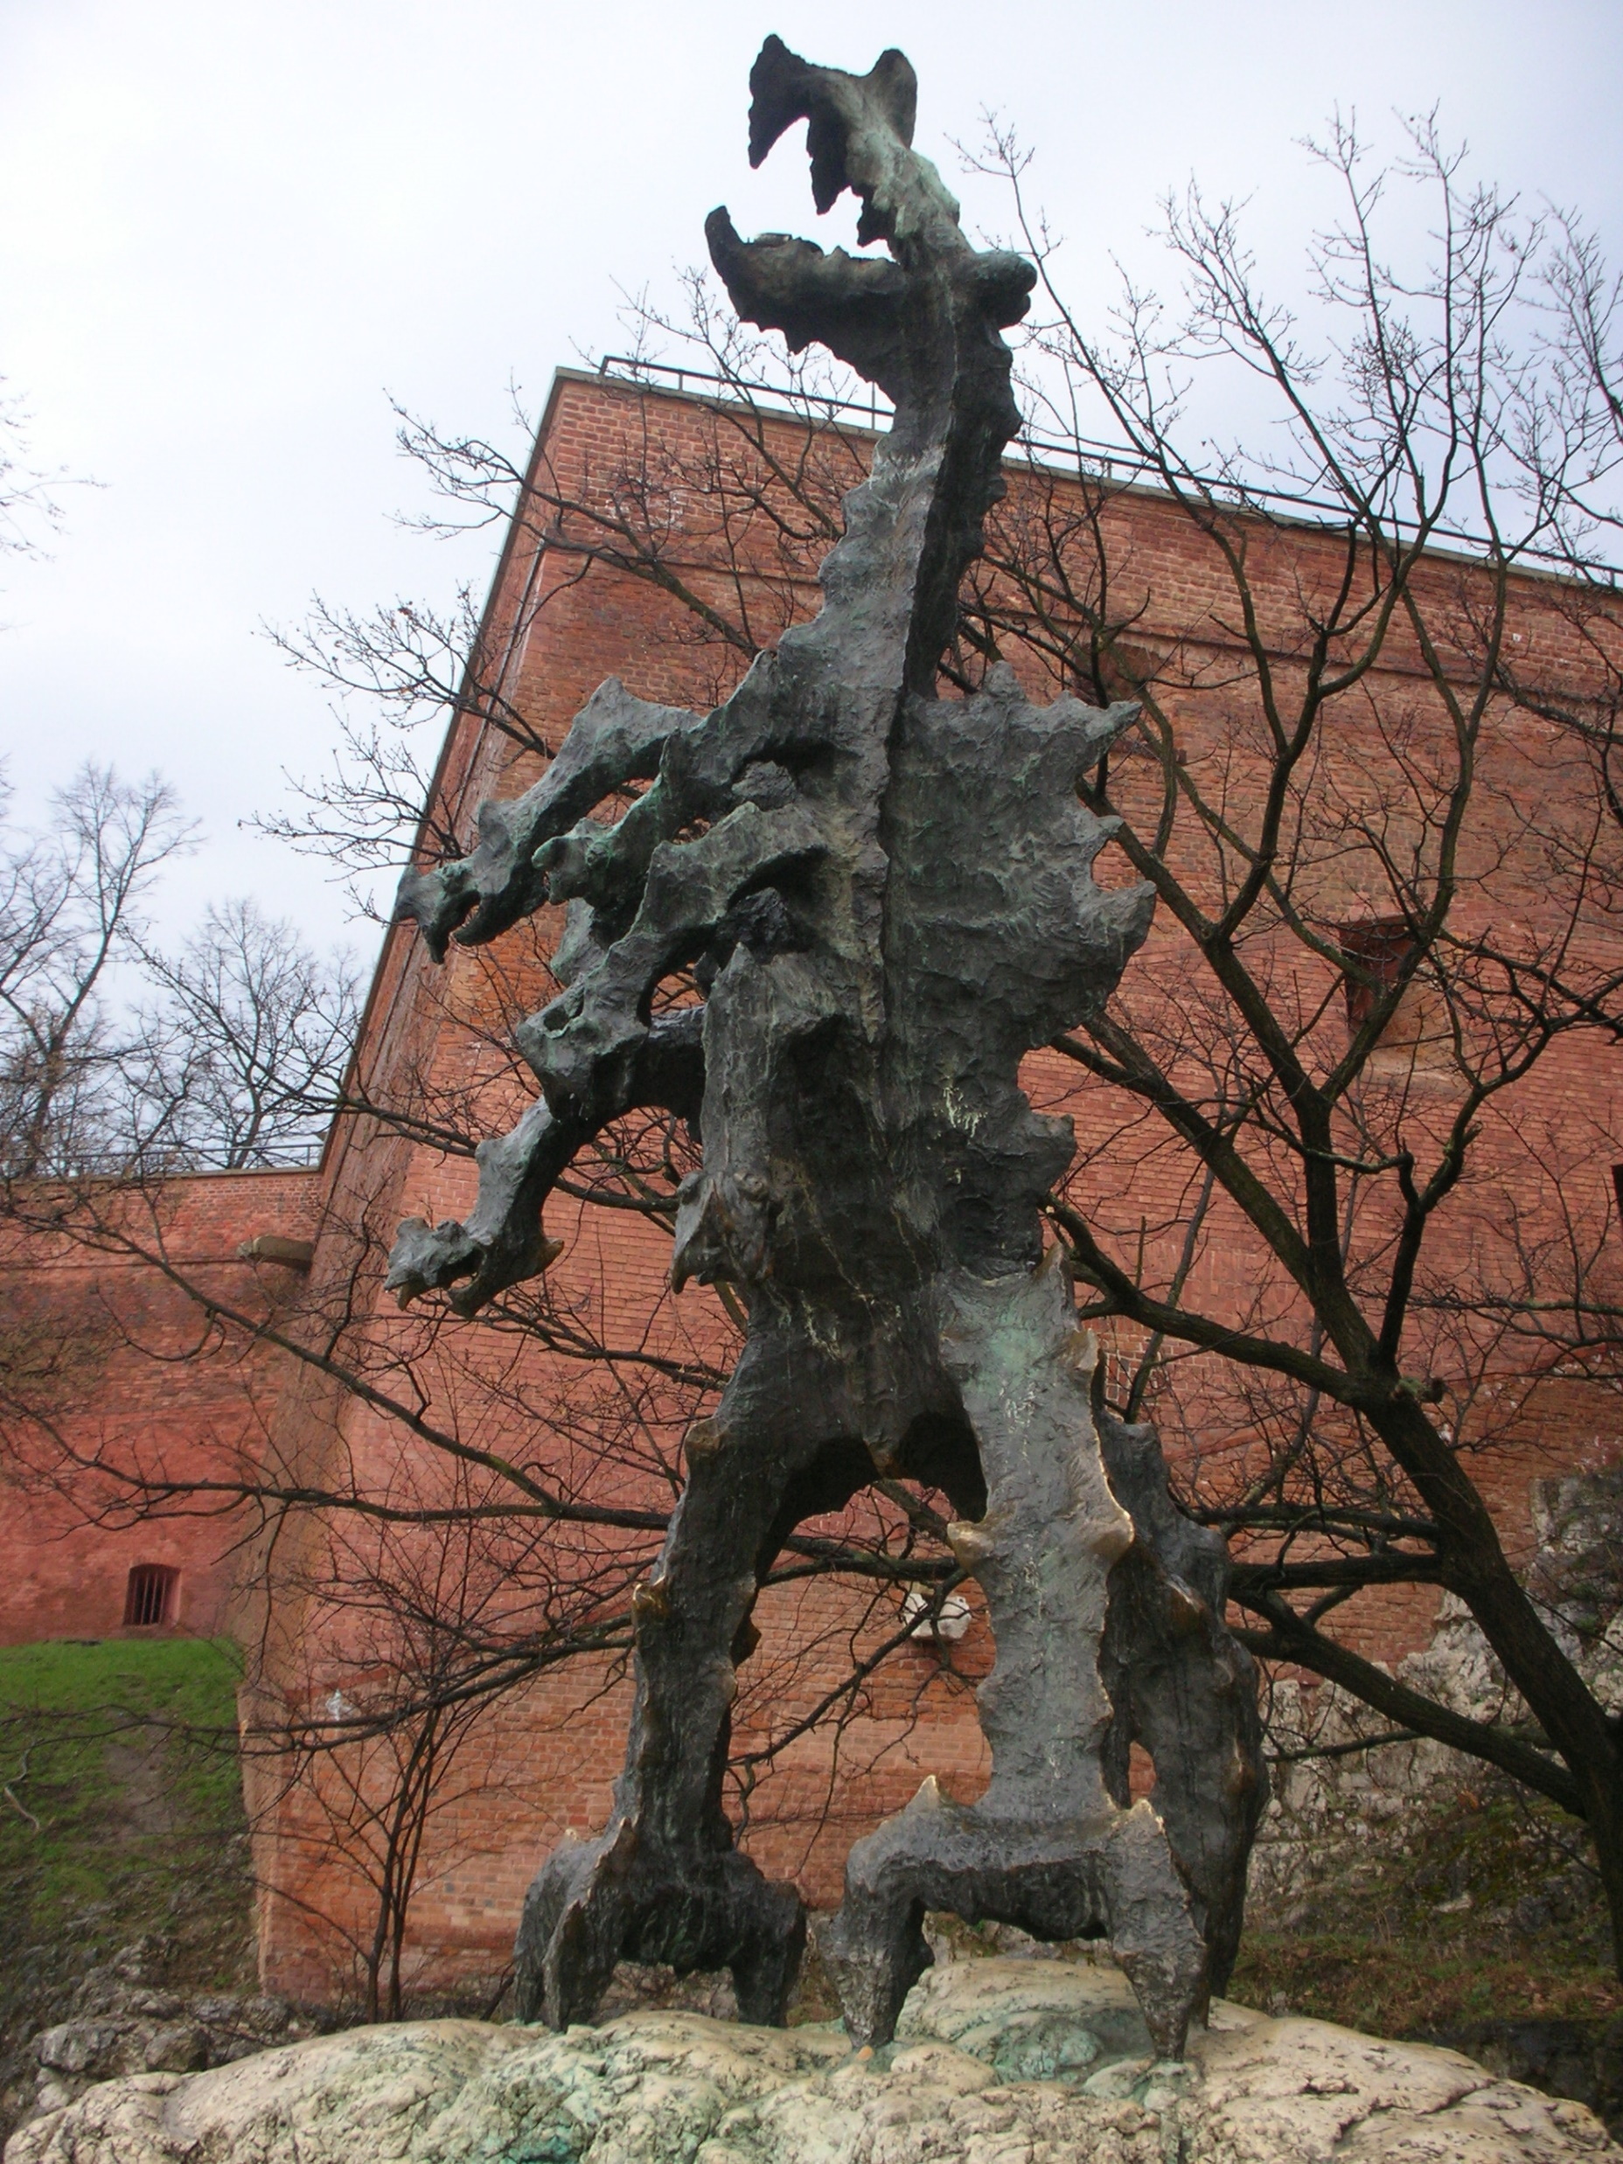
Notes:
Now, there’s a statue of the dragon outside Wawel Castle. It even breathes fire!

