Slide 1
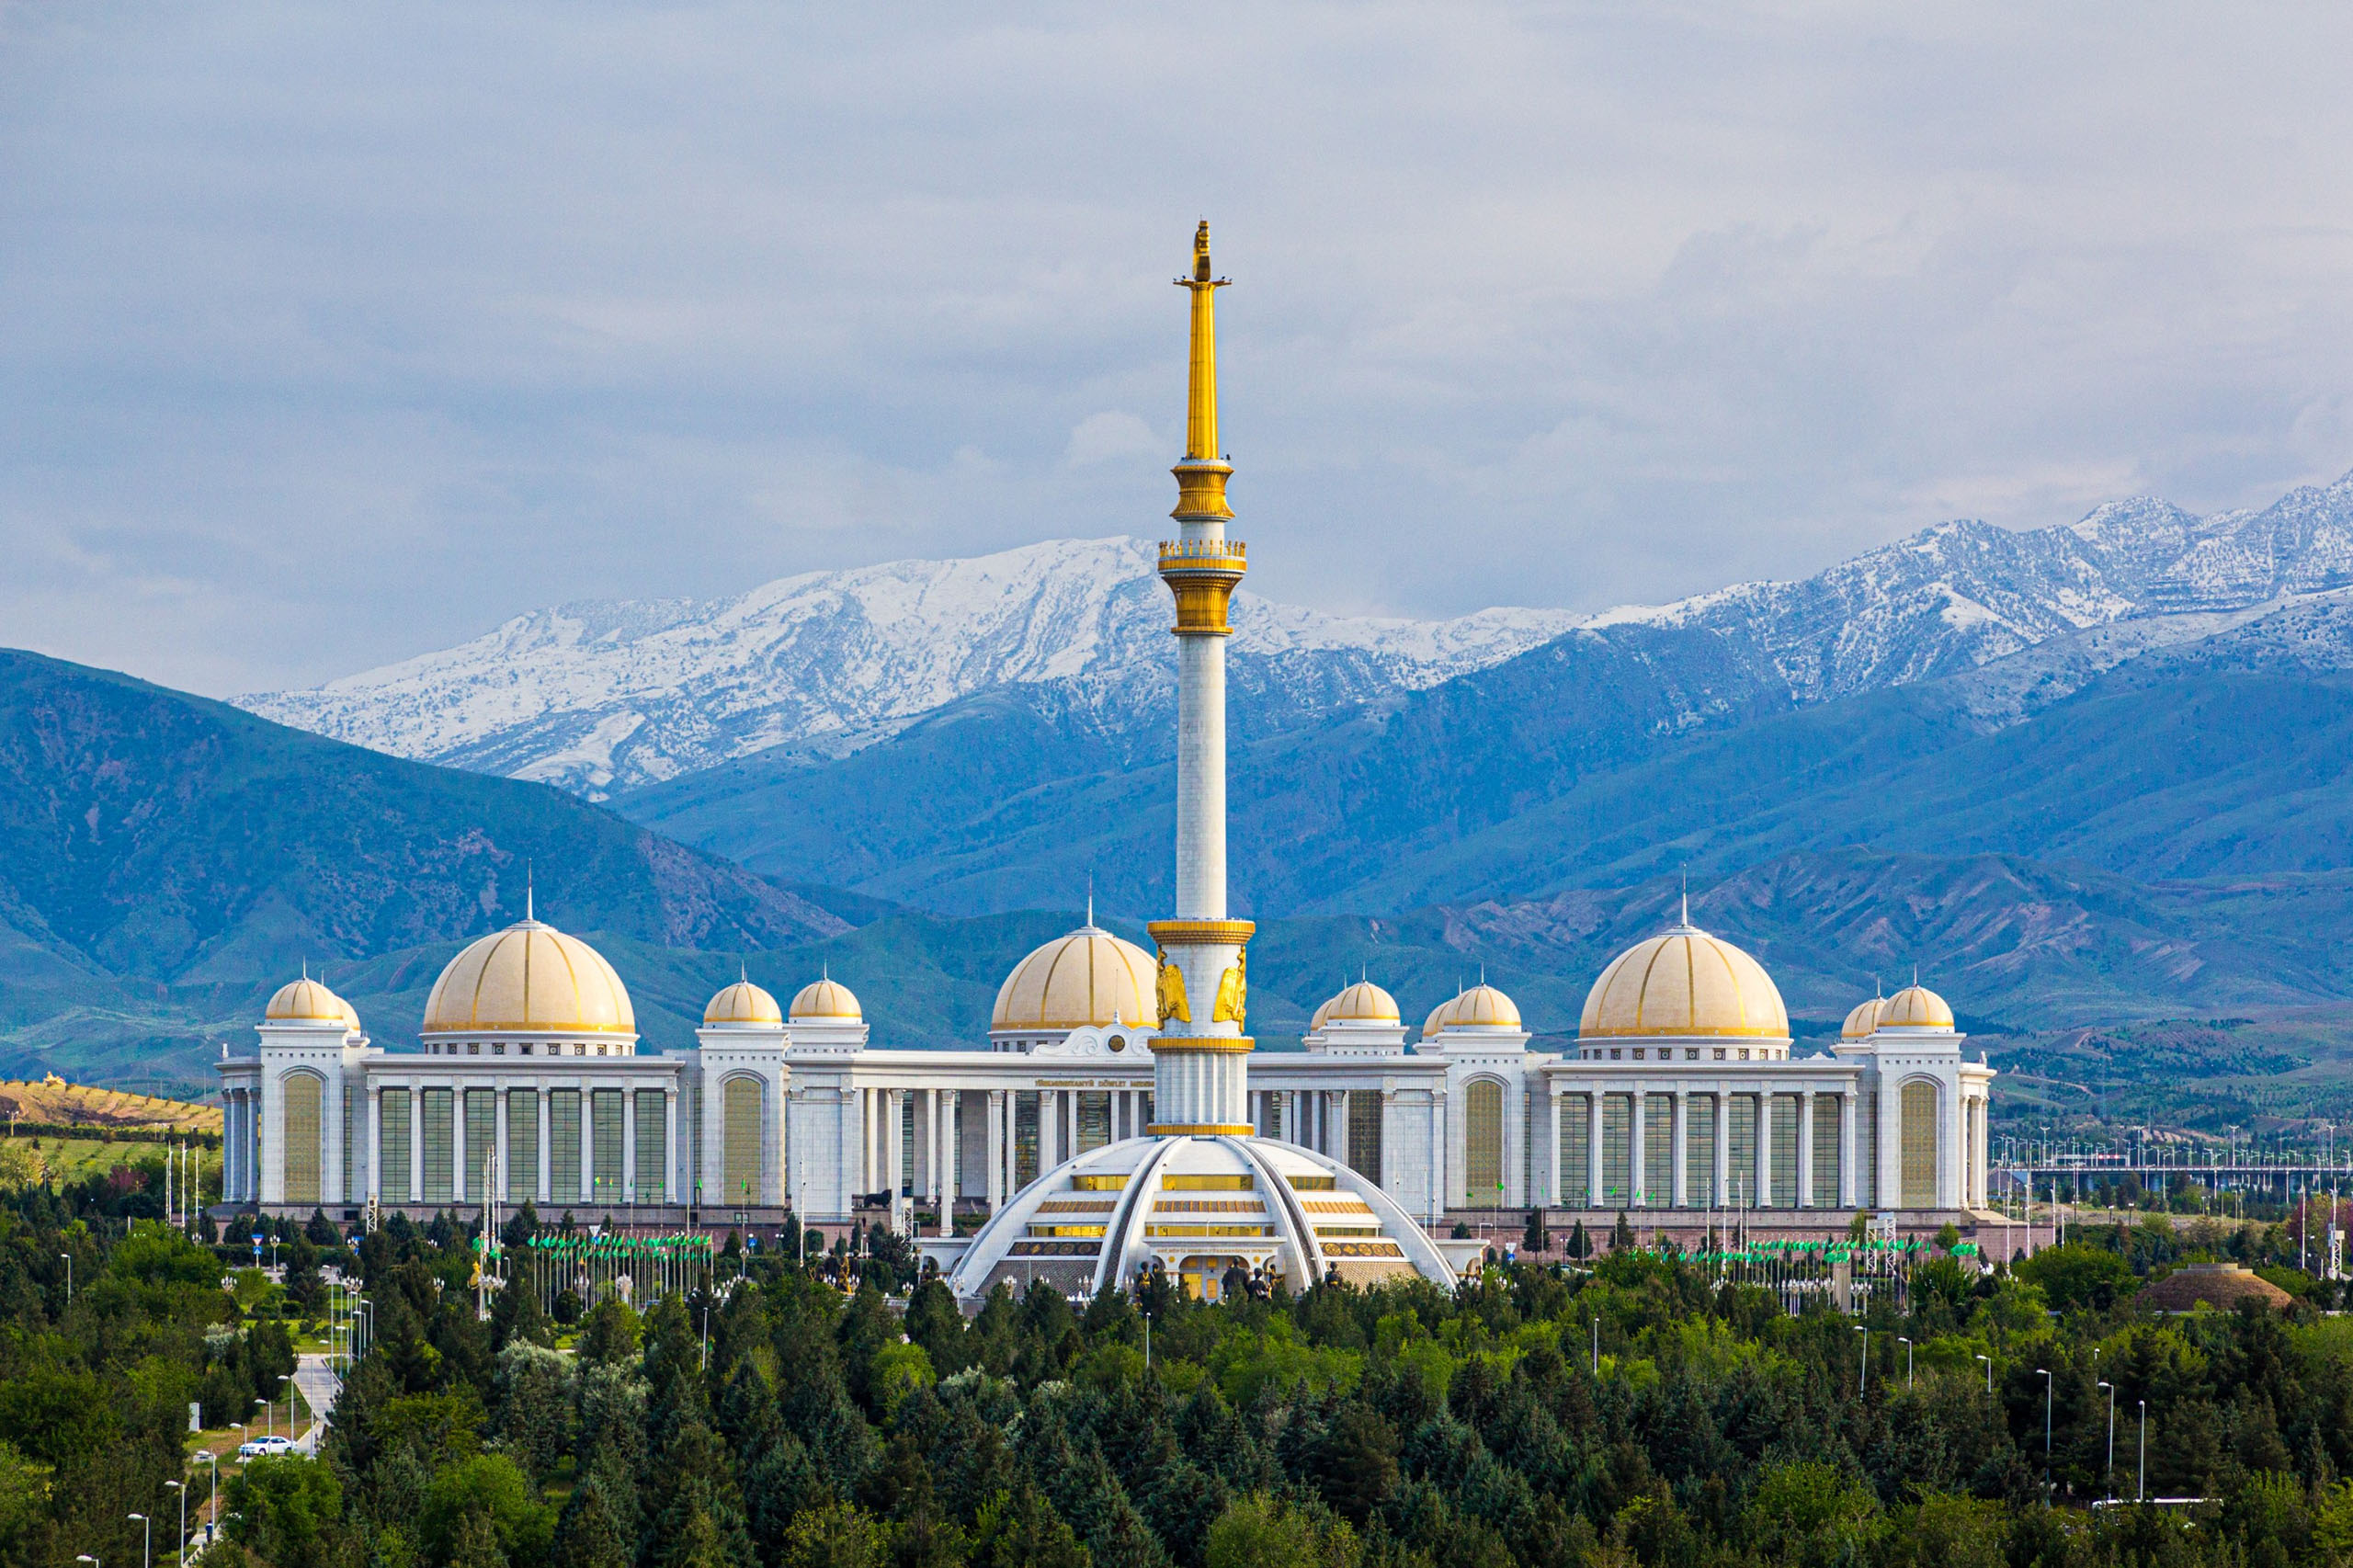
Turkmenistan

Slide 2
Notes:
Turkmenistan is country located in Central Asia. It was a part of the Soviet Union. It is a mainly Islamic country and has a population of 6 million.

Slide 4
Notes:
This is the Turkmen Flag. The white crescent on the flag represents Islam. The five white stars each represent the five regions of Turkmenistan and the five pillars of Islam. The background of the flag is green to represent a green field and the five different red and yellow symbols represent different carpets from regions in Turkmenistan.

Slide 5
Notes:
This is Yangykala Canyon. It is located in northwest Turkmenistan. It is a geographical phenomenon that is 5.5 million years old. The canyon was originally part of a prehistoric ocean, and once the ocean was gone, the wind and the rain made the canyon look how it does today.

Slide 6
Notes:
Turkmenistan is not all desert. There are mountains too! These are called the Kopet Dagh Mountains, and they form most of the border between Turkmenistan and Iran.

Slide 7
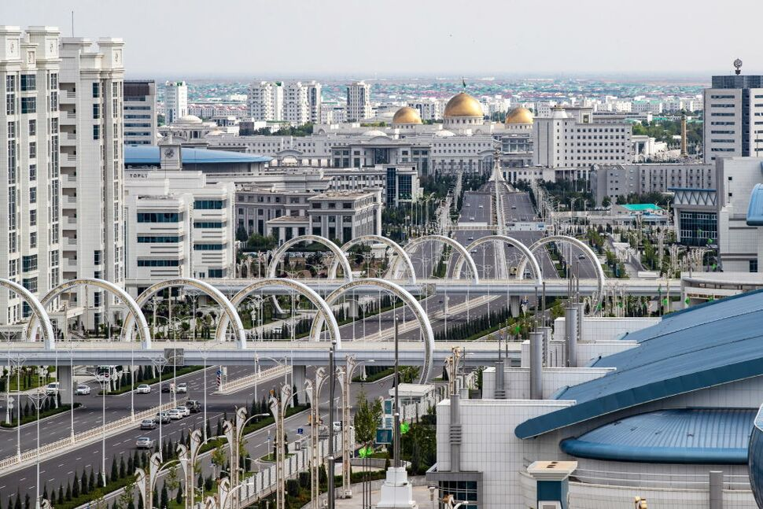
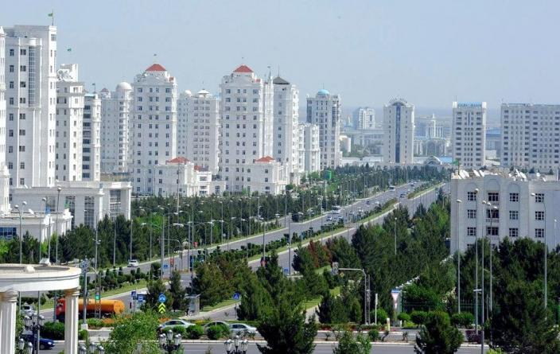
Notes:
Ashgabat is the capital of Turkmenistan. The city has many tall marble buildings. It has the highest density of white marble buildings in the world.

Slide 8
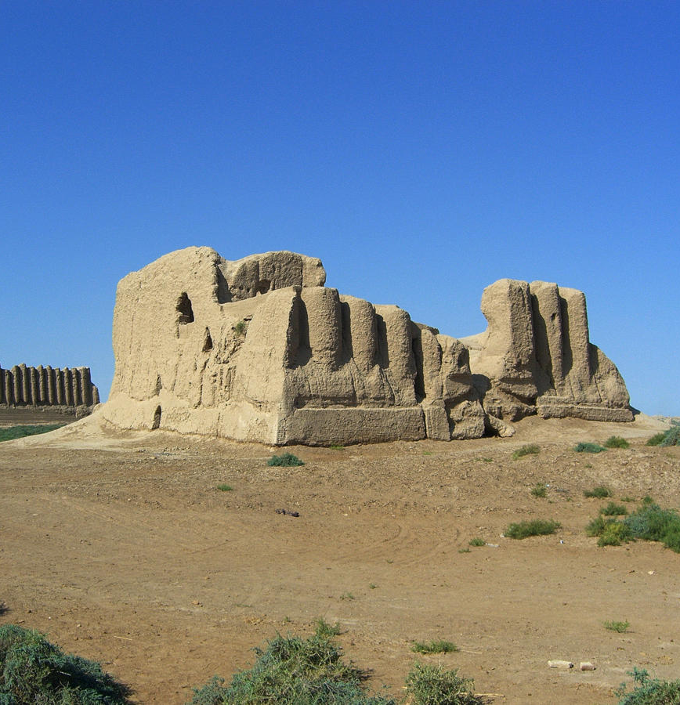
Notes:
Turkmenistan was once part of the Silk Road. The Silk Road is an ancient trading route that connected Asia and Europe. There are many ancient ruins in Turkmenistan that were trading posts and cities on this road.

Slide 9
Notes:
This is Darvaza gas crater. It was created from a natural gas field accident and has been burning ever since. It is a popular tour site, but could be closed soon.

Slide 10
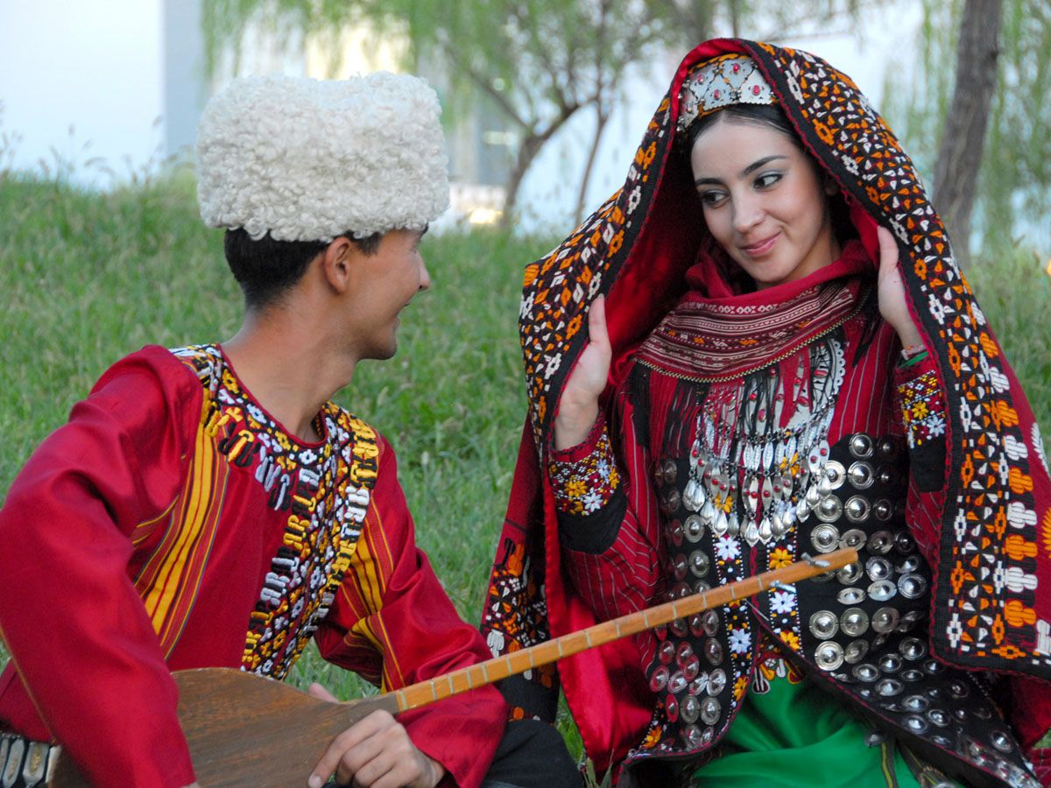
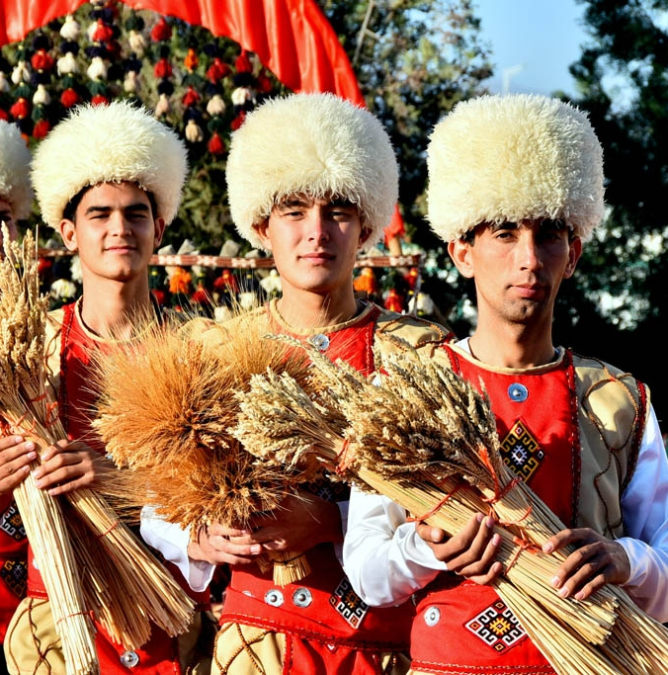
Notes:
Turkmen traditional dress is very colorful and unique. Men wear sheepskin hats called Telpeks. Women wear lots of jewelry. Unmarried women wear their hair in two braids, while married women wear headscarves.

Slide 11
Notes:
Turkmen traditional food is very rich and simple. They eat meat dishes, rice dishes, dumplings, pita and many other dishes.

Slide 12
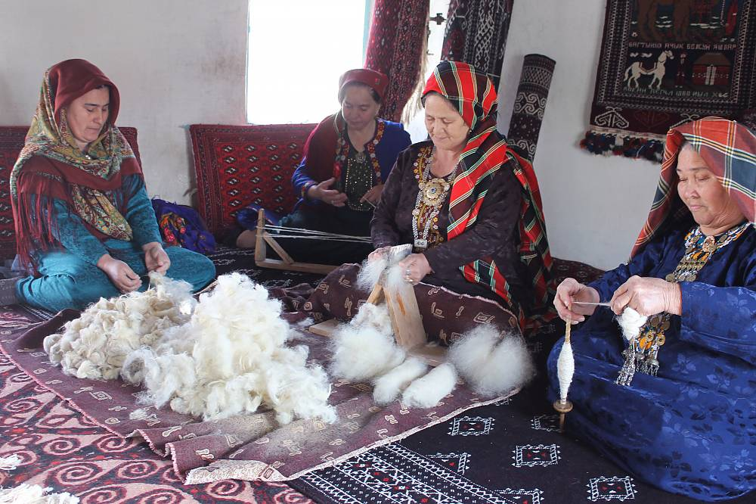
Notes:
Turkmenistan is very famous for its carpets. The process begins with getting wool from sheep.

Slide 13
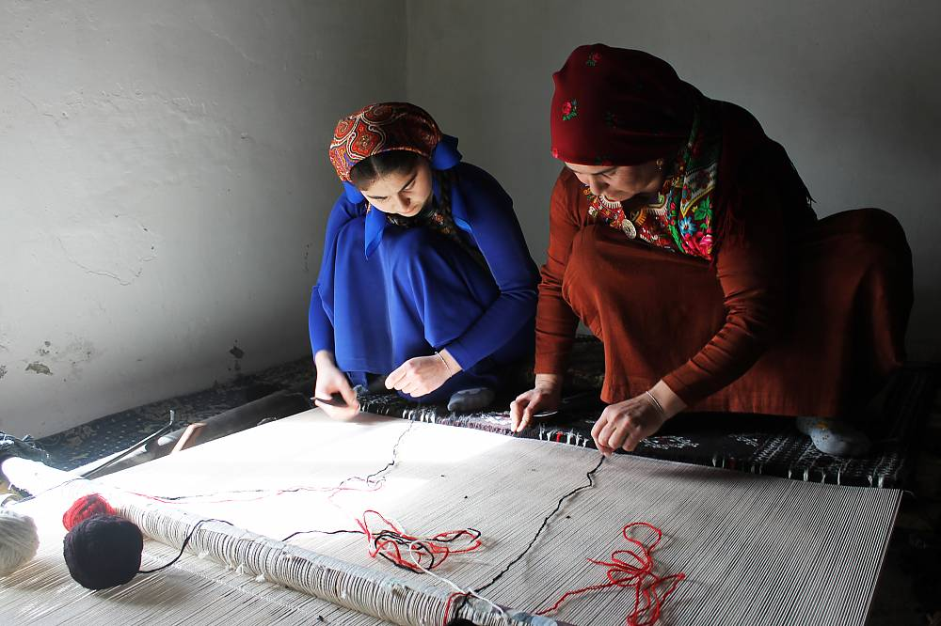
Notes:
The next step is weaving the wool into yarn and then weaving the yarn into carpet patterns.

Slide 14
Notes:
Carpet making is a very important part of Turkmen culture. It is an important skill that brings together families and allows for the expression of culture and identity.

Slide 15
Notes:
Turkmens sell their carpets at regional markets and all over the world!

Slide 16
Notes:
An example of making your own Turkmen carpet.

