Slide 1
Notes:
Mongolia is a large country that is located between China and Russia. It is a very beautiful and a very empty country. There are very few people who live there, and they are very spread out. A huge part of Mongolia is made up of the second largest desert in the world, the Gobi Dessert.

Slide 2
Notes:
This is the capital city of Mongolia. The city is called Ulaan Bataar. It is a big city, but it is the only big city in Mongolia. Some people live in the city, but some people don’t. Those people live differently than most of us. They are nomads. To be a nomad means to not have a house that is in one place, but to have a home that you can move around from place to place.

Slide 3
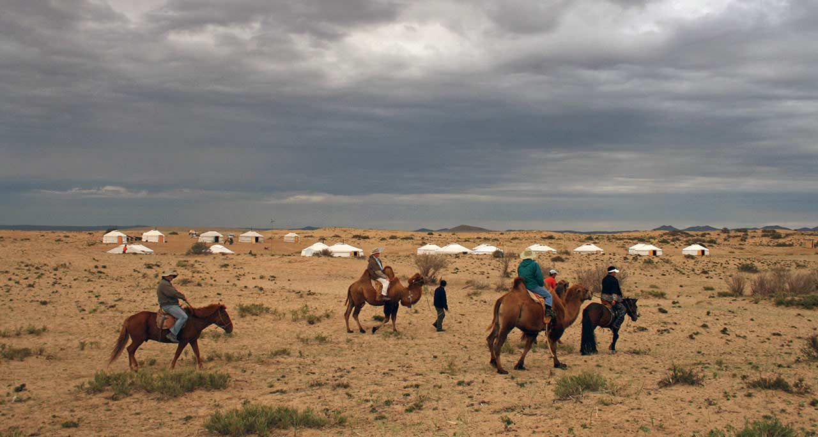
Notes:
What do you guys see in this picture? Many of the people who live in Mongolia are nomads (40%). They move around the dessert on horses and camels and live in special tents called Yurts.

Slide 4
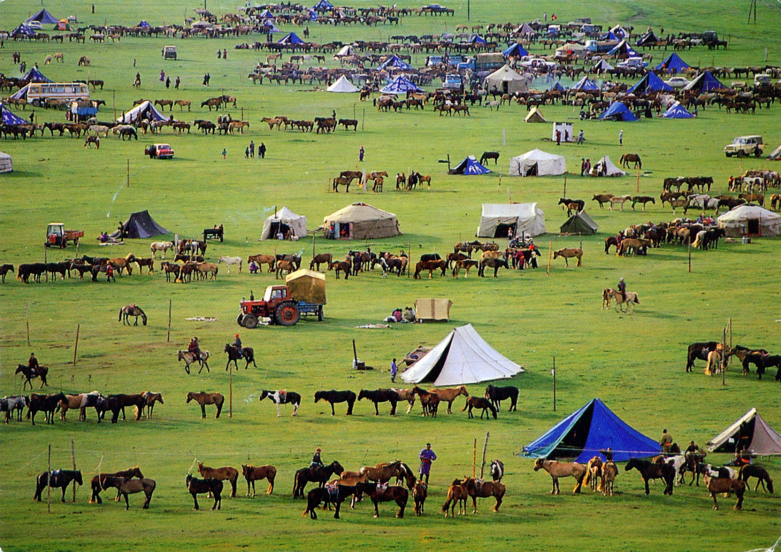
Notes:
Here is a small village of mongolians that have come together. How many different shapes of tents can you see? The one’s that are round with flat sides are the yurts, like the one in the very middle of this picture. Mongolians travel around their country with their horses, carrying their tents with them. They can stop anywhere they want. This way of life is very similar to the people we learned about who live in Kazakhstan. Do you remember making yurts a few months ago? These are the same sorts of structures!

Slide 5
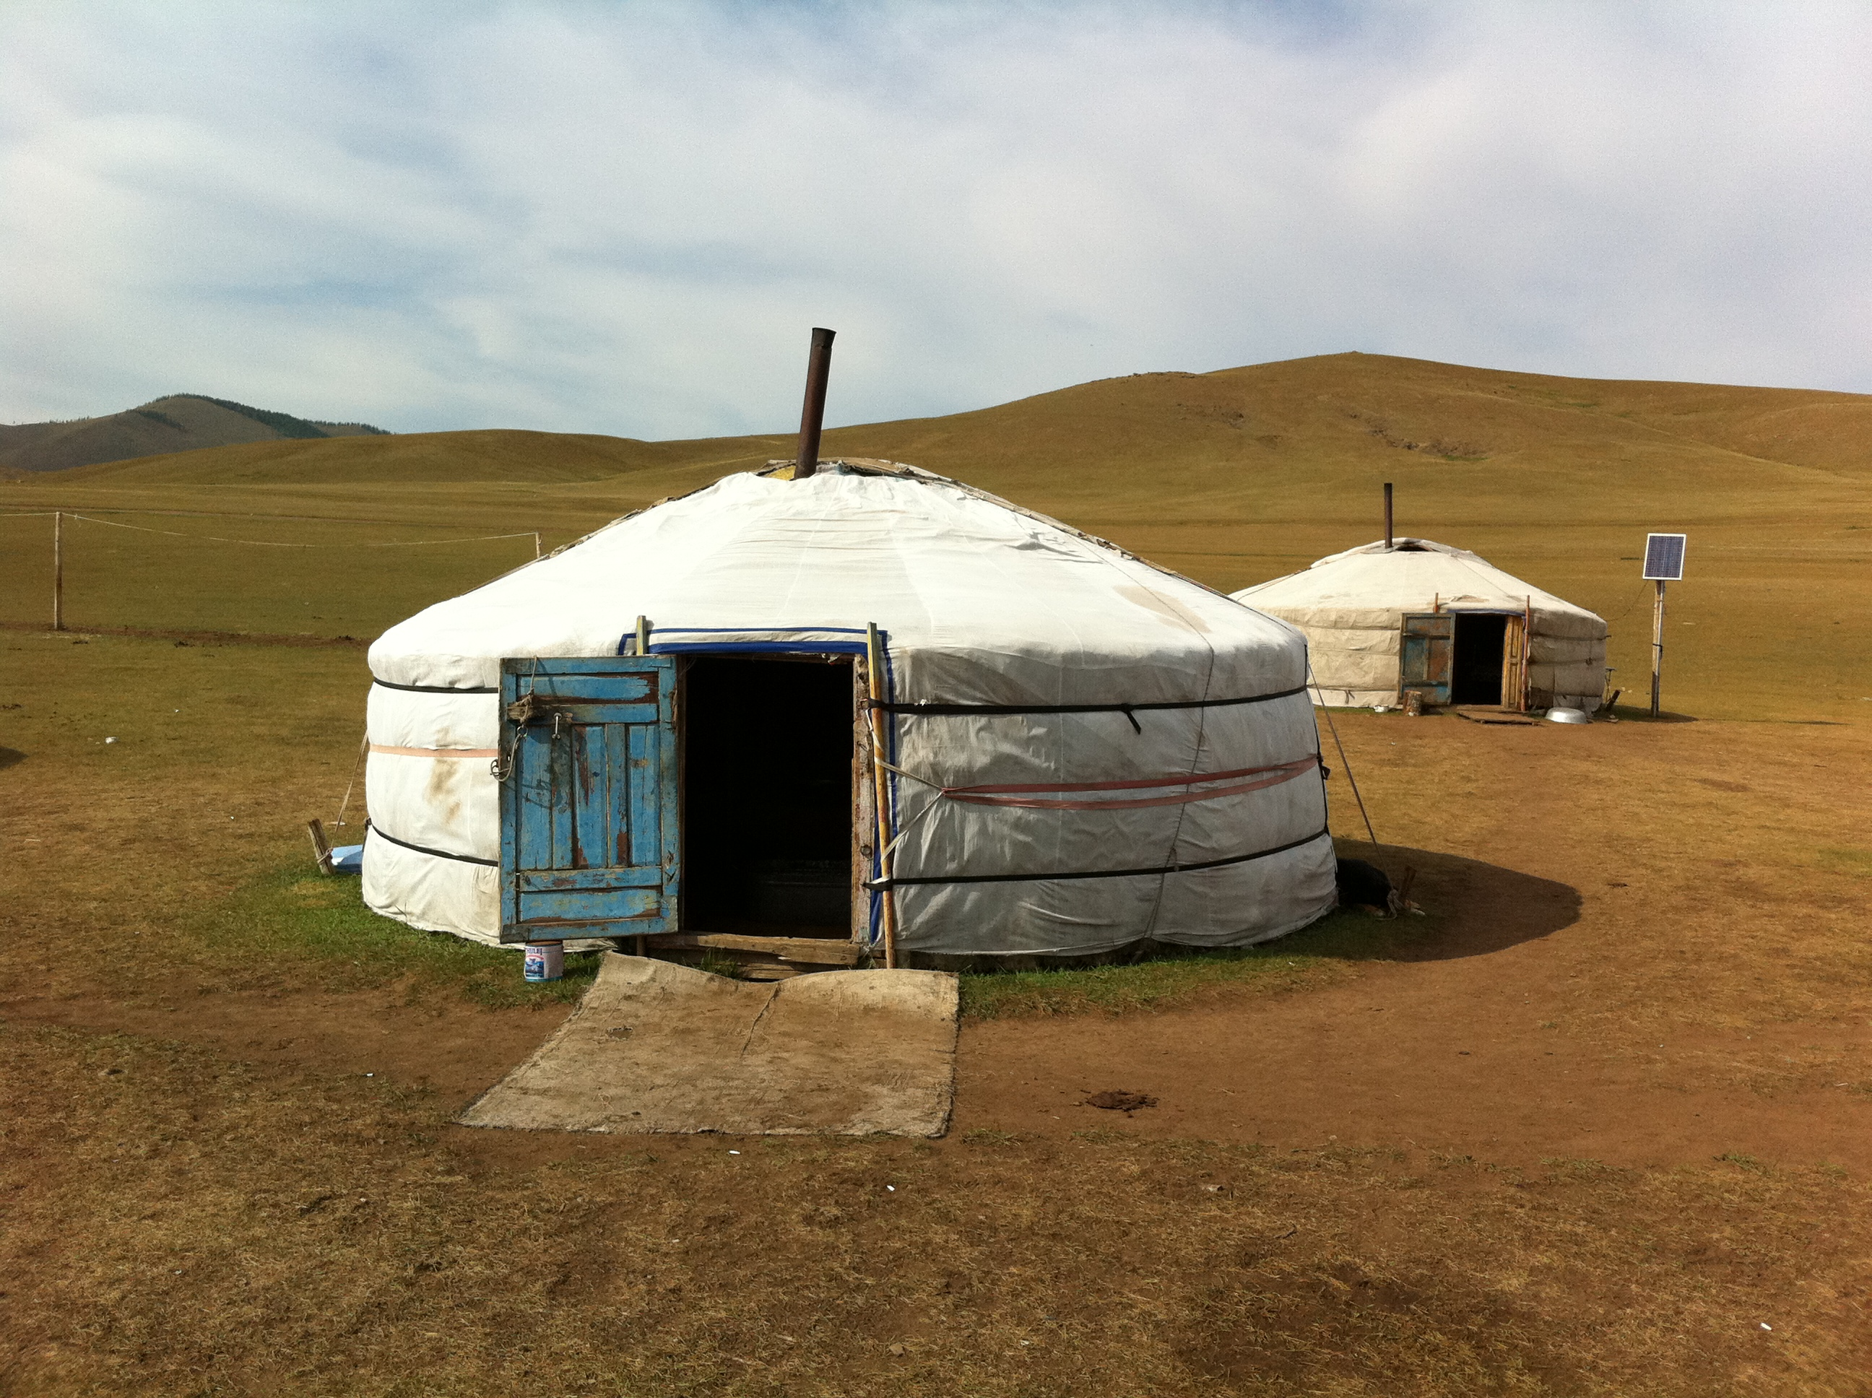
Notes:
To help you remember, here are some yurts close up. They have stoves in the middle for heating, which is what that chimney is for. You can also see that the back yurt has a solar panel. They even have electricity in the yurts!

Slide 6
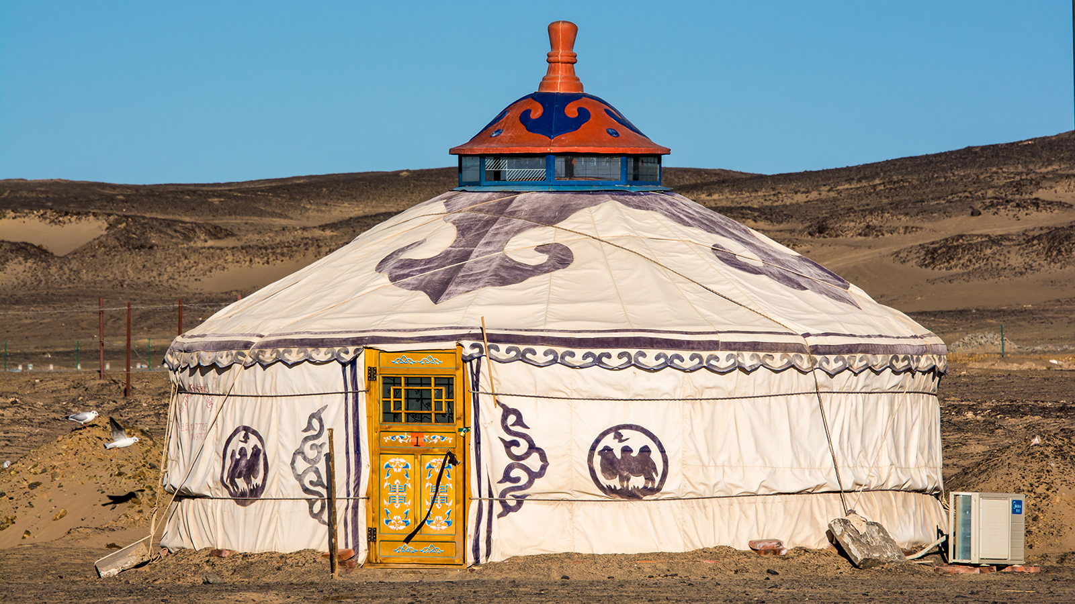
Notes:
Then they wrap the whole thing in cloth. Sometimes they decorate their yurts to make them very fancy and pretty.

Slide 7
Notes:
Here’s the inside of a yurt. Pretty fancy!!

Slide 8
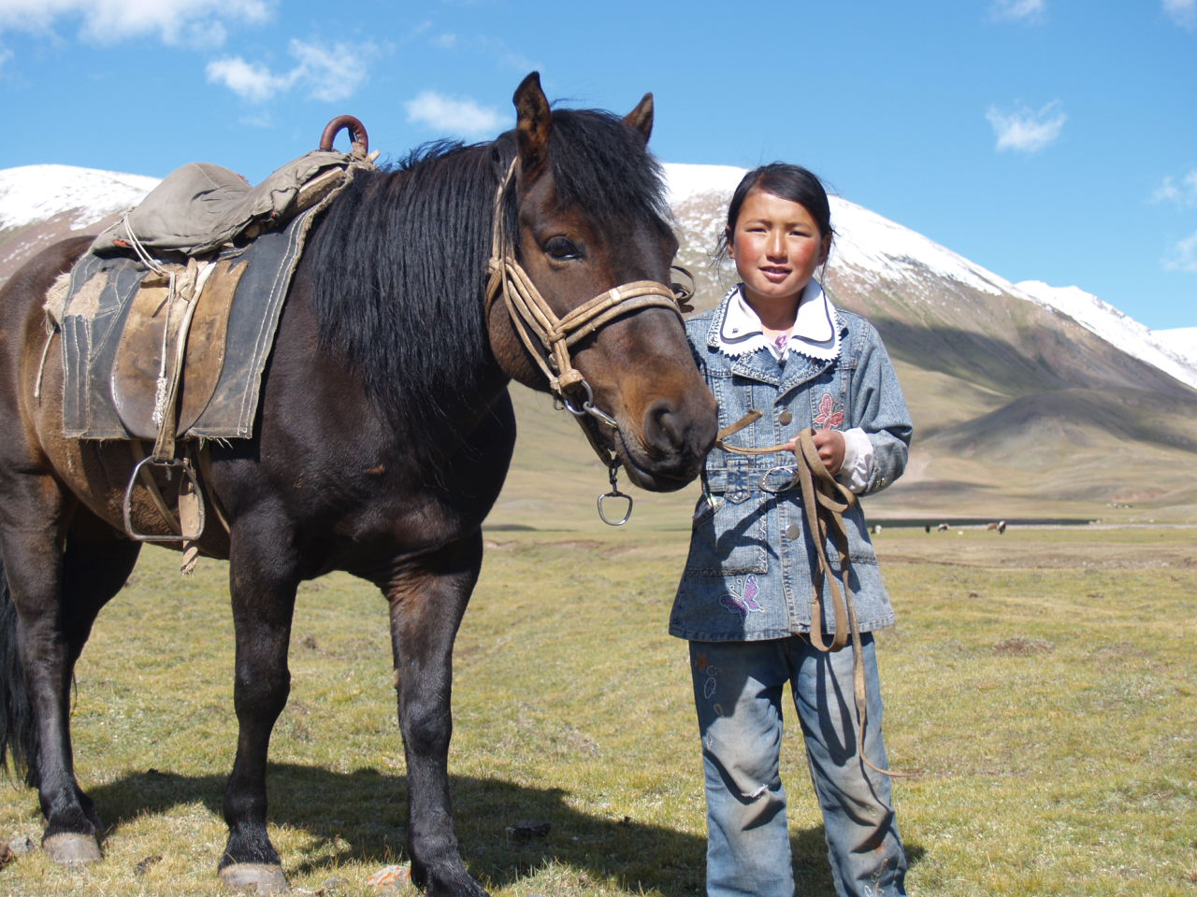
Notes:
Here is a young Mongolian girl with her horse. She is ten years old. To get from one place to another, everyone must be able to ride horses in Mongolia. When you are a child, you learn to ride a horse as soon as you can walk.

Slide 9
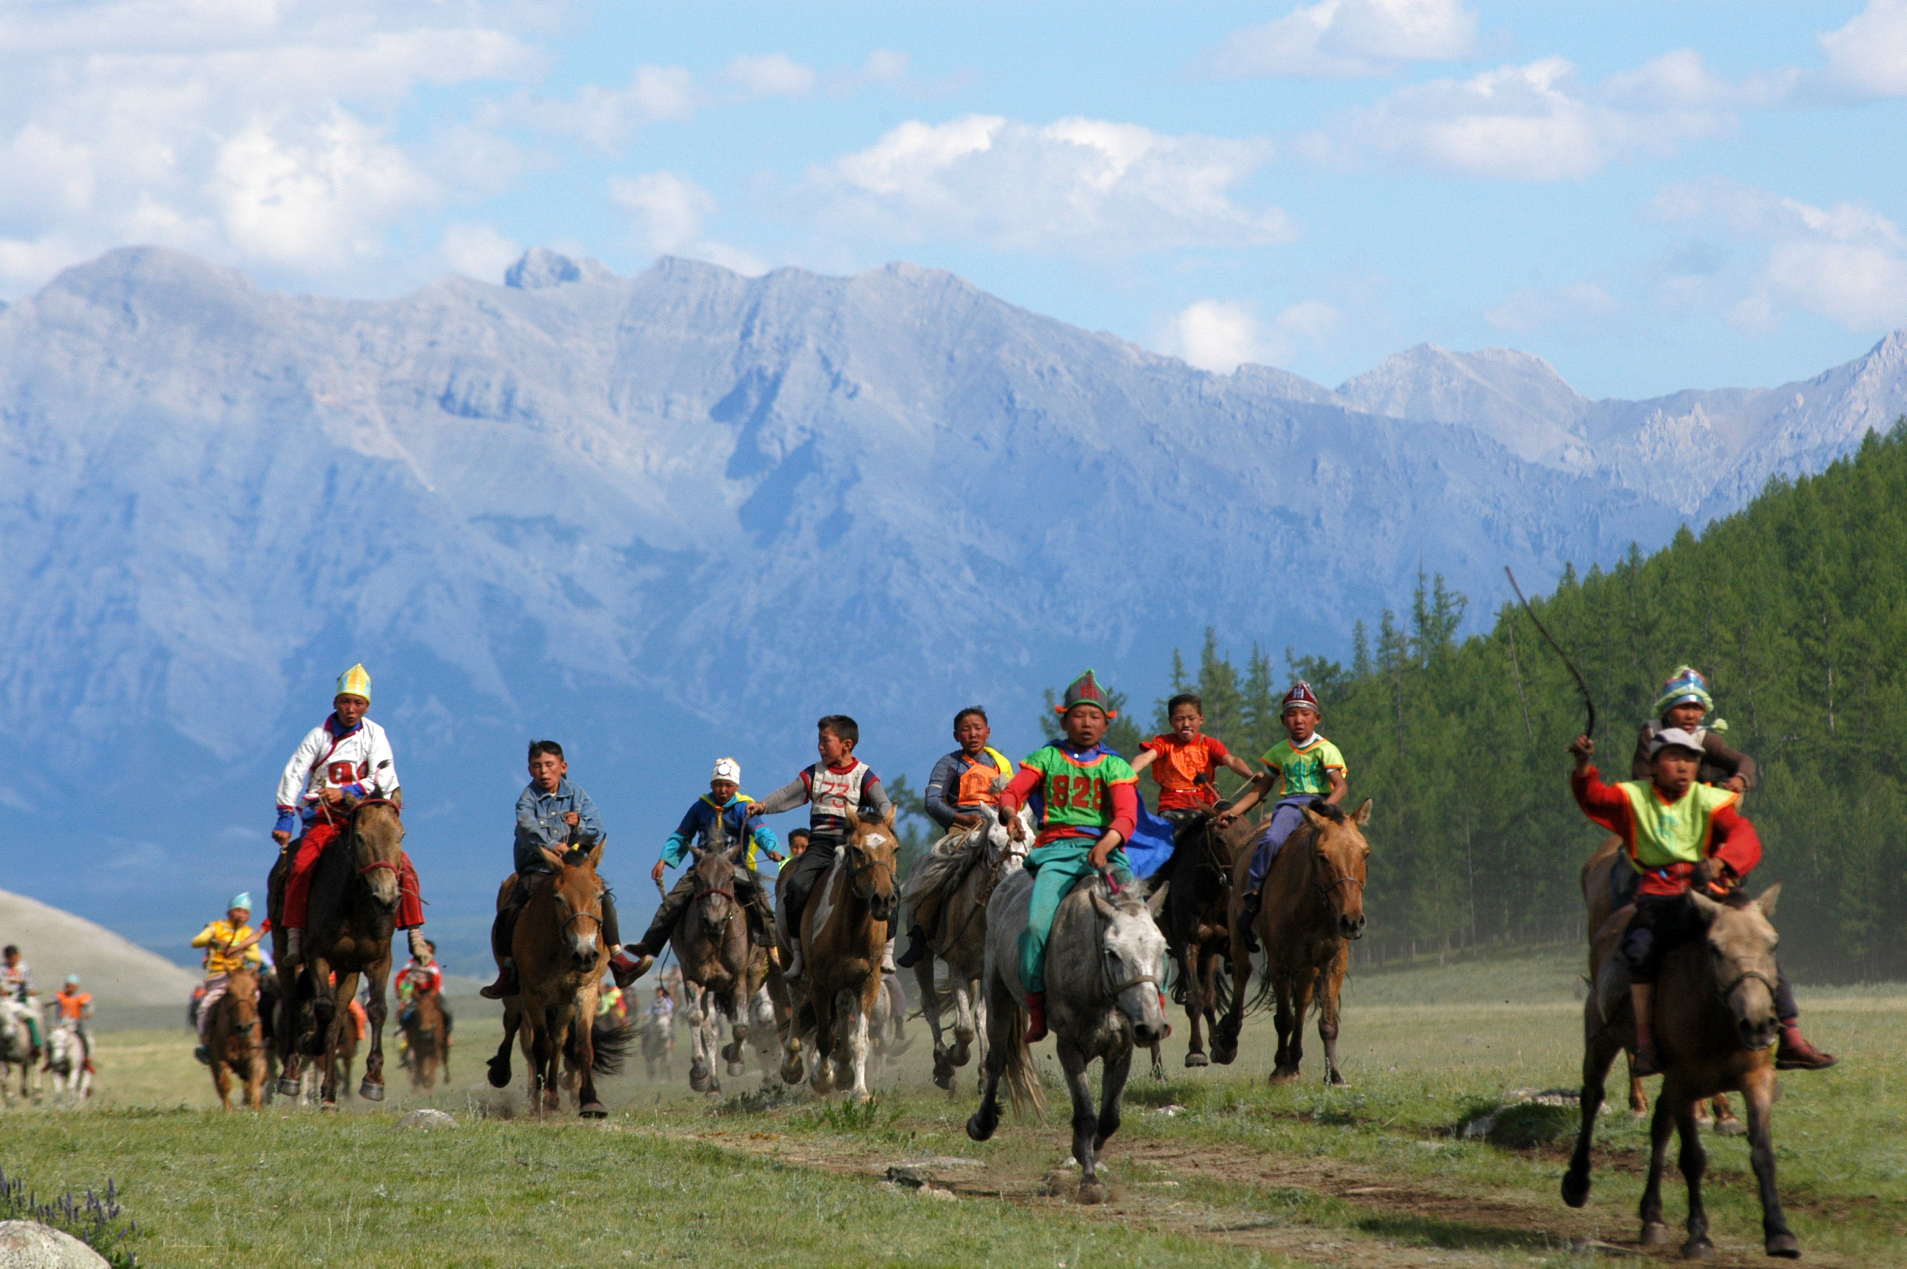
Notes:
In Mongolia all of you would ride horses every day. Here are some children racing horses.

Slide 10
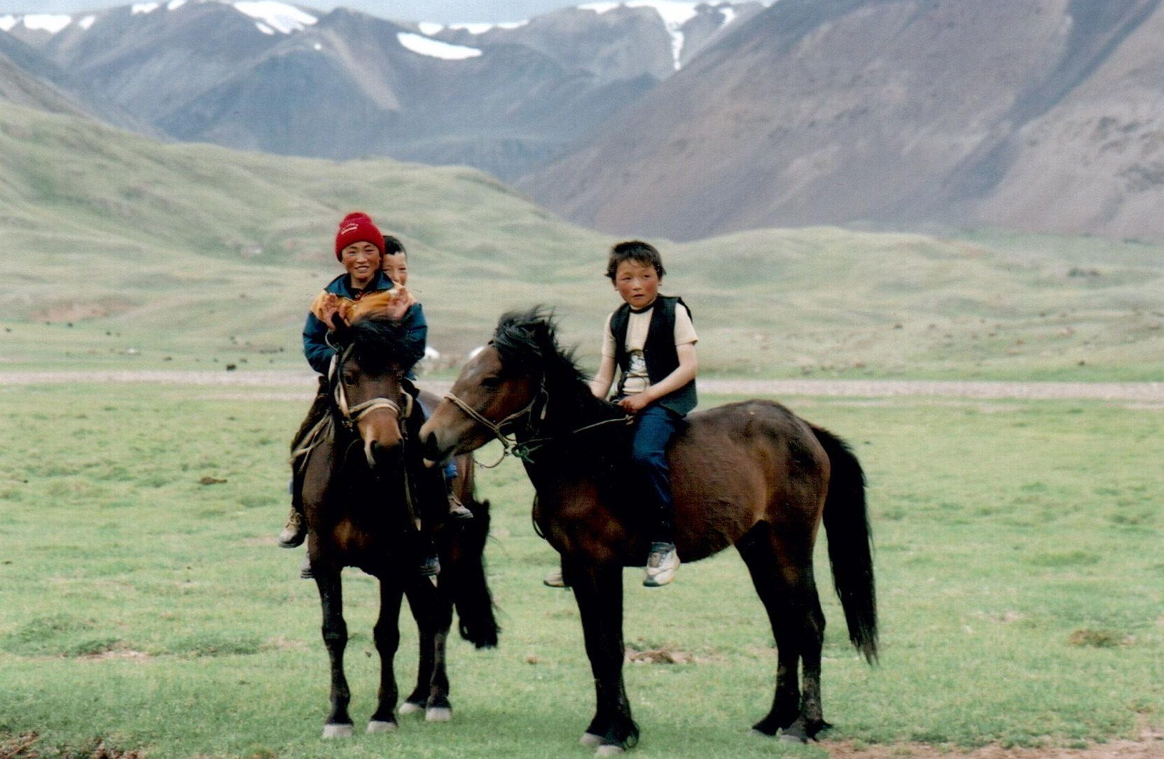
Notes:
And here are some other kids on their way to school. I’ve got a couple more pictures to show you that are a little silly, do you want to see them? In Mongolia they have a special kind of wrestling that is traditional. They have wrestled in this way for hundreds of years. Today they have wrestling fights, but they still wear the same outfits they wore hundreds of years ago. Do you guys want to see what they wear?

Slide 11
Notes:
These are Mongolian wrestlers. This is going to sound really silly, but when they wrestle, they grab each other by the underpants and try to tip the other person upside down. It sounds a little silly to us, but it is no laughing matter to them. They are very big and strong!

Slide 12
Notes:
Here is a picture of two wrestlers.

