Slide 1
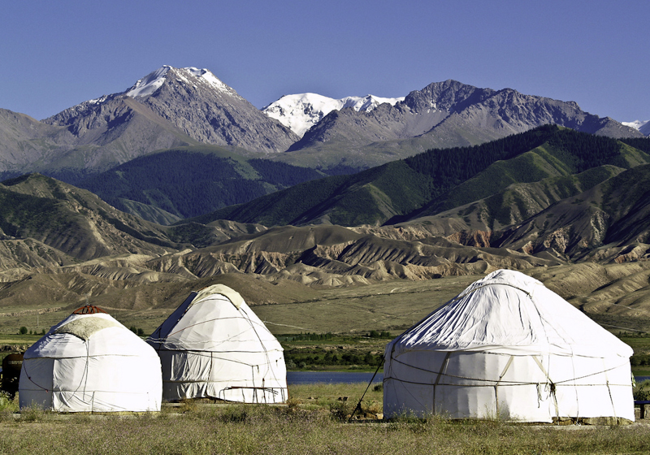
Kazakhstan

Slide 3
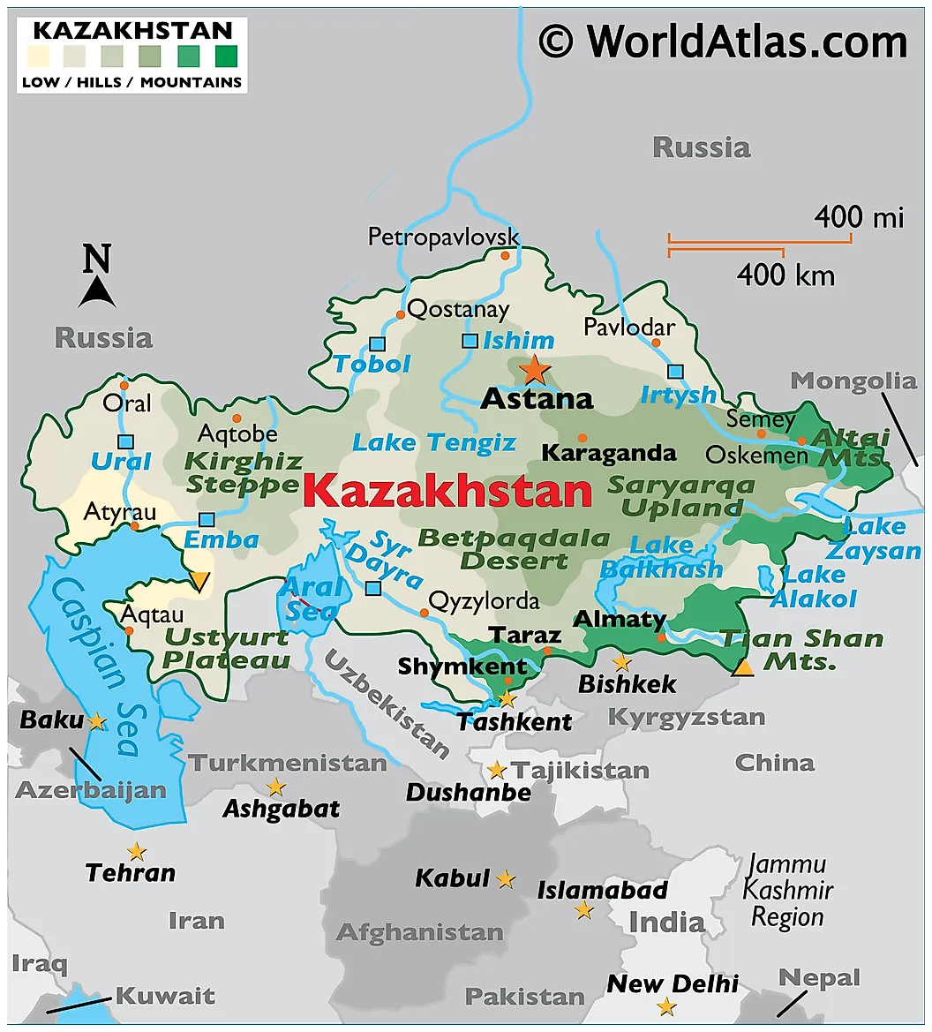

Slide 4
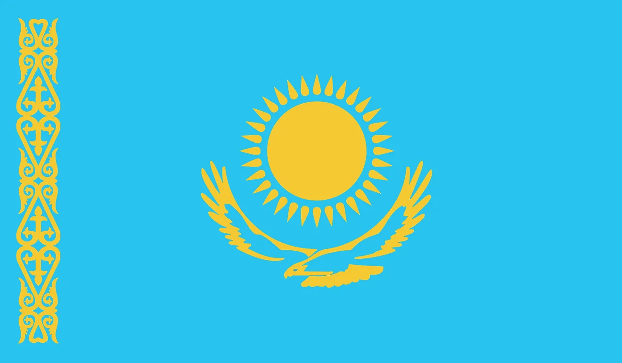
Notes:
The pattern represents the ancient traditions of the Kazakh people. The blue represents the Turkish origin of the citizens of Kazakhstan. For these people, blue represents the vastness of the sky and the sky god Tengri, from Kazakh folklore. The sun symbolizes life and energy, and the eagle symbolizes power and freedom.

Slide 5
At a Glance
Population: 20,086,000
Language: Kazakh, Russian
Capital: Astana
Currency: Kazakhstani Tenge

Slide 6
Notes:
Astana- capital since 1997, literally means capital city; population of 1 million people

Slide 7
Notes:
The Baiterek Tower, representing a Kazakh folktale about a bird that lays a golden egg in the branches of a poplar tree.

Slide 8
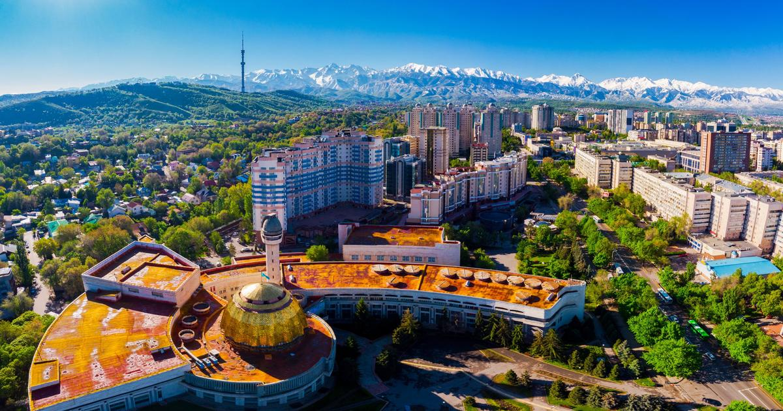
Notes:
Almaty- capital during the Soviet Union, largest city in the country; 1.7 million people live here

Slide 9
Notes:
Altai Mountains-
There is a legend: "The God Tengri, been angry with a flying squirrel because it had offended his son, threw a lightning to her, and the flying squirrel stretched its pads and turned into a mountain with the same name.

Slide 10
Notes:
The Steppe-The word “steppe” is derived from the Russian word for “flat grassy plain.” The world's most extensive flat steppes are in temperate Eurasia.
- Long harsh winters

Slide 11
Notes:
Saiga Antelope- Saiga antelopes are extremely distinctive thanks to their bizarre swollen nose, which is thought to filter out dust during dry summers and to warm the cold winter air.

Slide 12
Notes:
Kazakh horse

Slide 13
Notes:
Kazakhs migrated to look for pasturage as the seasons changed. In spring, summer and autumn, they lived in collapsible round yurts and in winter built flat-roofed earthen huts in the pastures.

Slide 14
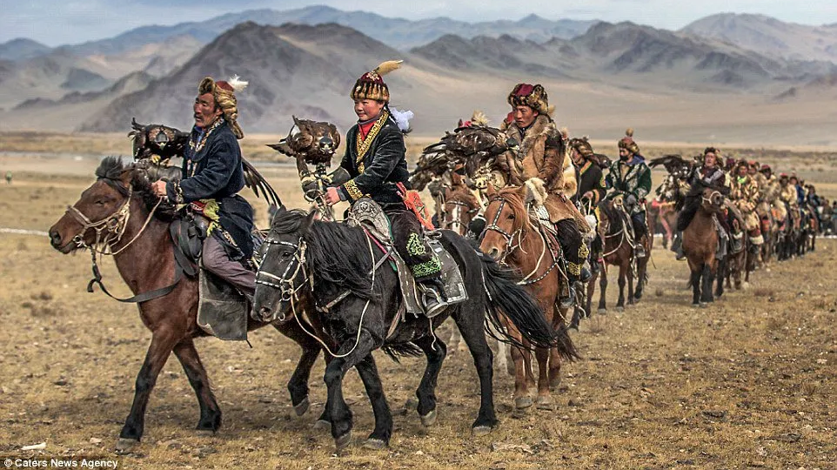
Notes:
For more than two centuries, Kazakh have hunted on horseback with trained golden eagles. Across mountains and steppes, a large variety of animals are hunted for their fur, including rabbits, marmots, foxes and even wolves. This fur is an integral part of traditional Kazakh clothing.

Slide 16
Notes:
Beshbarmak is a beast of a feast of a meal. It includes boiled vegetables, stock, a chyk onion broth and hearty chunks of meat, typically horse, sheep or lamb. The name translates to mean five fingers and, traditionally, that’s how you ate it. For nomadic people travelling across the windy steppe, it was easier to live without the trappings of cutlery and seats.

Slide 17
Notes:
Kazakh people lead a nomadic lifestyle. It has a wooden circular frame covered with felt and braided with ropes and can be easily assembled and dismantled within a short period of time. The bearers of yurt-making knowledge are craftspeople, both men and women, who produce yurts and their interior decorations. Yurts are made from natural and renewable raw materials. Men and their apprentices make the wooden frames by hand, along with wooden, leather, bone and metal details. Women make the interior decorations and exterior coverings, ornamented with traditional zoomorphic, vegetative or geometric patterns.

