Slide 1
Notes:
Can you guys find America on the map? The country in red is the country we are going to be talking about today. It is called Estonia, and it is very small, with only 1.3 million people, and entire country with fewer people than the city of Chicago! (substitute San Diego, San Antonio, Philidelphia or Dallas, if any of those are more pertinent)

Slide 2
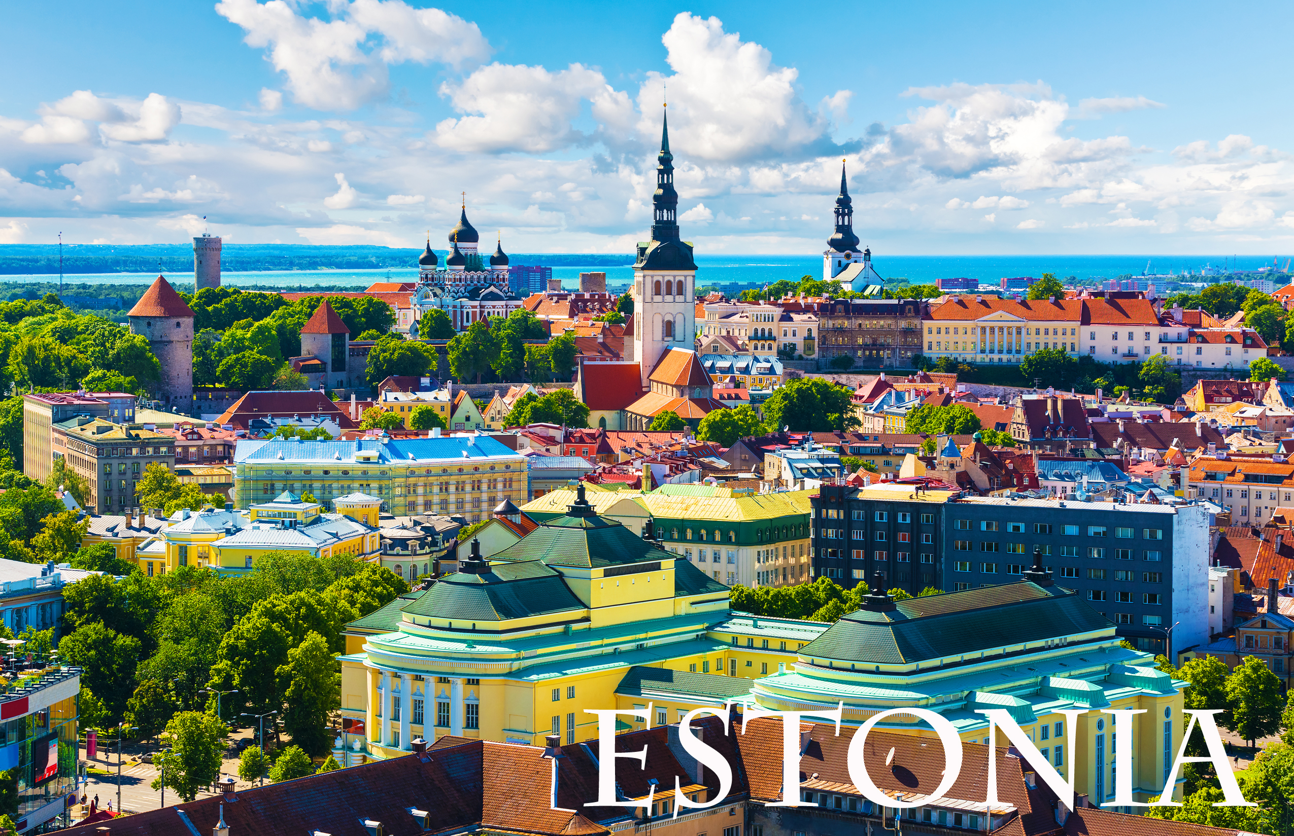
Notes:
This is the capital city, Tallinn, in the summer. What do you guys see in this picture? It Is an old, colorful and beautiful city.

Slide 3
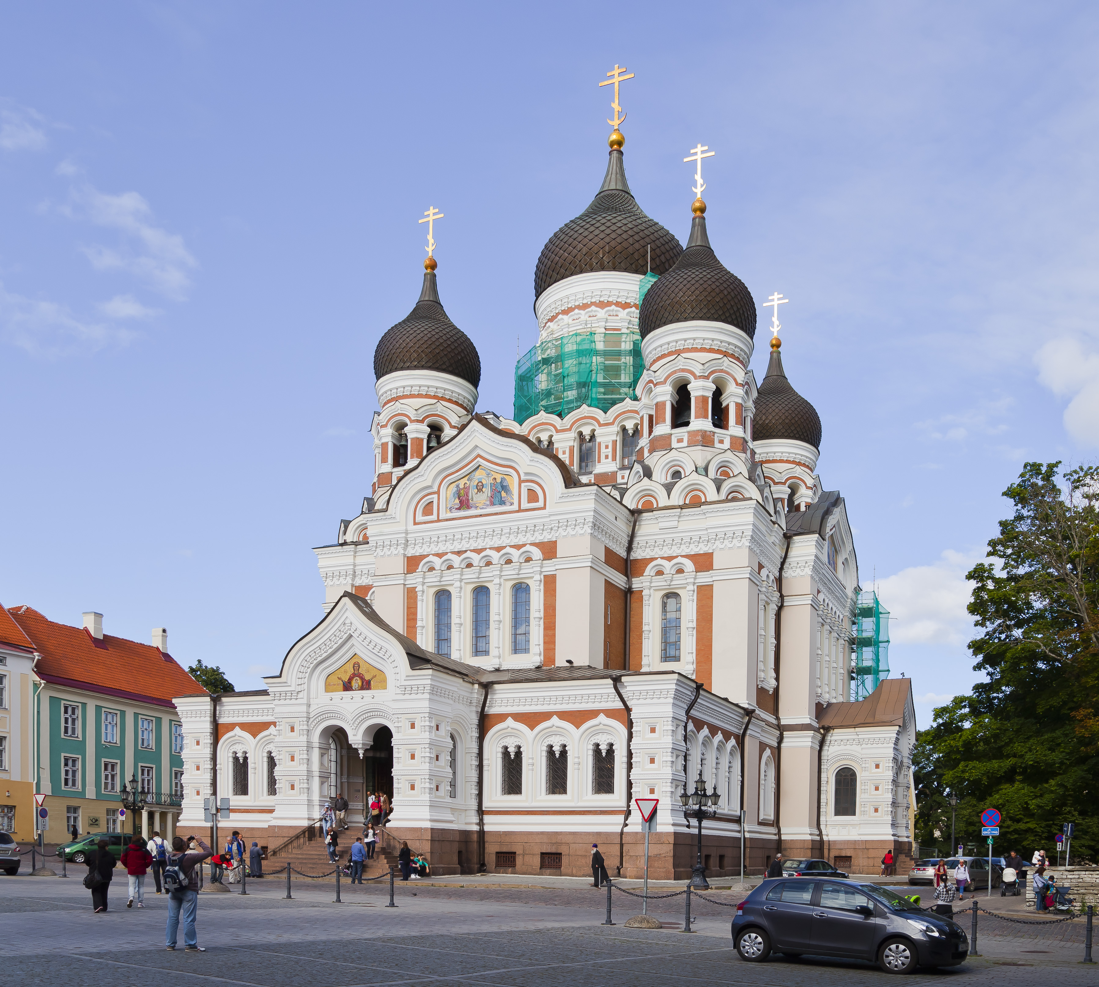
Notes:
What do you guys think this building is? It is an old church in Tallinn called the Alexander Nevsky Church, named after a great warrior in Estonian and Russian history.

Slide 4
Notes:
Here is another picture of Tallinn in the winter. Estonia is very far north on the globe, which means they have cold long winters with a lot of snow?

Slide 5
Notes:
Which season do you guys like best, summer or winter? Would you like to visit Tallinn in the summer or the winter? Why?

Slide 6
Notes:
This is a picture of the old wall of Tallinn. It is almost a thousand years old!

Slide 7
Notes:
Here are some sheep enjoying the Tallinn countryside in the winter.

Slide 8
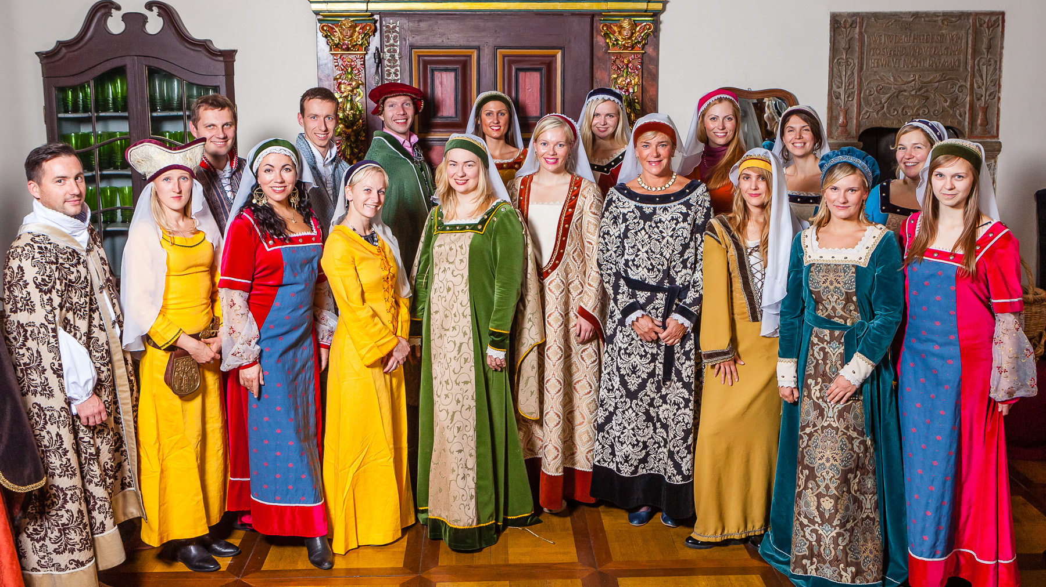
Notes:
These are some traditional Estonian dress. The people of Estonia usually dress like we do, but this is how they used to dress many years ago. What do you guys see in this picture? Would you like to dress like this?

Slide 9
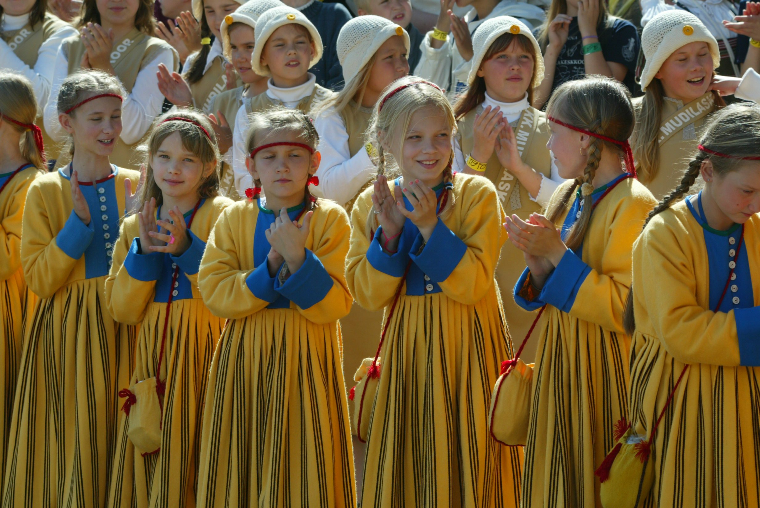
Notes:
Here are some young girls wearing some traditional dresses that children have been wearing in Estonia for hundreds of years. These dresses are made in Estonia in the same way that they have been for many generations.

Slide 10
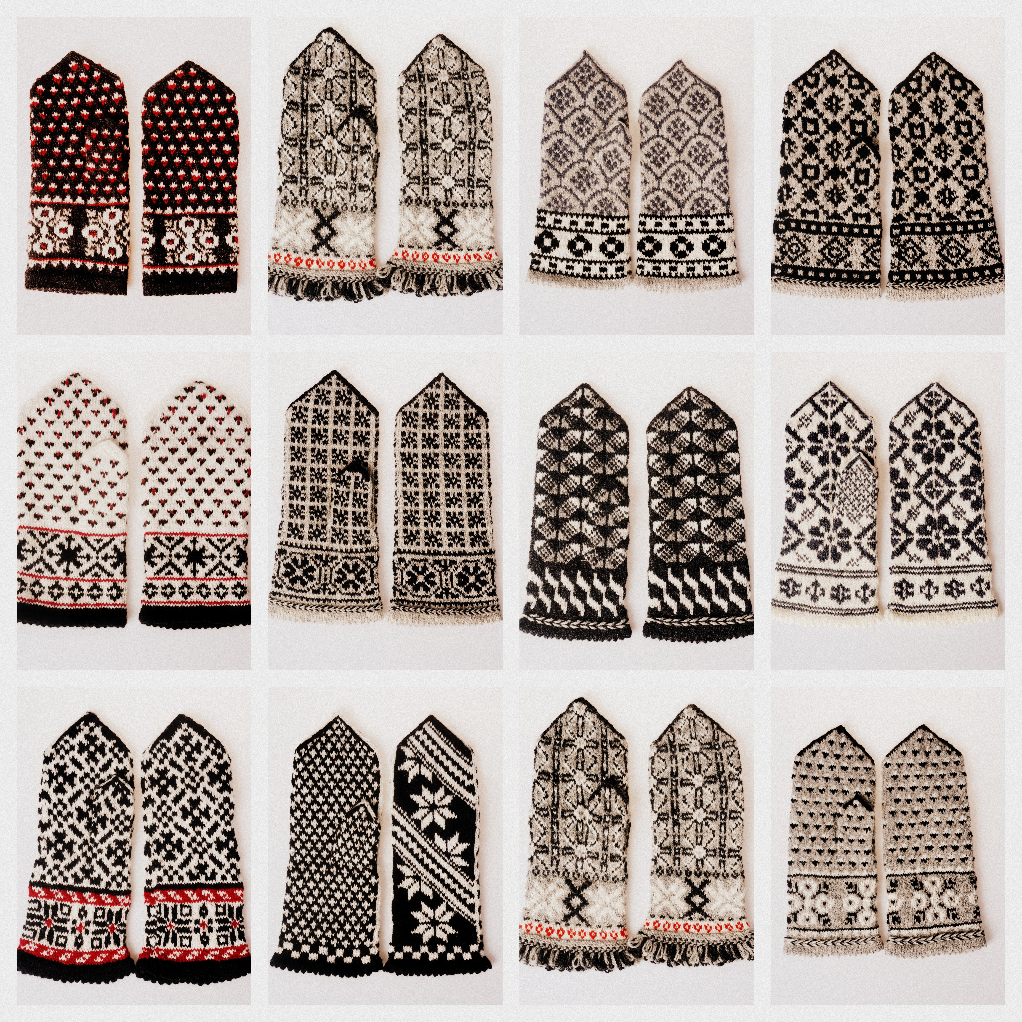
Notes:
In Estonia, because it is cold, they also have a long history of making hats and mittens. These mittens are made from the fur of an animal. Can anyone guess what kind of animals fur makes these clothes?

Slide 11
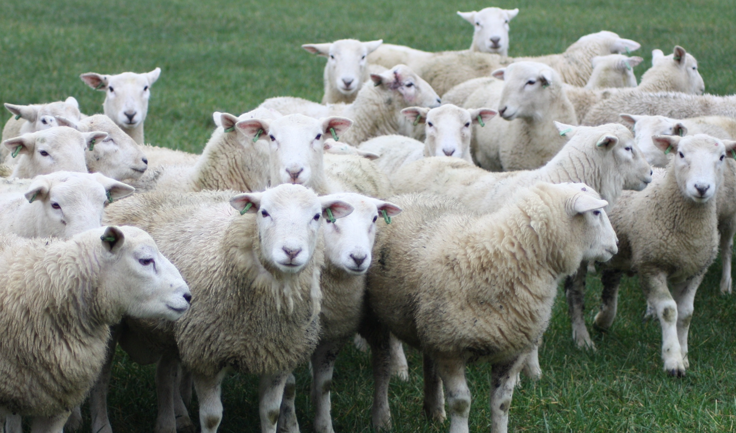
Notes:
Sheep! You guessed it.

Slide 12
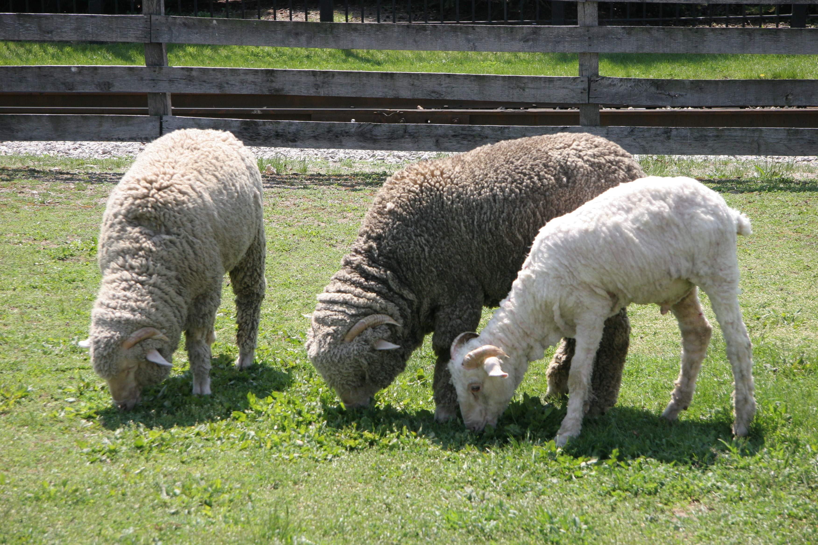
Notes:
Here are some Estonian sheep eating grass in the summer. What do you notice about them? Do you think they are old or young sheep?

Slide 13
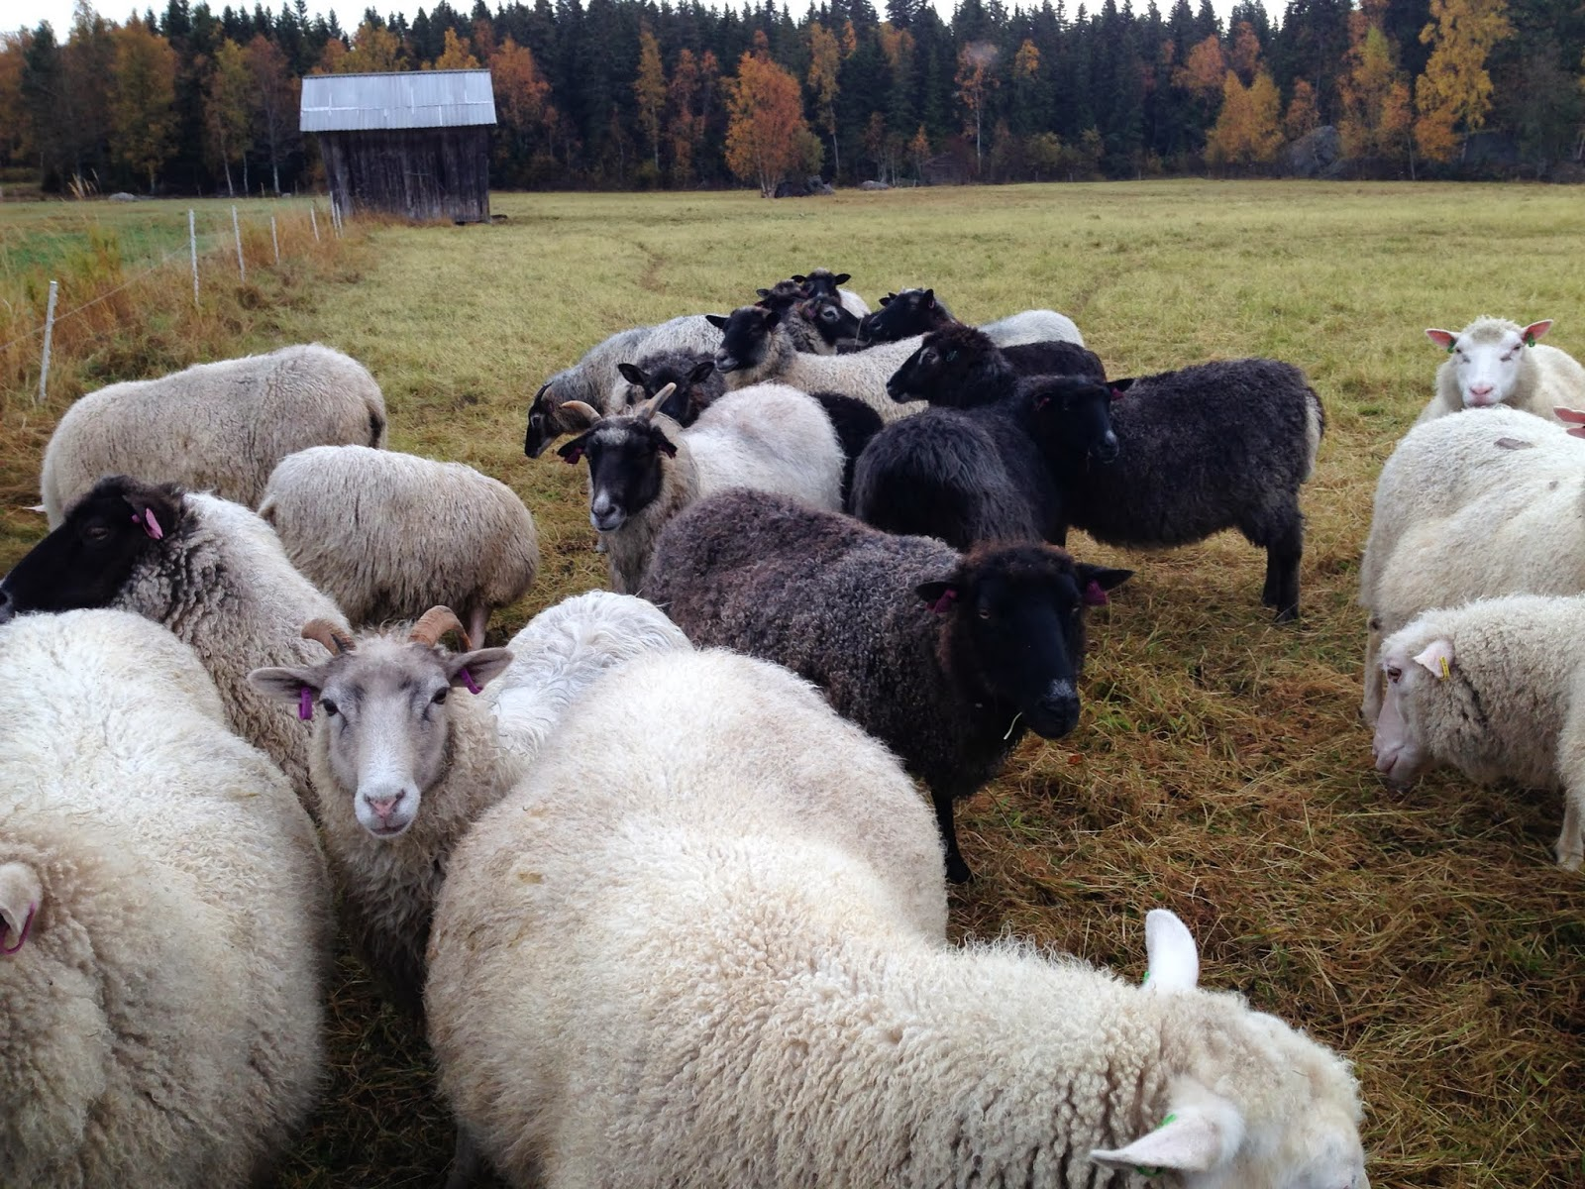
Notes:
Here are some Estonian sheep in the middle of their dinner eating some hay. Hay is grass that has been cut and saved, and is used to feed the sheep throughout the year. How many colors of wool can you see here?

Slide 14
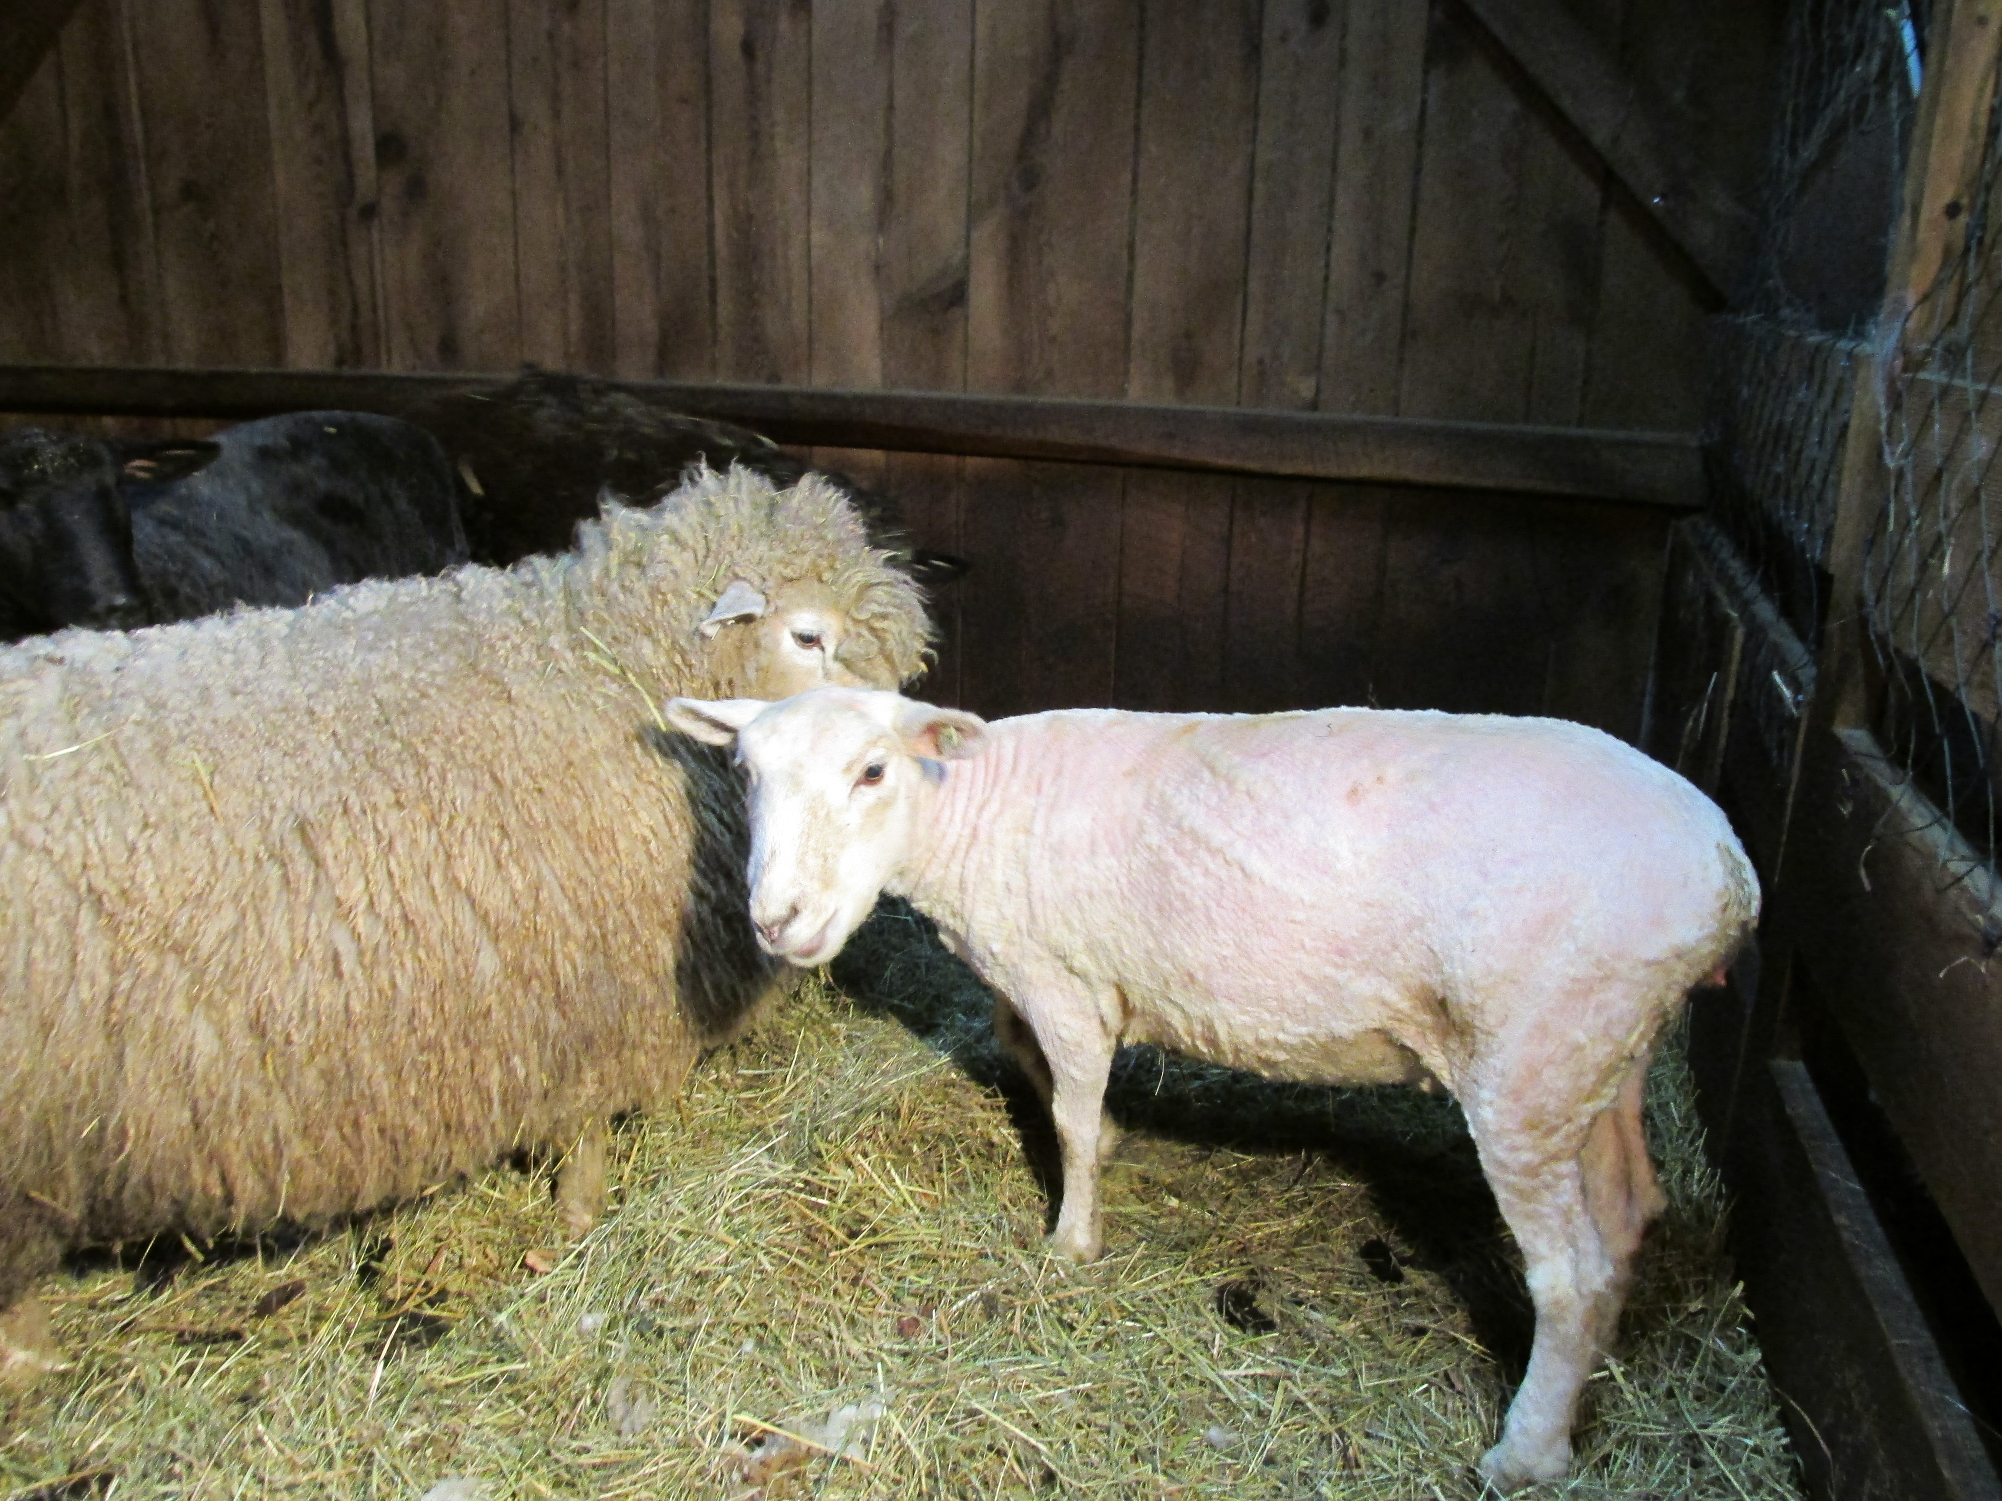
Notes:
Here are two Estonian sheep, one has its fur (we call it wool) and the other has already had its wool cut off so that it could be made into clothes for people.

Slide 15
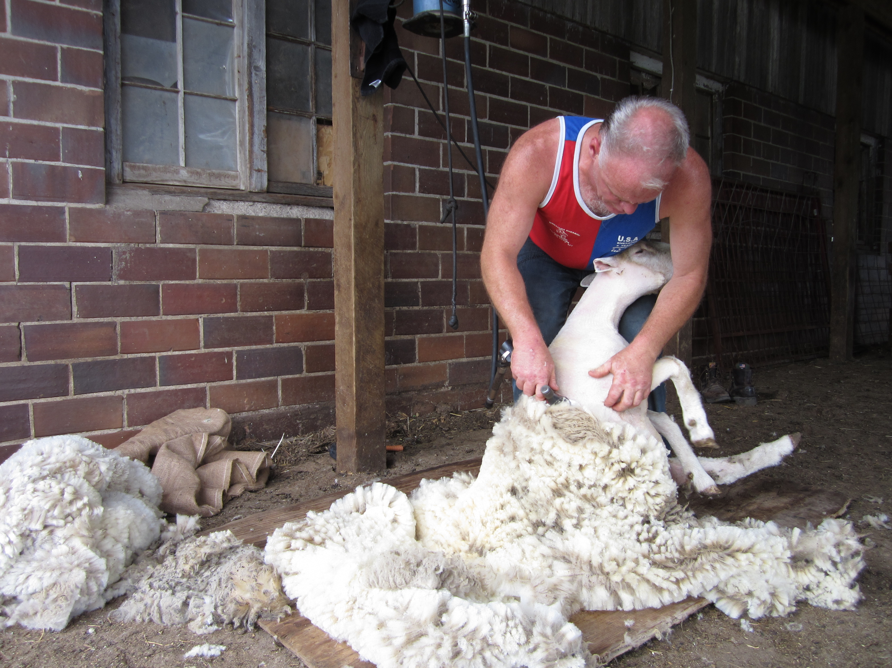
Notes:
Once a year, the sheep get shorn, which is a word that means a big haircut. How often do you guys get a haircut? All of the sheep’s wool is cut off of the sheep, but this usually happens before summer so that they also can be cooler and less hot.

Slide 16
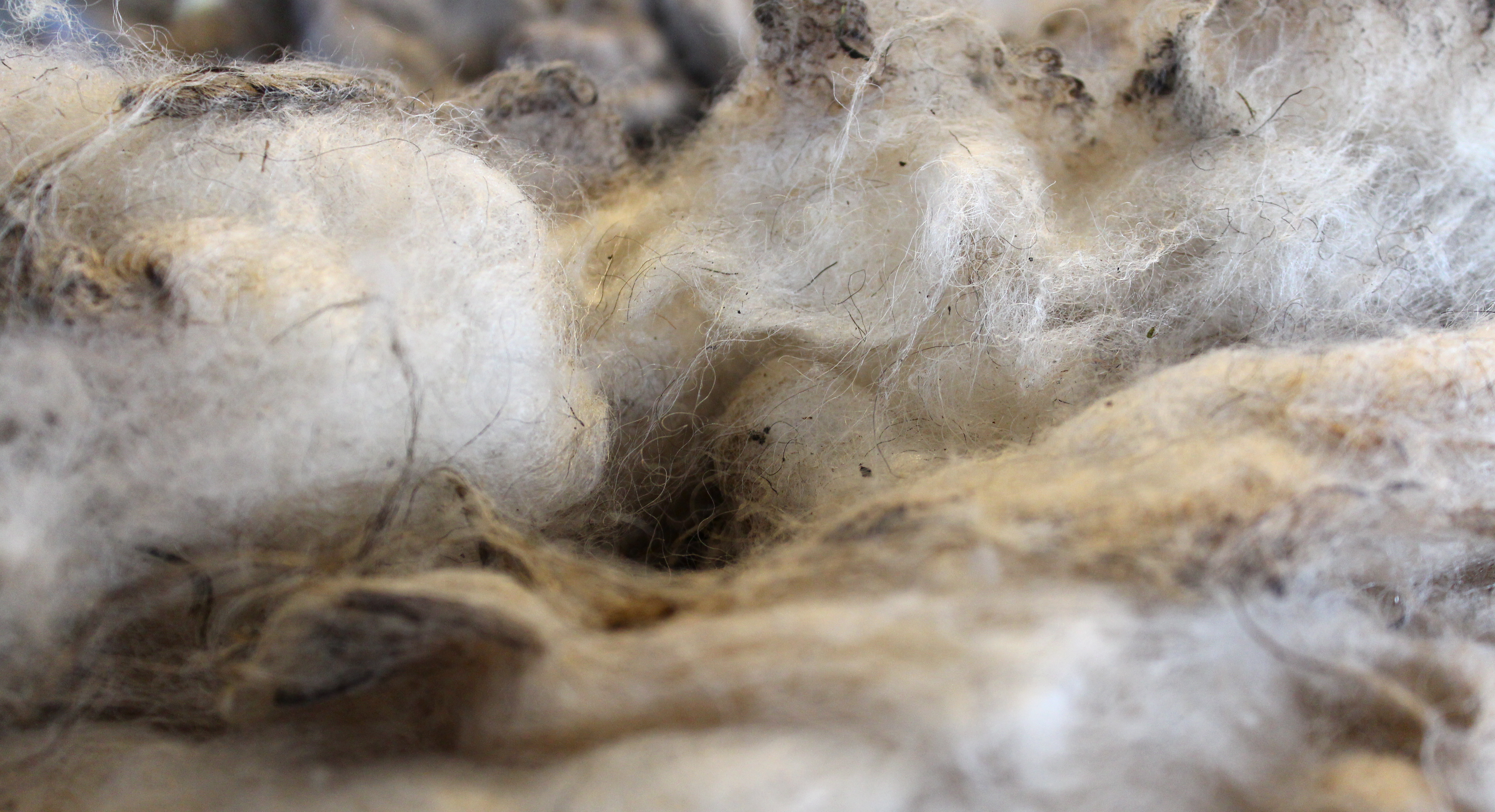
Notes:
This is a picture of what wool looks like when it is cut off the sheep. (now is when we usually pass out the wool, if you’ve found some). This wool is called fleece, when has just been taken from the sheep. I want everyone to touch it and feel it, smell it. What do you see/feel/smell? (try to get them to talk about the oils and smells) The oiliness that you feel is frome something called lanolin, thatis an oil that grows in the sheep’s hair.

Slide 17
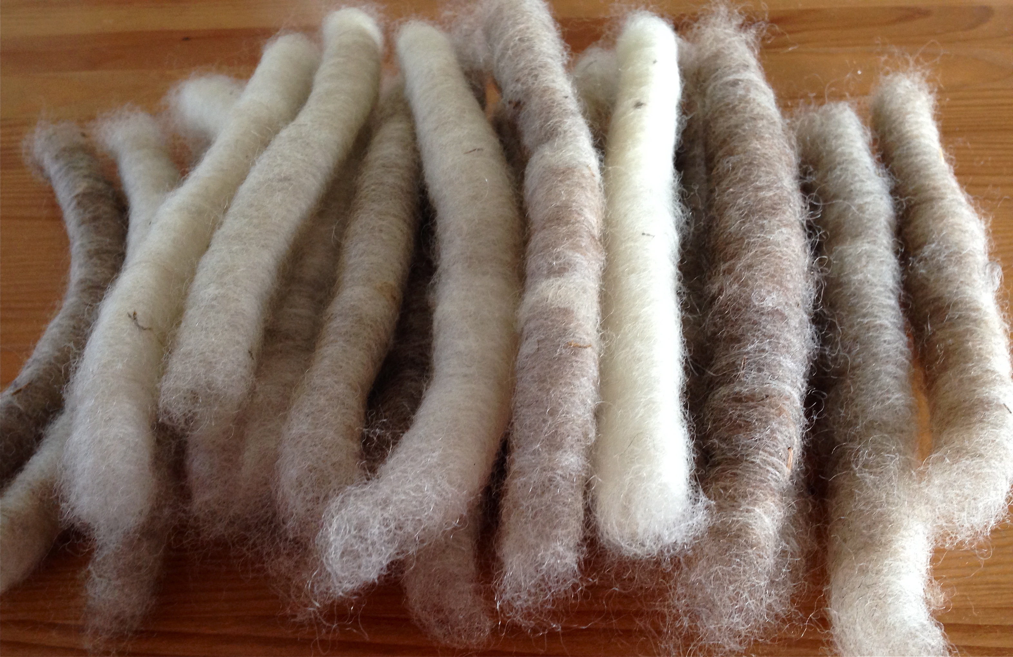
Notes:
These fleece is cleaned and separated, and then rolled into these long pieces. Most of the lanolin is removed to make it less oily.

Slide 18
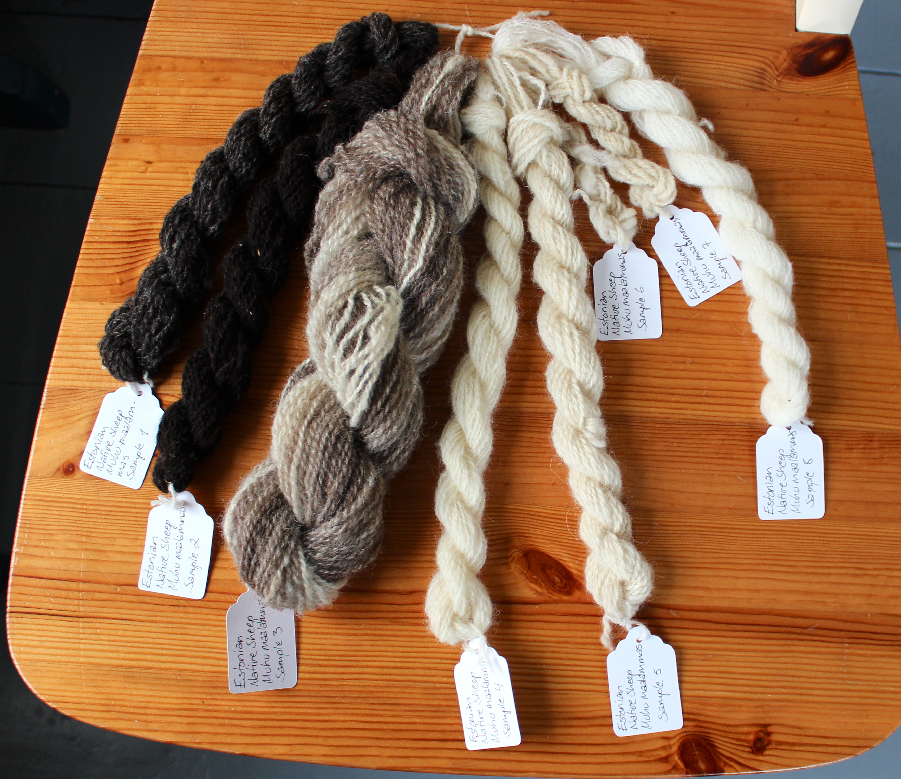
Notes:
Then these pieces of wool are the put through a machine called a loom, and made into yarn, which we can see here. s

Slide 19
Notes:
The last step, is to take this yarn and weave it together into gloves, hats or anything else you would want to wear!

