Slide 1
Notes:
This is Prague castle, which is where the king of the Czech republic used to live. They began building it over 1000 years ago, and kept working on building it for 900 years!!

Slide 2
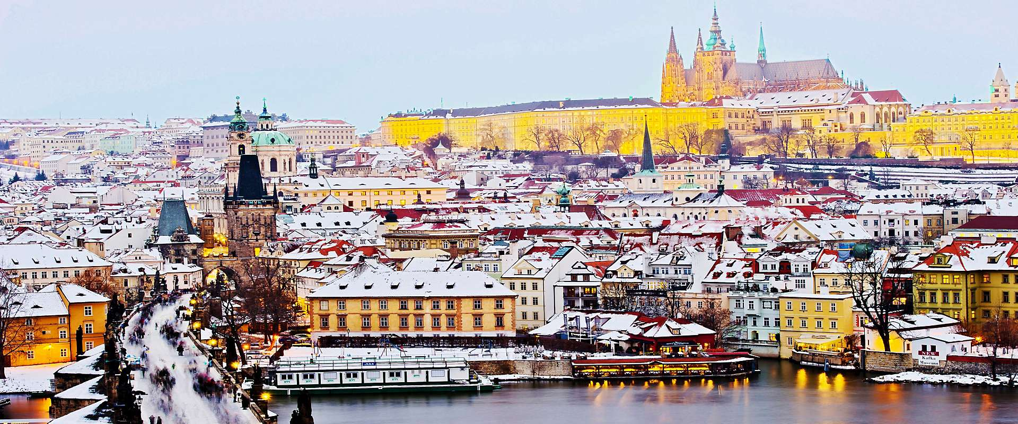
Notes:
This is another picture of Prague Castle, from the other side of the river. What do you see in this picture? What season do you think it is?

Slide 3
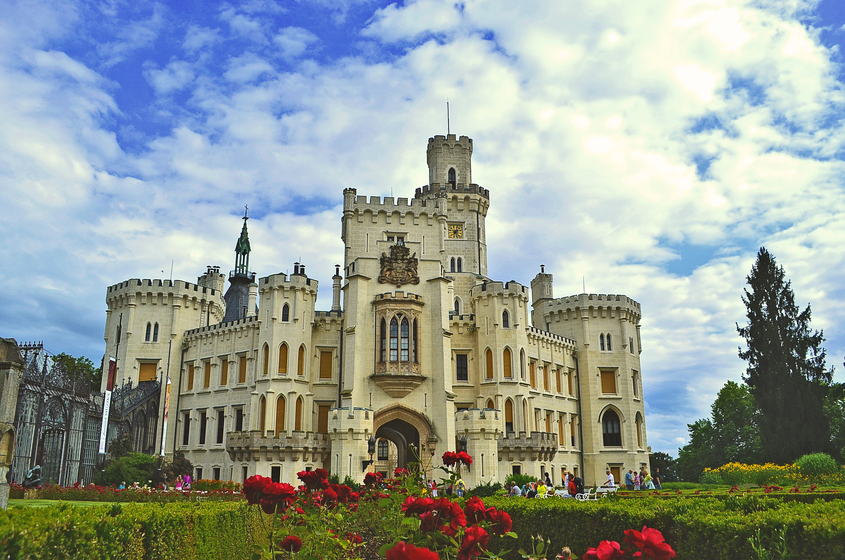
Notes:
This is castle hluboka

Slide 4
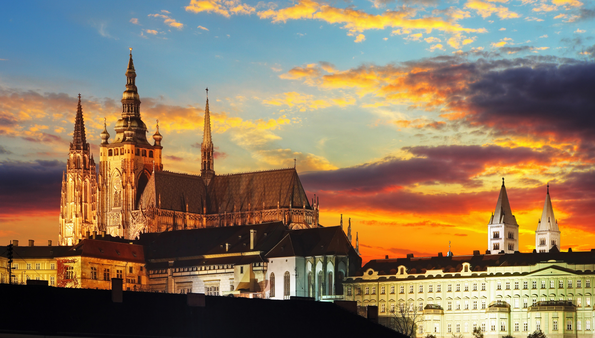

Slide 5
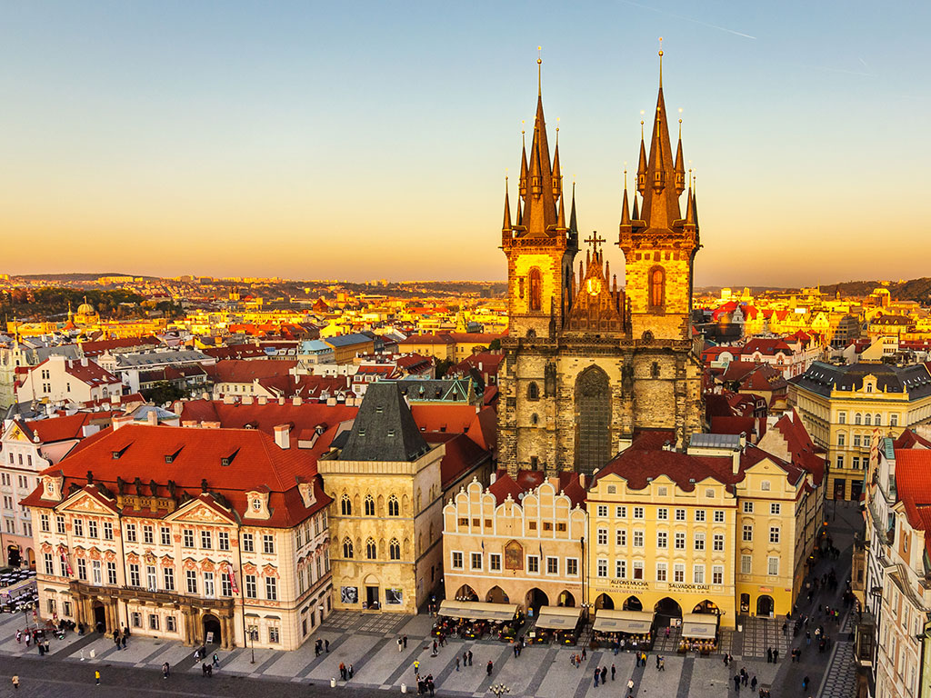
Notes:
This is also a picture of Prague. The big building is not a castle though, it is a church. The church is called Church of Our Lady before Tyn and it is 700 years old!

Slide 6
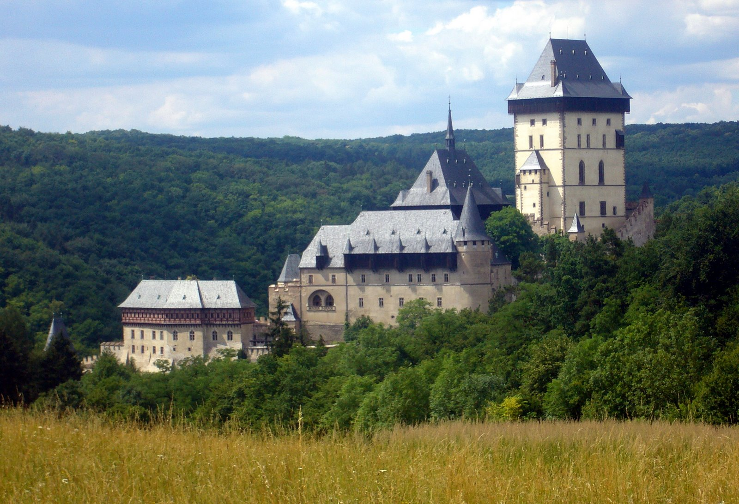
Notes:
This is an old castle in the countryside called Karlštejn (pronounced Carl-stain) Castle. This is where the crown jewels were kept for many years.

Slide 7
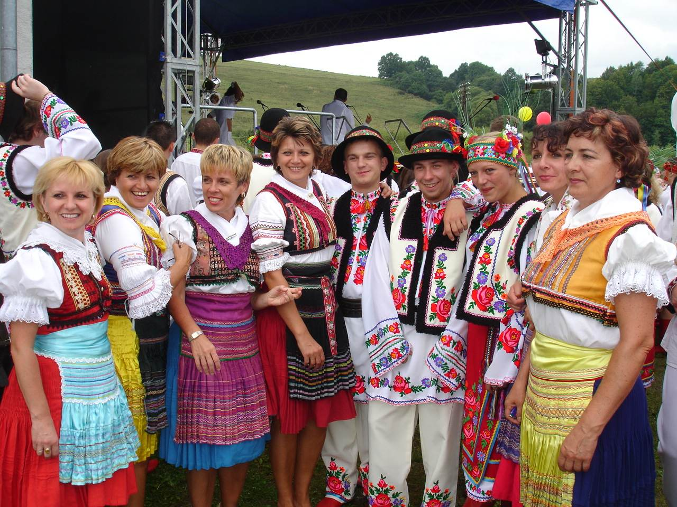
Notes:
These are some Czech people in traditional czech clothing. What kinds of things are they wearing? Would you like to wear these clothes?

Slide 8
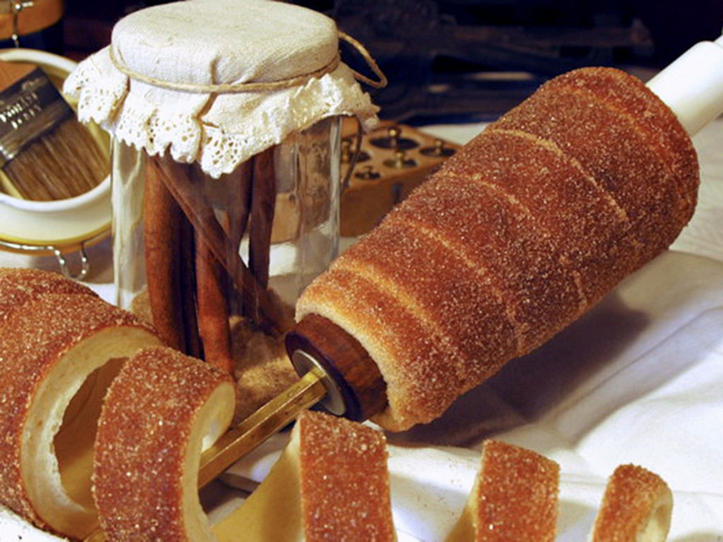
Notes:
These are a Czech pastry called trdelník (pronounced tre-del-nik). They have cinnamon and sugar and are delicious!

Slide 9
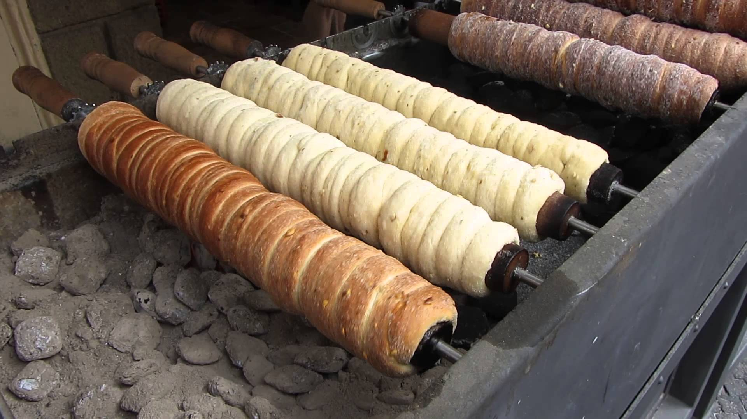
Notes:
They are made by rapping dough around wooden rollers, and then rolling them over hot coals. You can buy them on the streets of prague.

Slide 10
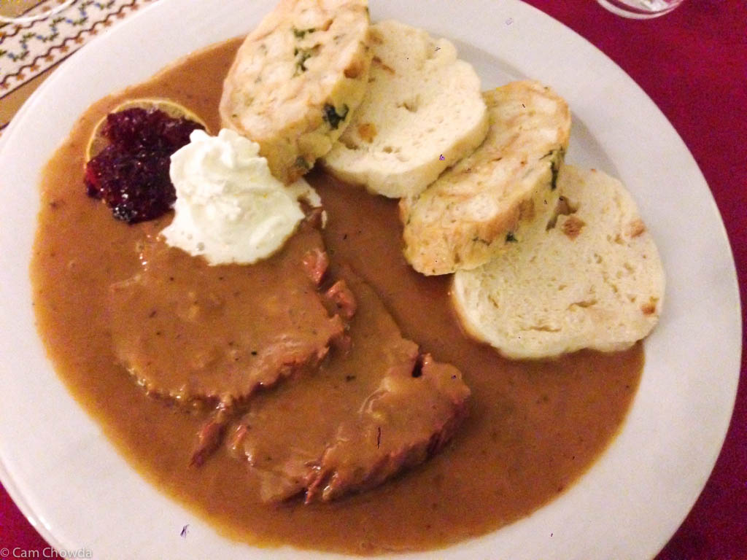
Notes:
Here is some more czech food. This is roast beef with traditional czech bread dumplings, it is covered in a sauce that is a lot like gravy, and then usually served with sour cream. Does this look tasty to you?

