Slide 1
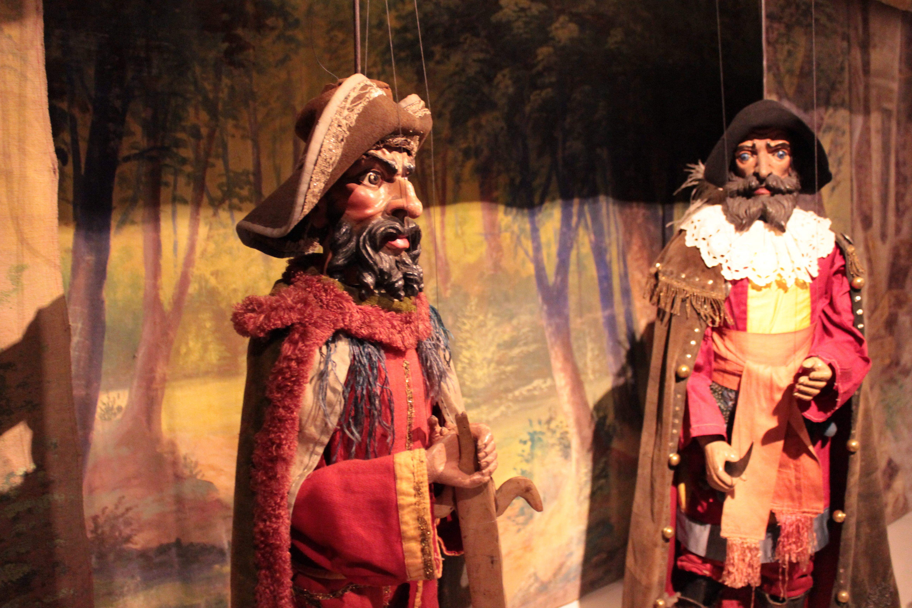
Notes:
Also today, we are going to talk about a kind of puppetry that is very popular in the Czech Republic. These are special puppets made from wood. They are called marionnettes. In Prague, they have special theaters where you can go and see marionnette shows.

Slide 2
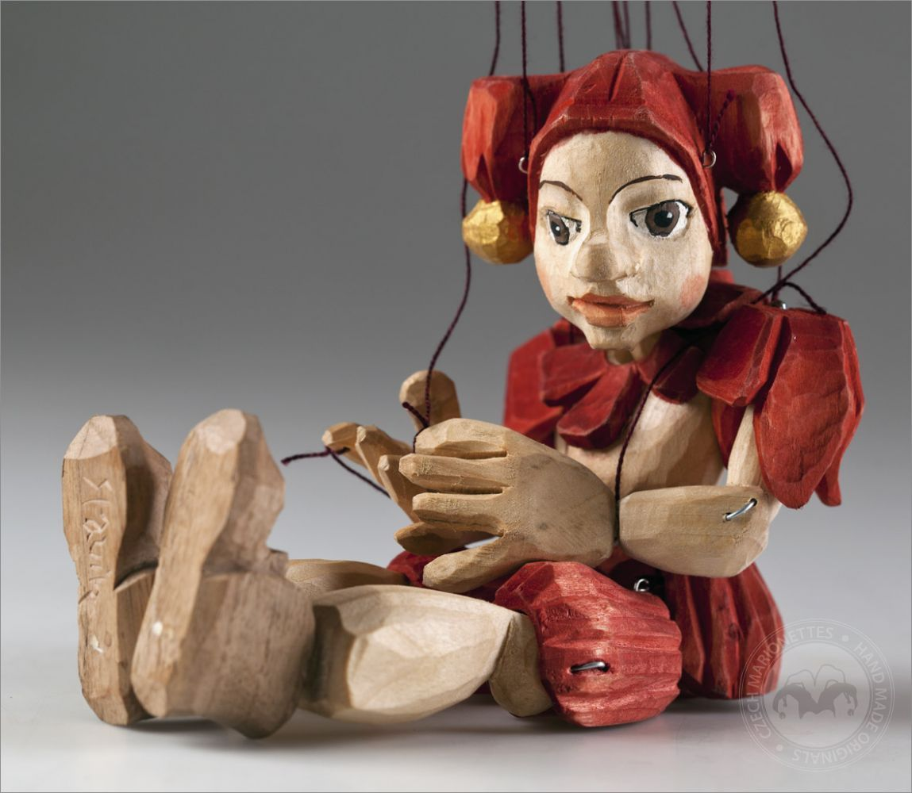
Notes:
Here is what one of these puppets looks like up close. What do you guys notice?

Slide 3
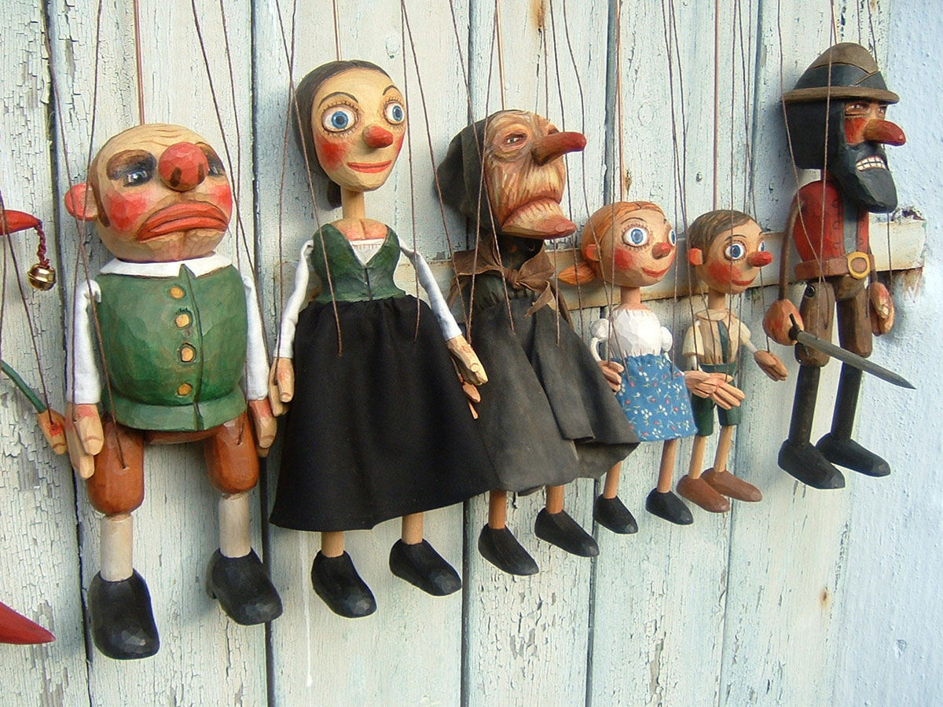
Notes:
Marionettes can be made to look like anything. Which of these is your favorite? What do you like about it? What kind of story do you think they are going to tell with these puppets?

Slide 4
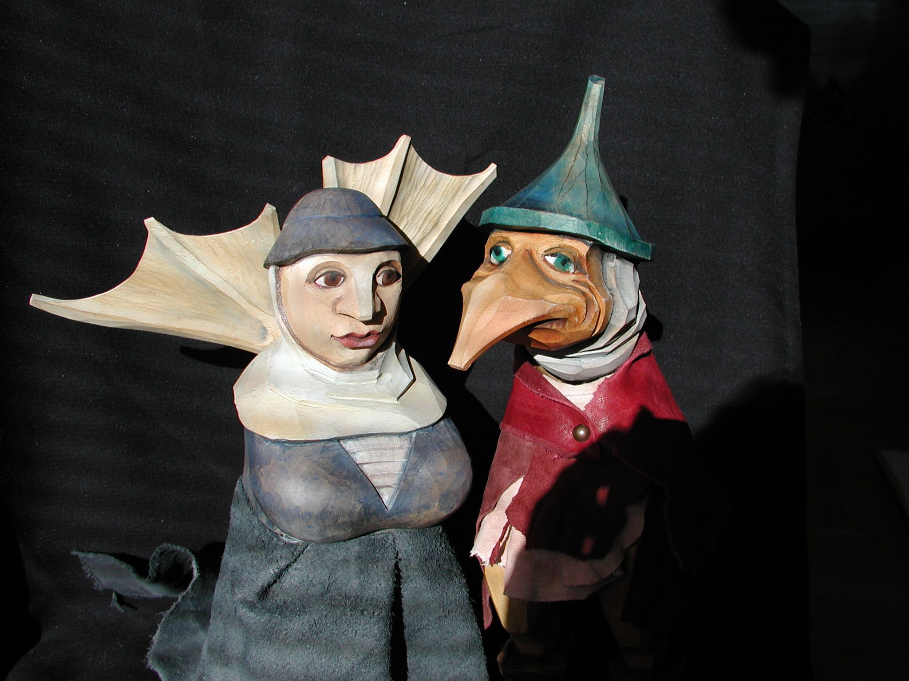
Notes:
Here are some more pictures of marionettes.

Slide 5
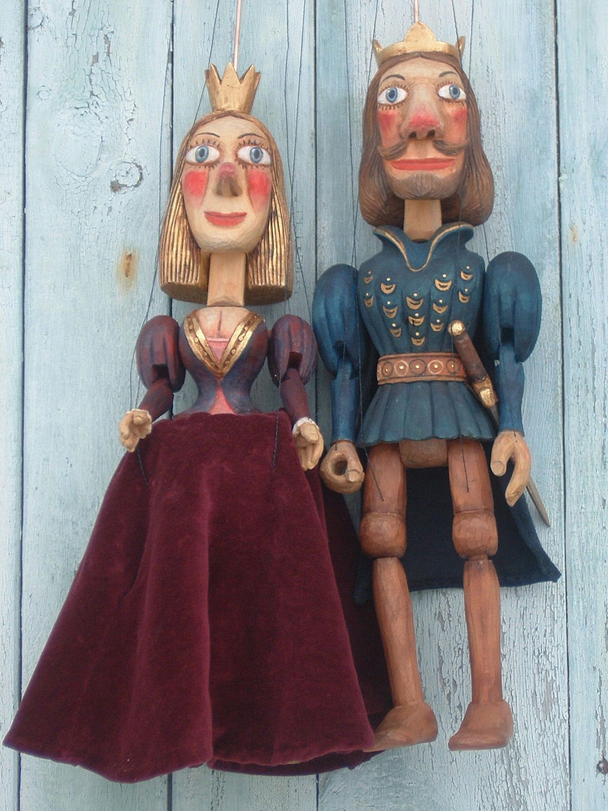
Notes:
What do you think these two puppets are?

