Slide 1
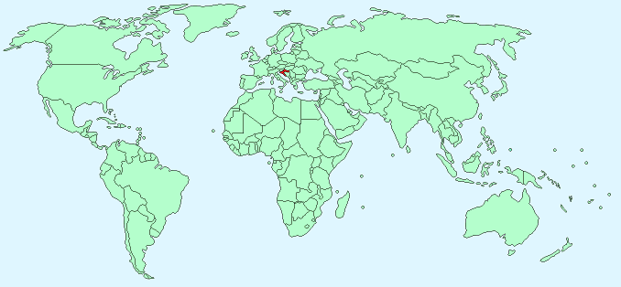
Notes:
Can you guys find America on this map? The small country in red here is a Country called Croatia. Croatia is a country about the size of West Virginia that has about has 4 million people that live there. These people are called Croatians and speak a language called Crotian.

Slide 2
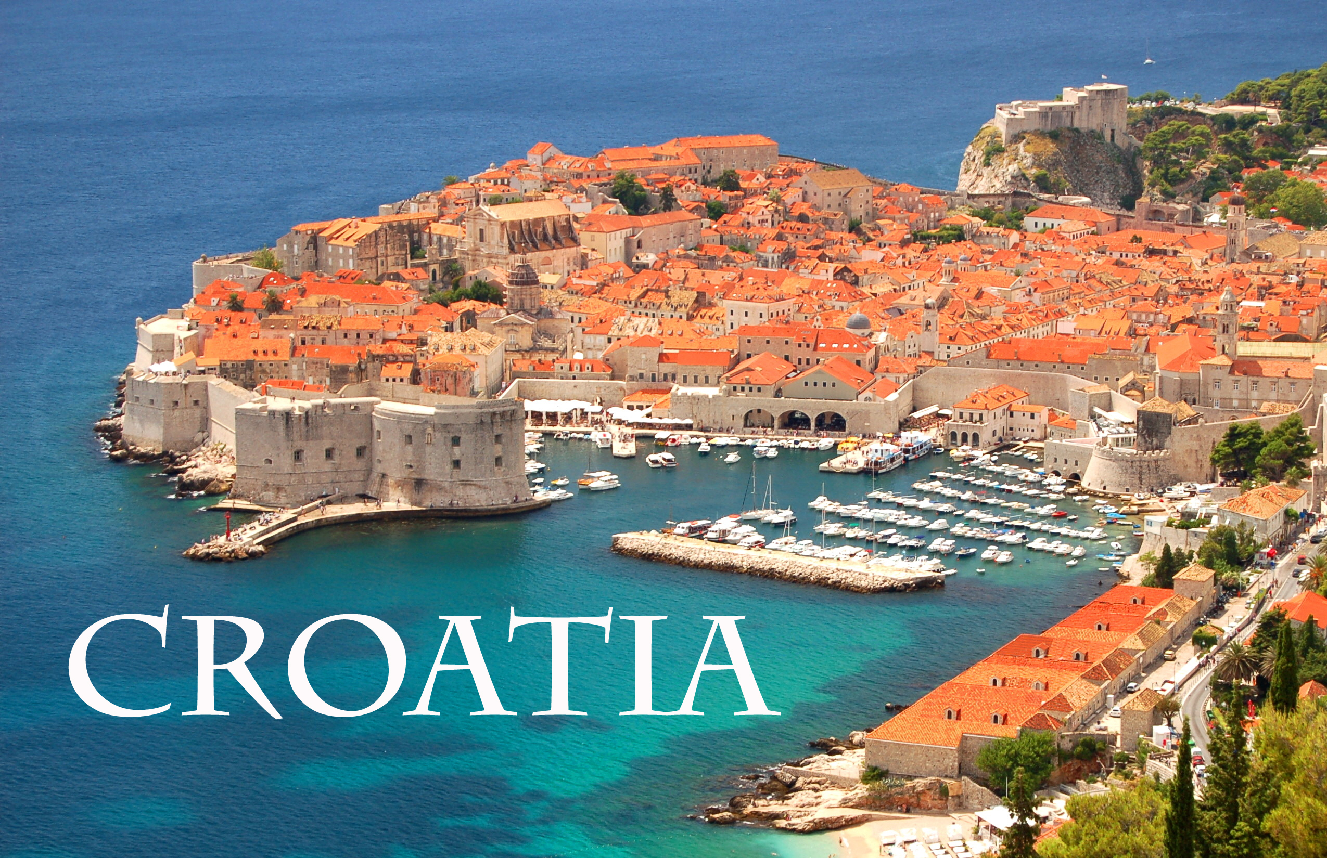
Notes:
Part of Croatia is near an ocean called the AdriaticSea. Has anyone here been to a sea? Has anyone swam in it? Was it warm or cold? This is a city called Dubrovnik. Dubrovnik

Slide 3
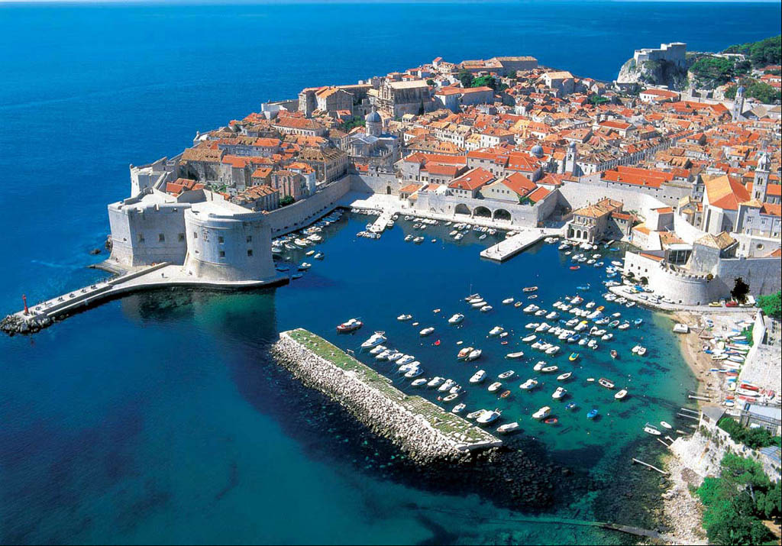
Notes:
Here is another picture of Dubrovnik. What do you see in this picture? Would you want to live here or visit?

Slide 4
Notes:
This is another town on the Adriatic Sea in Croatia called Rijeka (pronounced Ree-yeh-ka). Rijeka is famous because one day a year they have a big festival where they close the streets and everyone dresses in costumes.

Slide 5
Notes:
Here is a photo of the streets during the big festival and parade in Rijeka. It is traditional in Croatia to dress up for these festivals in their scariest outfits and masks to scare away all of the bad spirits and things from the city. Do you guys want to see some pictures of these scary masks? They are very scary, so it is okay to cover your eyes or look away. Remember, these are just people dressed up in costumes.

Slide 6
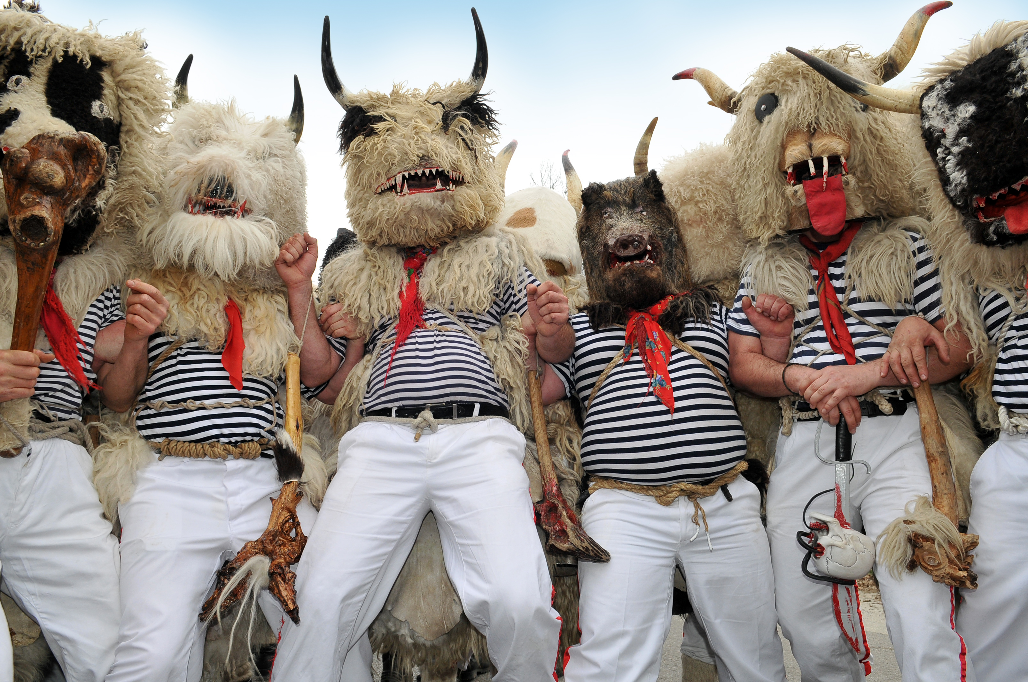
Notes:
Here they are! What do you guys think? Are they scary or not? Would you like to dress up like them?

Slide 7
Notes:
Here are some more men trying to dance and scare away all the bad things in the city of Rijeka.

Slide 8
Notes:
Even kids like to dress up? Can you think of a holiday we celebrate that is kind of like this?

Slide 9
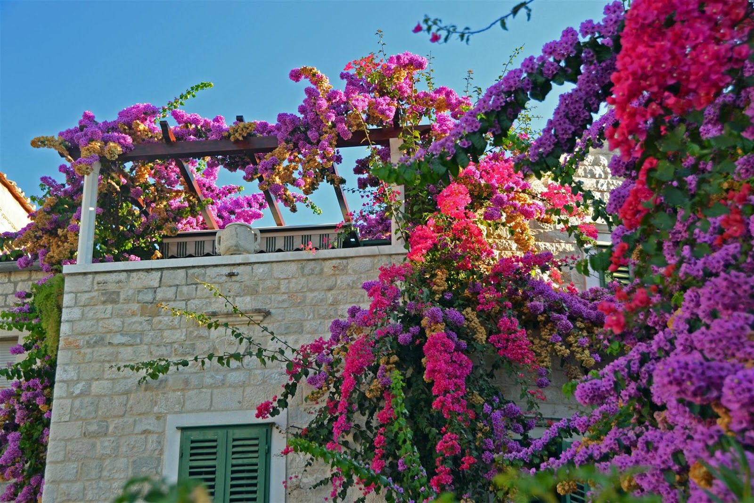
Notes:
Every year in spring, Zagreb – the capital of Croatia – is covered in flowers.

Slide 10
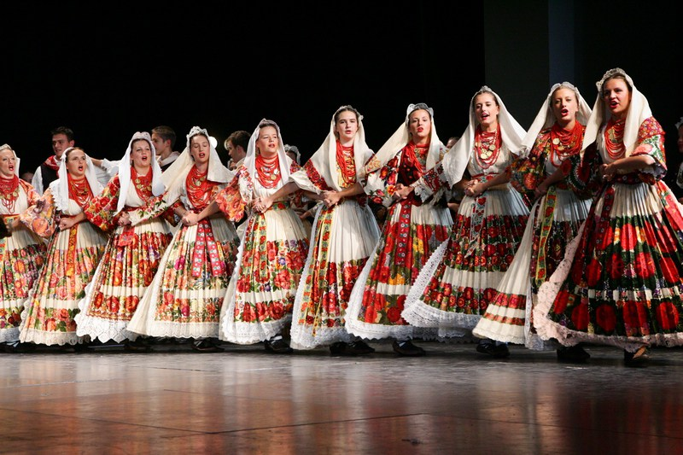
Notes:
Here are some women with flowers on their dresses to celebrate the spring!

Slide 11
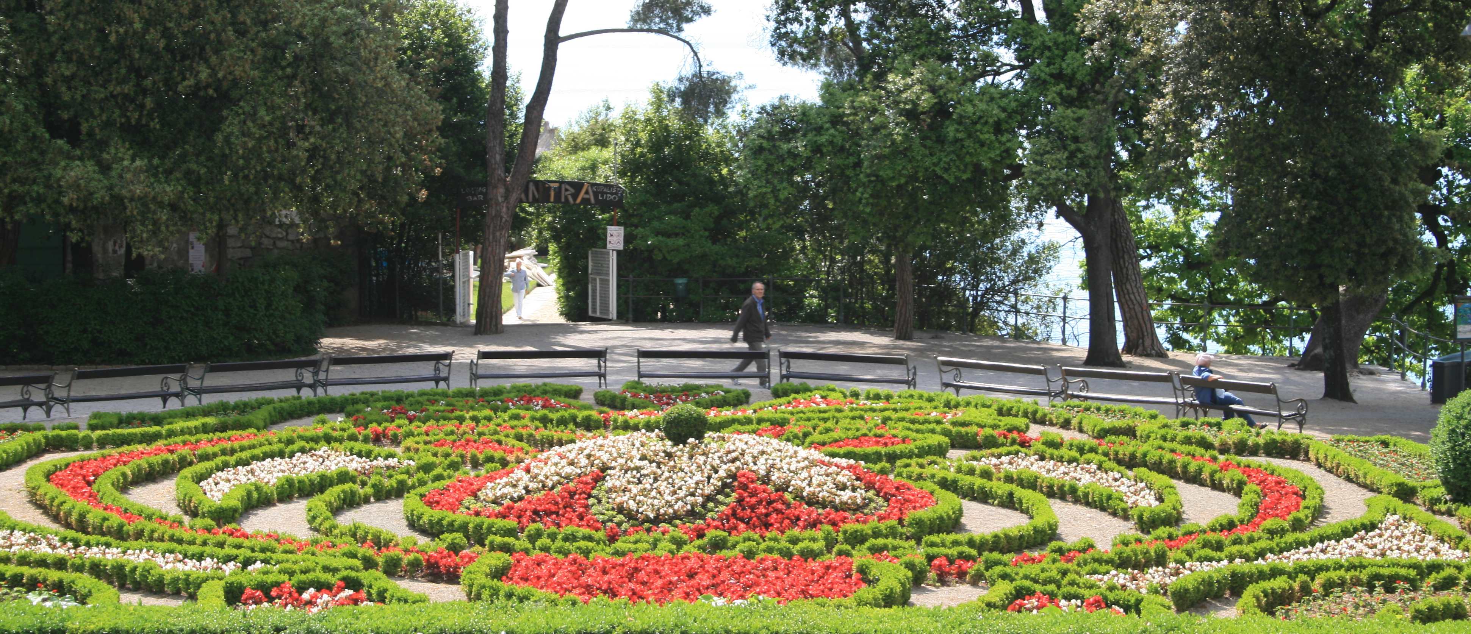
Notes:
There is one place in Zagreb where everyone goes to see the flowers in the spring, and that is the Zagreb Botanical Gardens.

Slide 12
Notes:
This is the botanical gardens.here Here they grow over 10,000 different kinds of plants and flowers from all over the world.

Slide 13
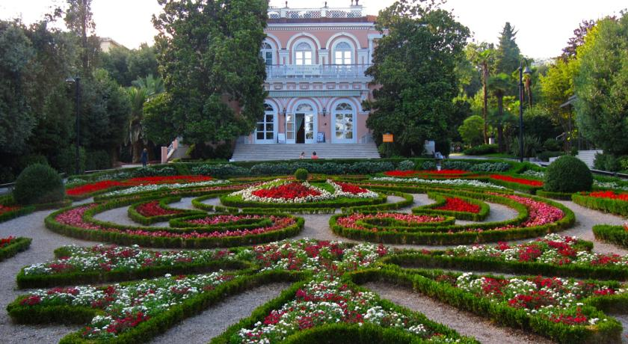
Notes:
And here is another picture inside the gardens.

