Slide 2
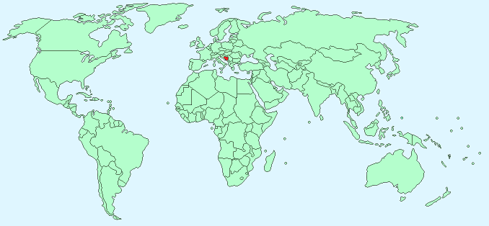

Slide 3
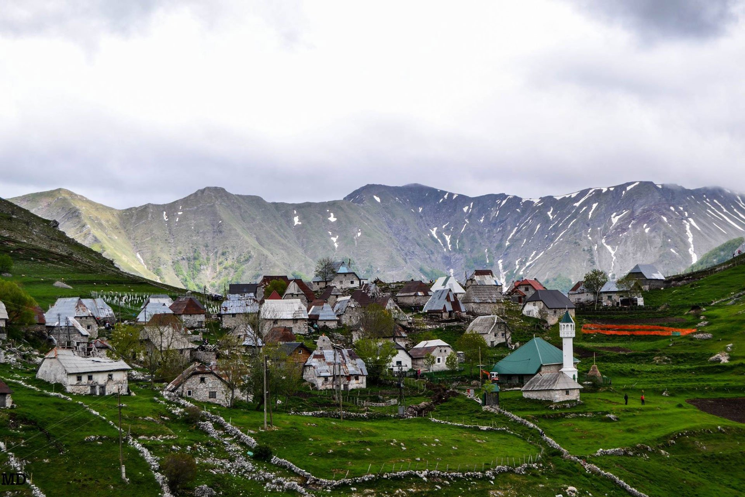
Notes:
This is the small town of Lukomir in the mountains. Bosnia has mountains, rivers, forests and lakes. It is a beautiful country.

Slide 4
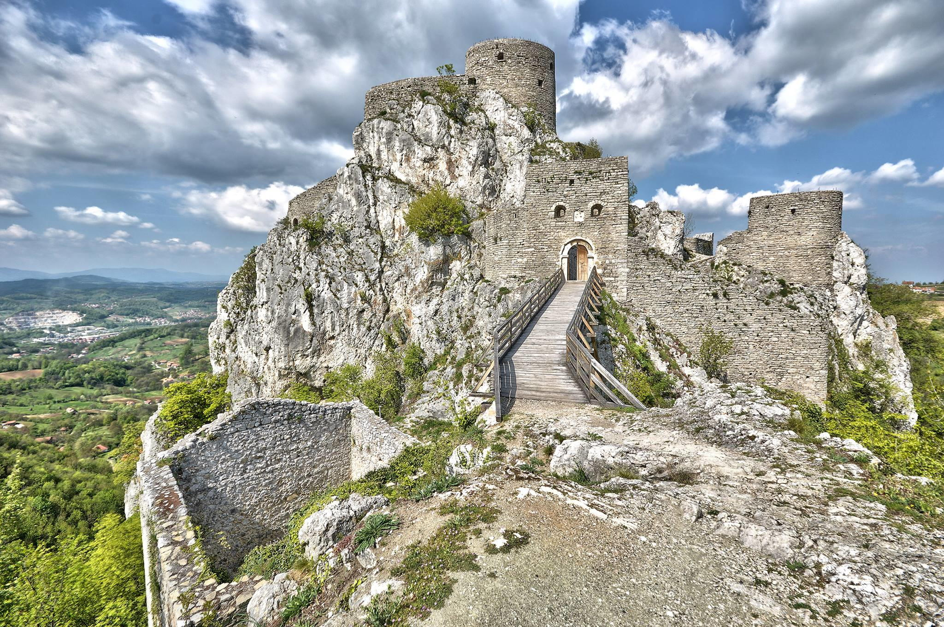
Notes:
This is Srebrenik Castle, built in 1333, almost 700 years ago!

Slide 5
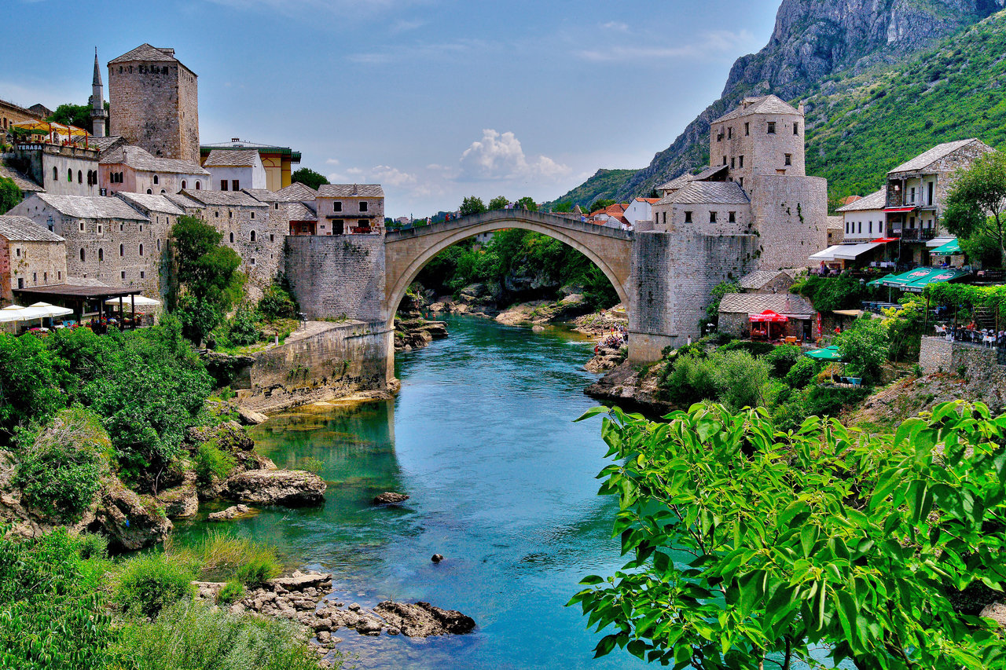
Notes:
This is Stari Most, or “old bridge” in Mostar, Bosnia. It was built more than 400 years ago by a king named Suleimon the Magnificent, and it connects the two parts of the town. Before this bridge, their used to be a bridge made out of wood.

Slide 6
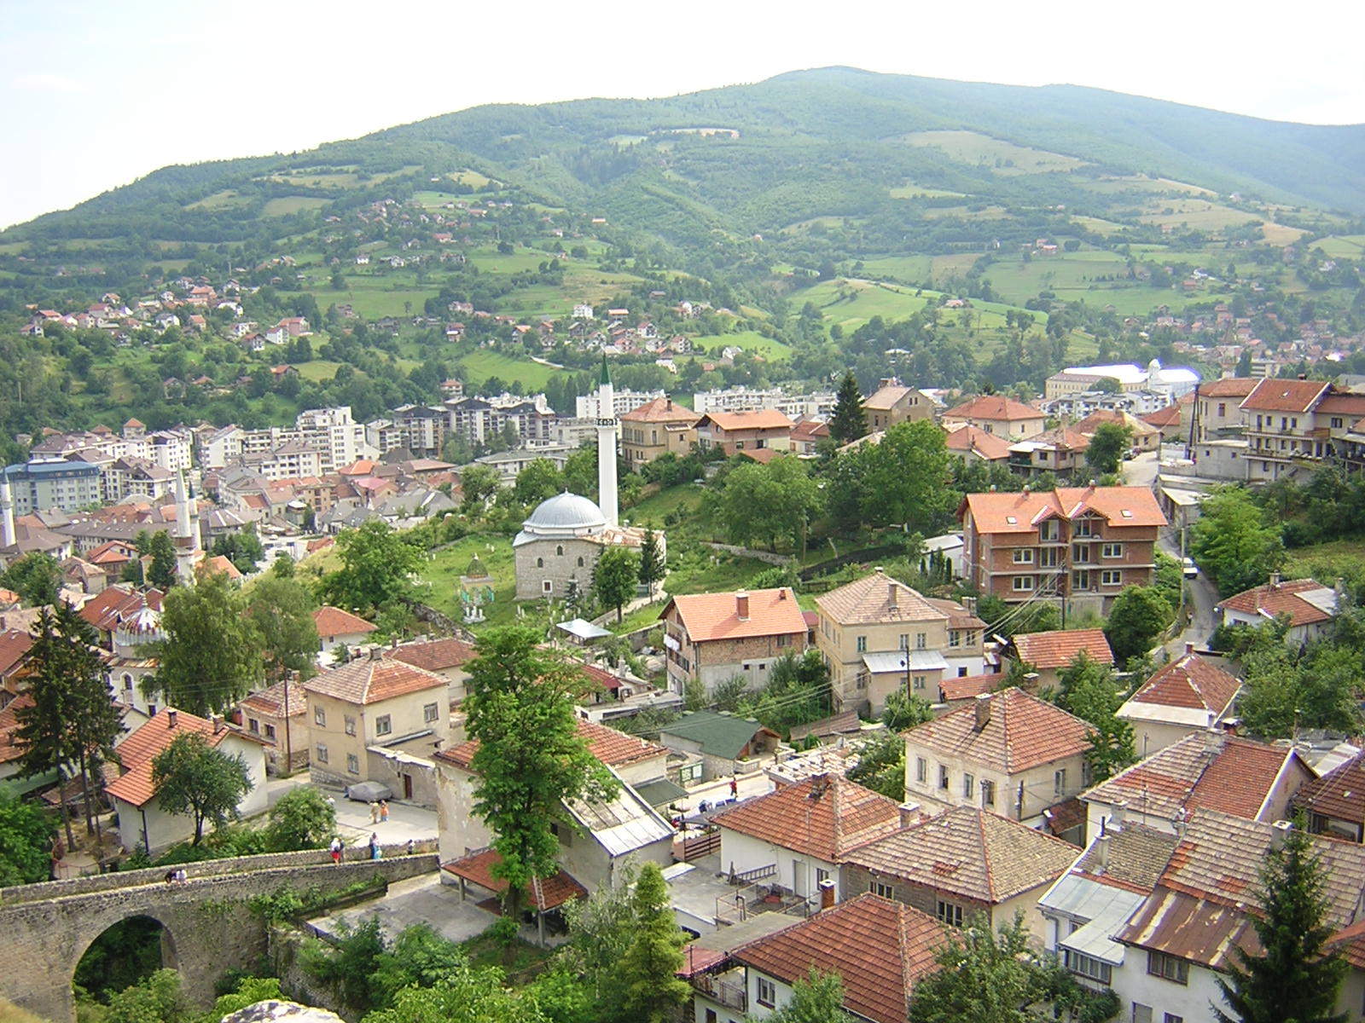

Slide 7
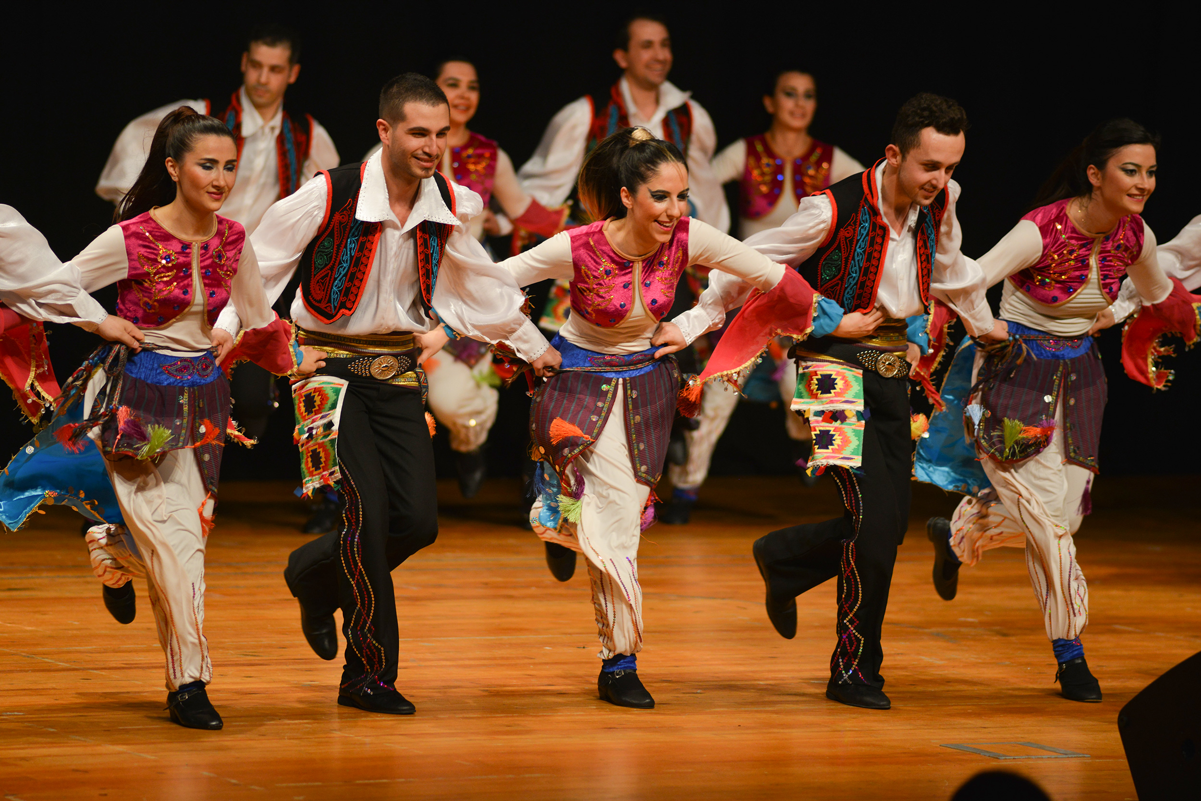
Notes:
These are some traditional Bosnian dancers. In Bosnia, many people dress like us, but they used to dress like this. What kinds of clothes do you see them wearing? What colors are they wearing? Vests are very common, as are black and blue pants and white shirts.

Slide 8
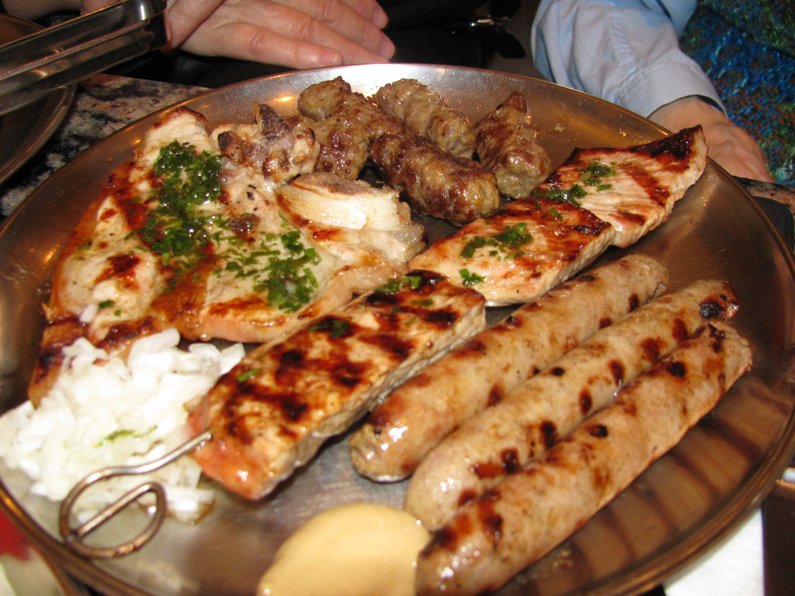
Notes:
And hear is some Bosnian food! They eat Bosnian meet on a stick, which they call Ćevapi (pronounced chevapi). Would you guys like to eat this?

Slide 9
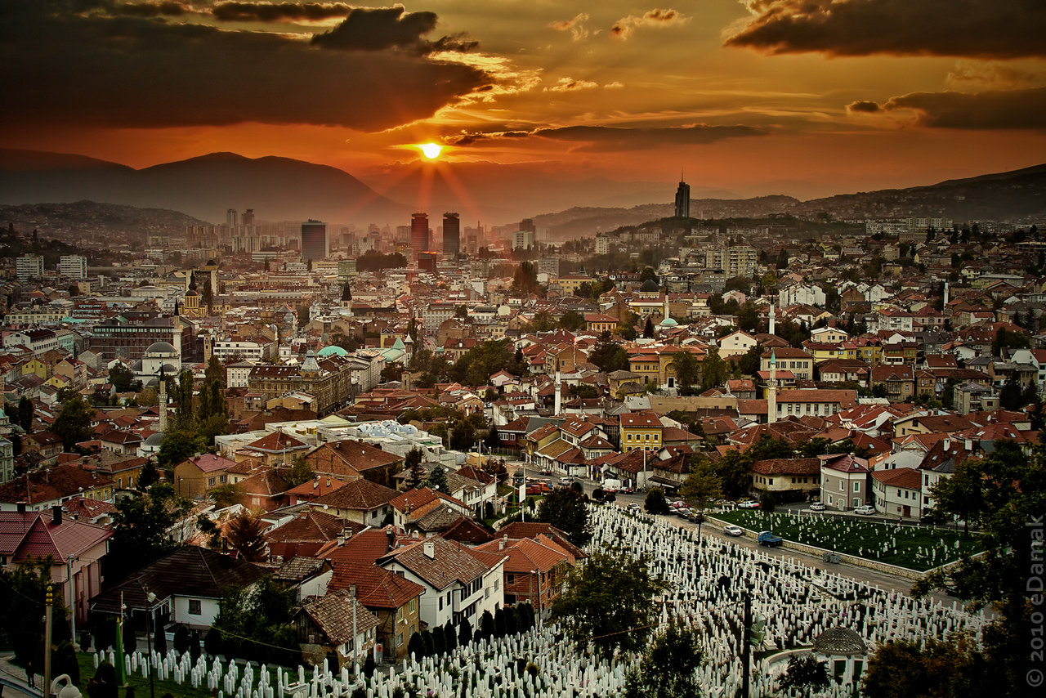
Notes:
This is their capital city, Sarajevo.

Slide 10
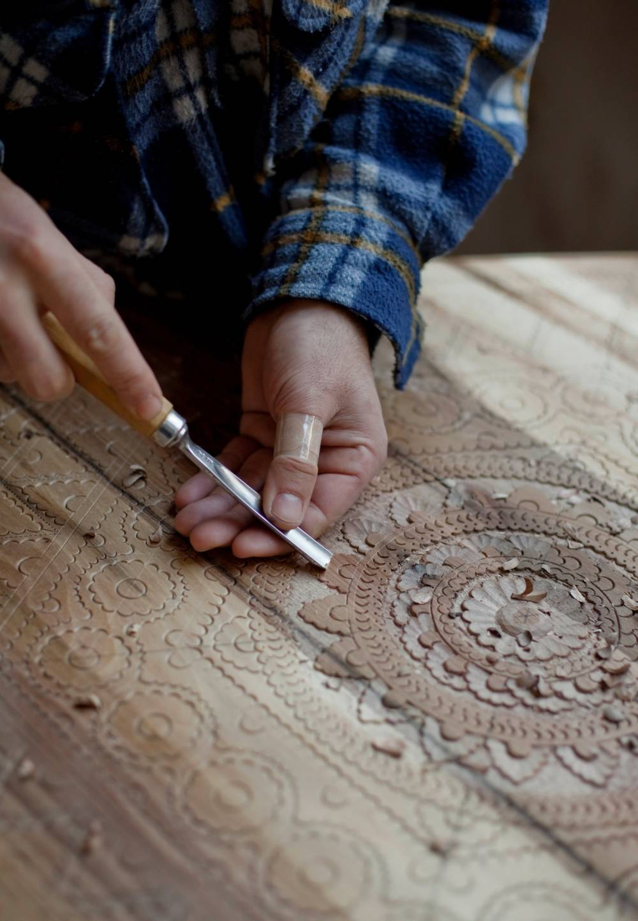
Notes:
In Bosnia (look back at some of the other images) they have lots of trees. Does anyone know what trees are made out of? In Bosnia, they have lots of trees and so they make lots of things out of wood. To make things out of wood is called carpentry. Here is a bosnian carpenter. What do you think he is making?

Slide 11
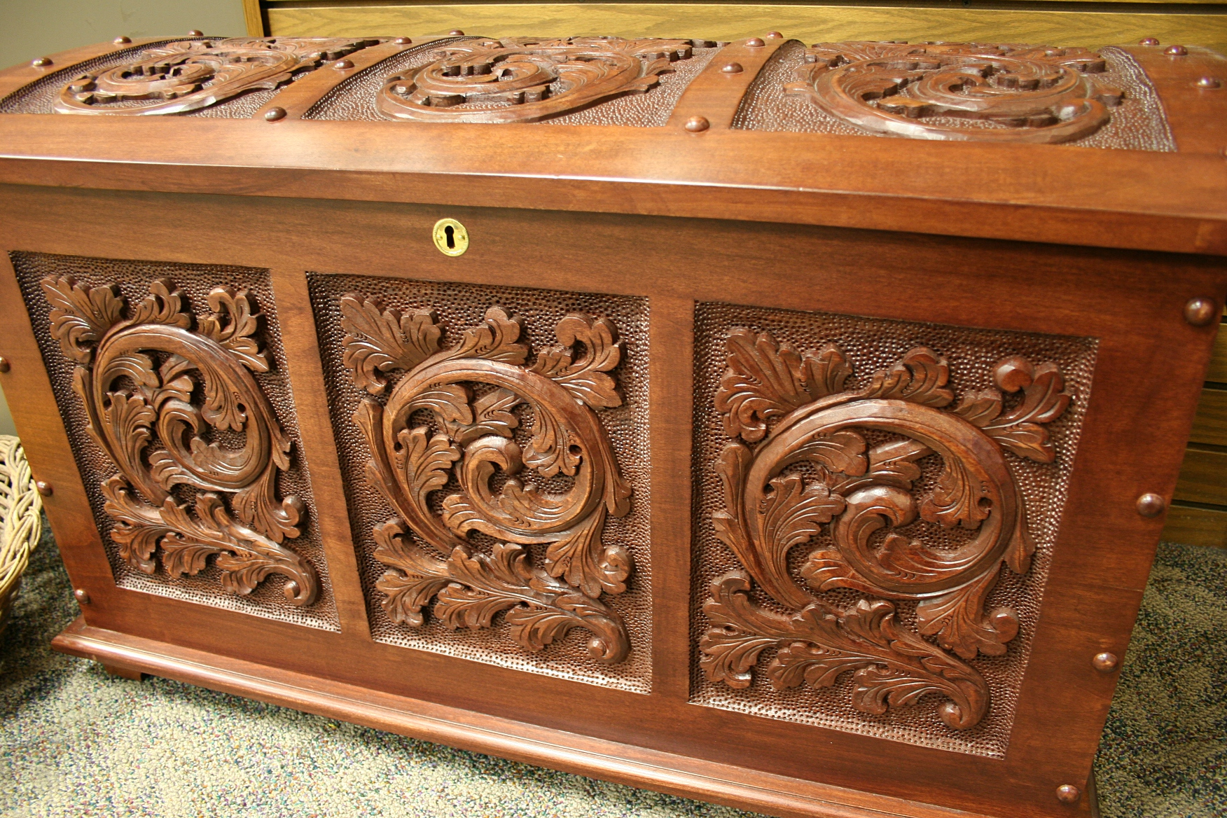
Notes:
Here is something another Bosnian carpenter made out of wood. What do you think goes inside?

Slide 12
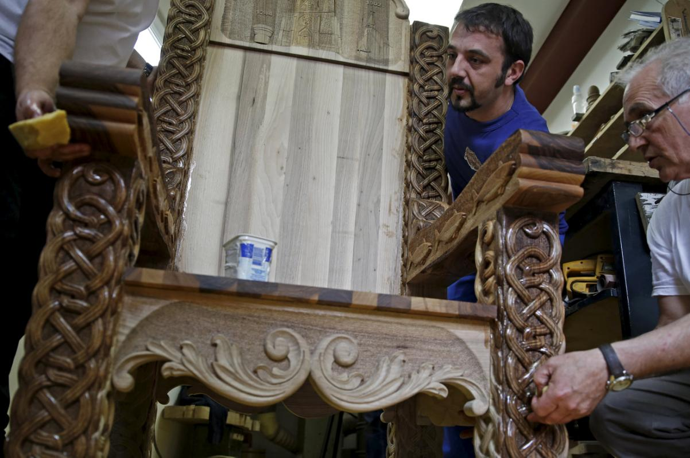
Notes:
Here are some Bosnian carpenters making something. What do you guys see in this picture? What do you think it is?

Slide 13
