Slide 1
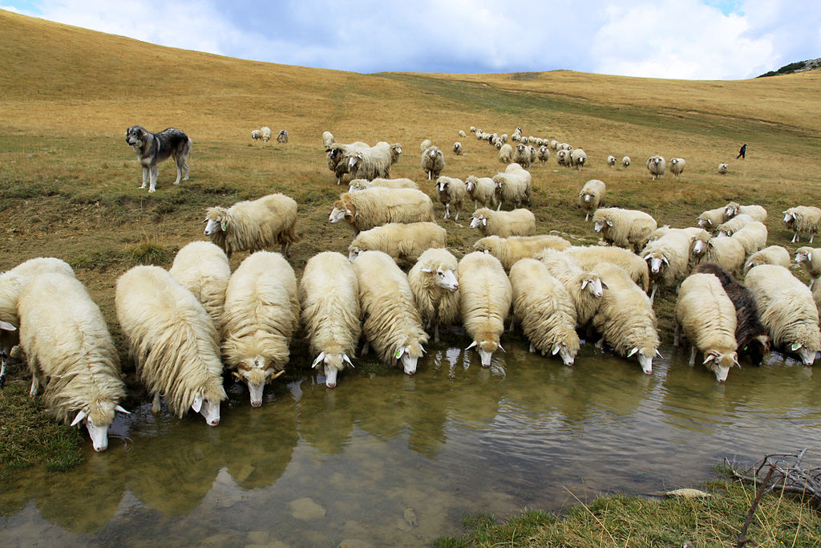
Bardoka- Albanian Sheep
Notes:
What are Qeleshe caps made from? Wool from Albanian sheep!

Slide 2
Notes:
Now you get to make your own Albanian sheep!

