Slide 1
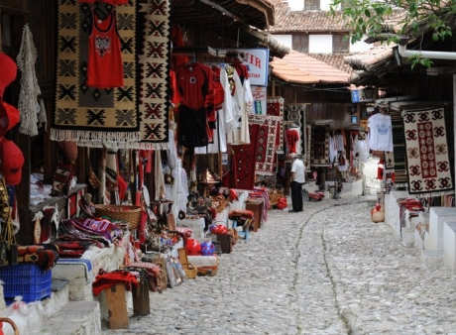
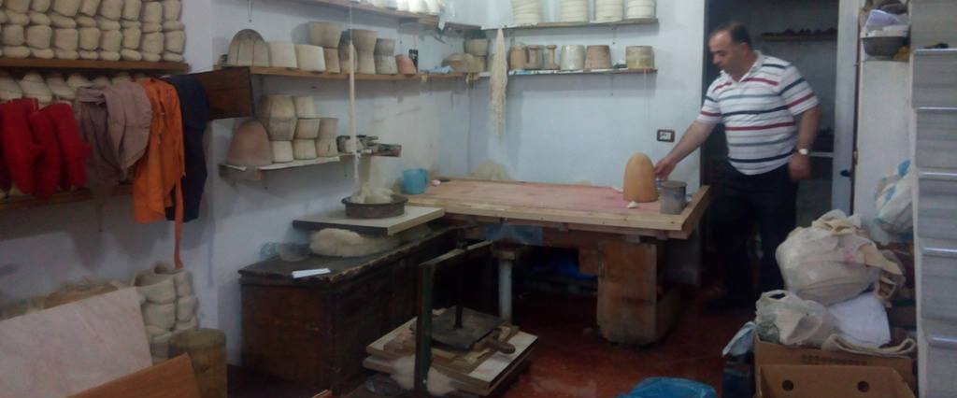
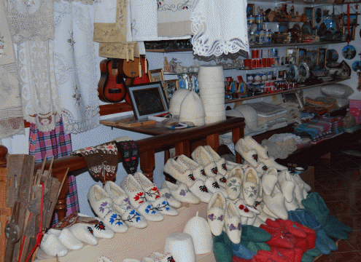
Felt making dates to the 1300s in Albania! Today, there are still people making shoes, hats, and other items from wool in the traditional practice.

Slide 2
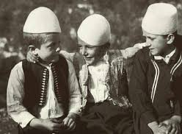
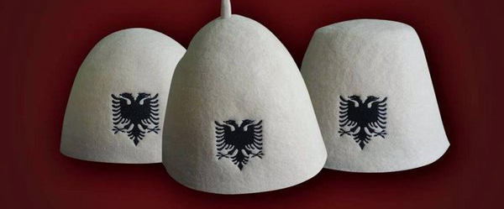
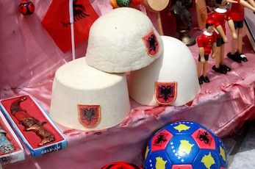
The qeleshe is a traditional Albanian cap made from felt. Today we will be making a qeleshe with a flat top!

