Slide 1
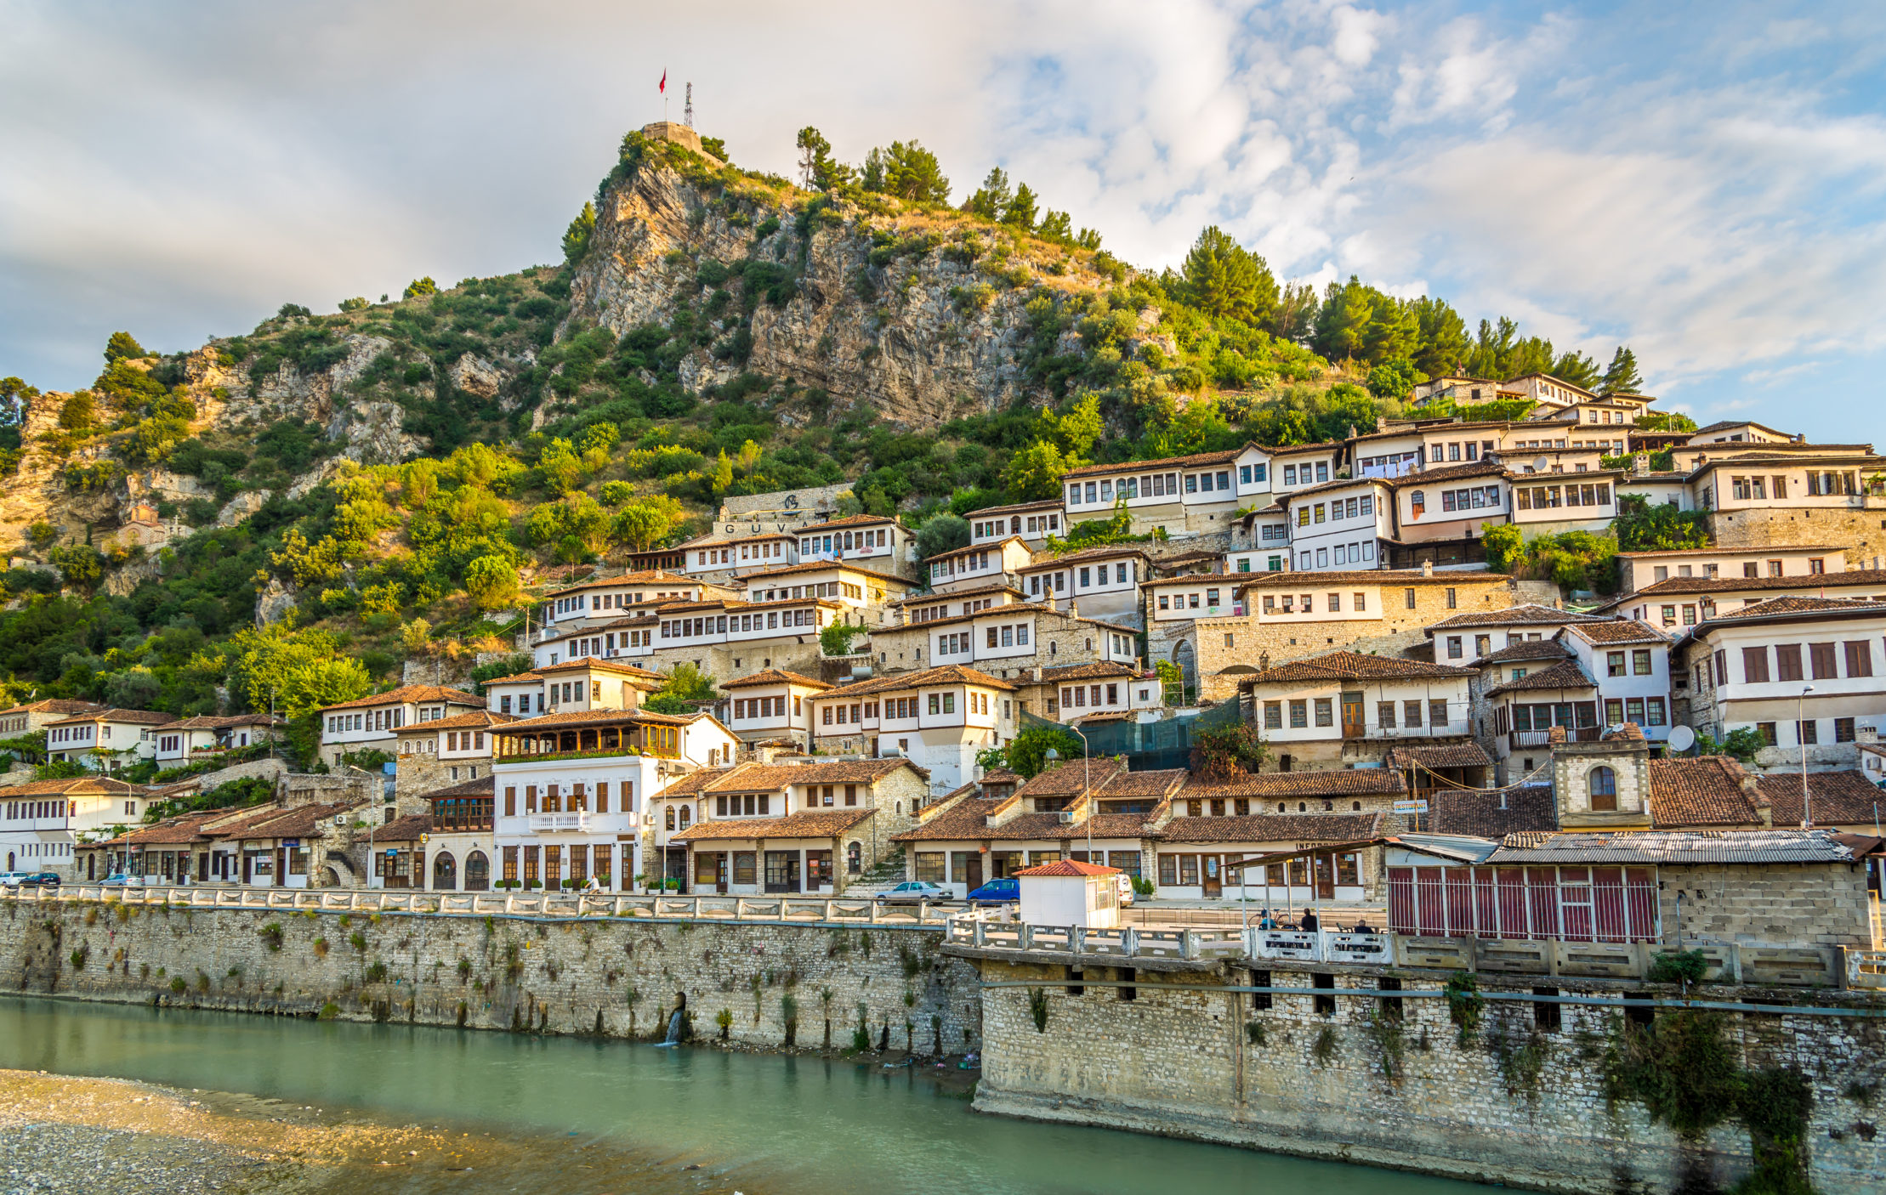
Albania
Albania

Slide 2
Notes:
Albania is located in south eastern Europe on the Adriatic Sea.

Slide 3
Notes:
Albania is bordered by Montenegro, Kosovo, North Macedonia, and Greece.

Slide 4
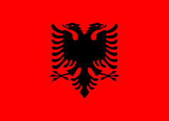
Notes:
This is the Albanian flag. The red stands for bravery, and strength, and the eagle represents independence. This is the flag Albania used in their fight to gain independence from the Ottoman Empire.

Slide 5
How to say…
Hello…Përshëndetje
Goodbye…
My name is…Unë quhem

Slide 6
Notes:
This is Tirana, the capital of Albania.

Slide 7
Notes:
Albania has a diverse landscape including mountains.

Slide 8
Notes:
And beautiful beaches!

Slide 9
Albanian Independence Day
Notes:
Albania celebrates their Independence Day on November 28. This photo is of a parade that happened on the 100 year anniversary of Albanian independence from the Ottoman Empire.

Slide 10
Byrek
Notes:
A traditional Albanian pastry dish that can be filled with cheese, veggies, or meat

Slide 11
Notes:
Traditional Albanian dress

Slide 12
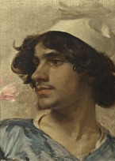
Qeleshe
Notes:
A traditional cap that men wear in Albania

Slide 13
Notes:
These caps have been a part of Albanian culture for a long time.

