Slide 1
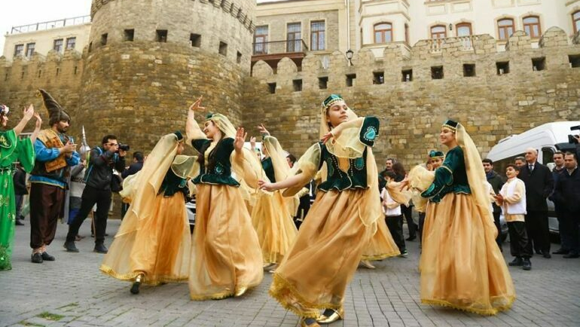
Azerbaijan

Slide 4
At a Glance
Population: 10,212,000
Capital: Baku
Language: Azerbaijani/Azeri
Currency: Azerbaijani Manat

Slide 5
Notes:
The blue color of the national flag of the Republic of Azerbaijan has the meaning of Turkic origin of the Azerbaijani people, red color reflects the desire to establish a modern society, and develop democracy, and the green color shows belonging to the Islamic civilization.

Slide 6
How to say…..
Hello...Salam (Sah-lahm)
Goodbye…Helekik (He-le-lich)
Thank you…Sag ol (Sa-ol)
You’re welcome…Buyur (Bu-yur)

Slide 7
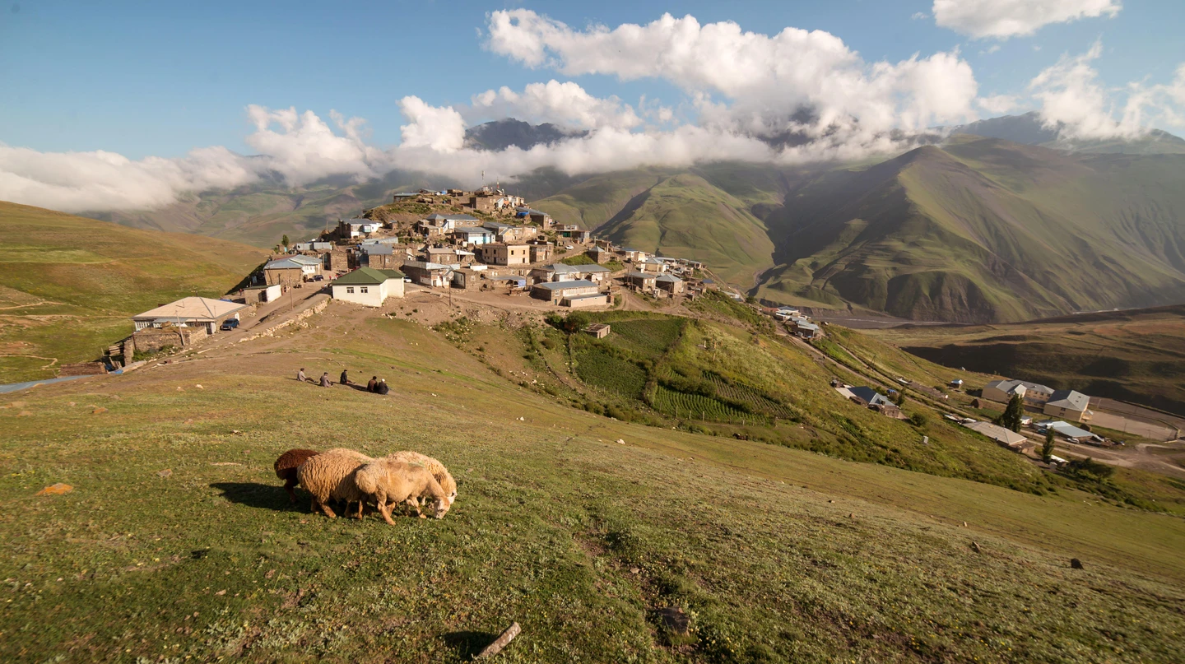
Khinalug
Notes:
The remote village of Khinalug is one of the highest settlements in Europe.

Slide 8
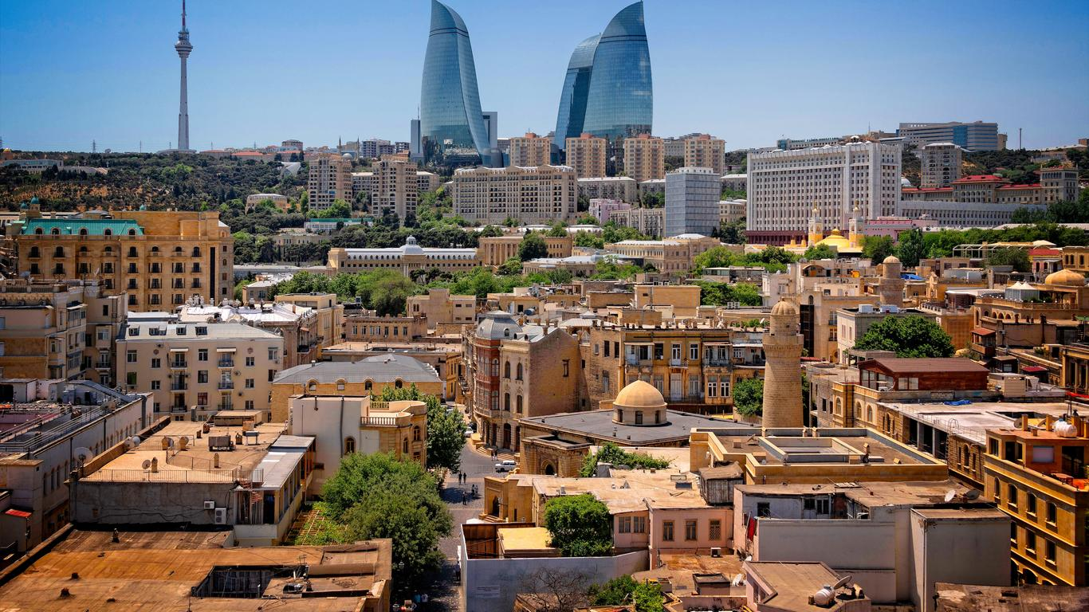
Capital: Baku
Notes:
Baku is one of the most beautiful places in Azerbaijan on account of its modern city centre and historical old town.

Slide 9
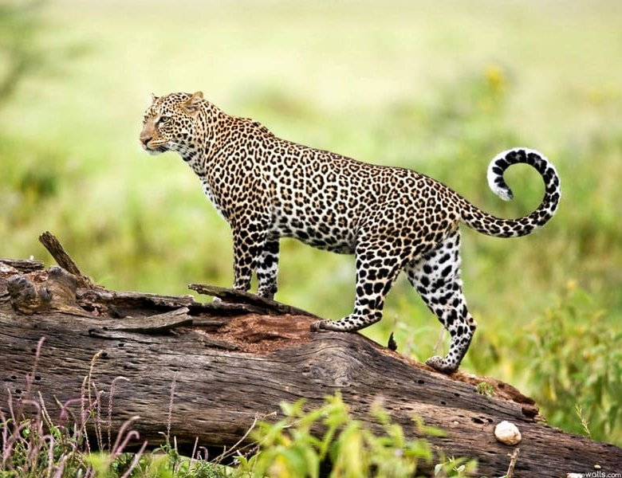
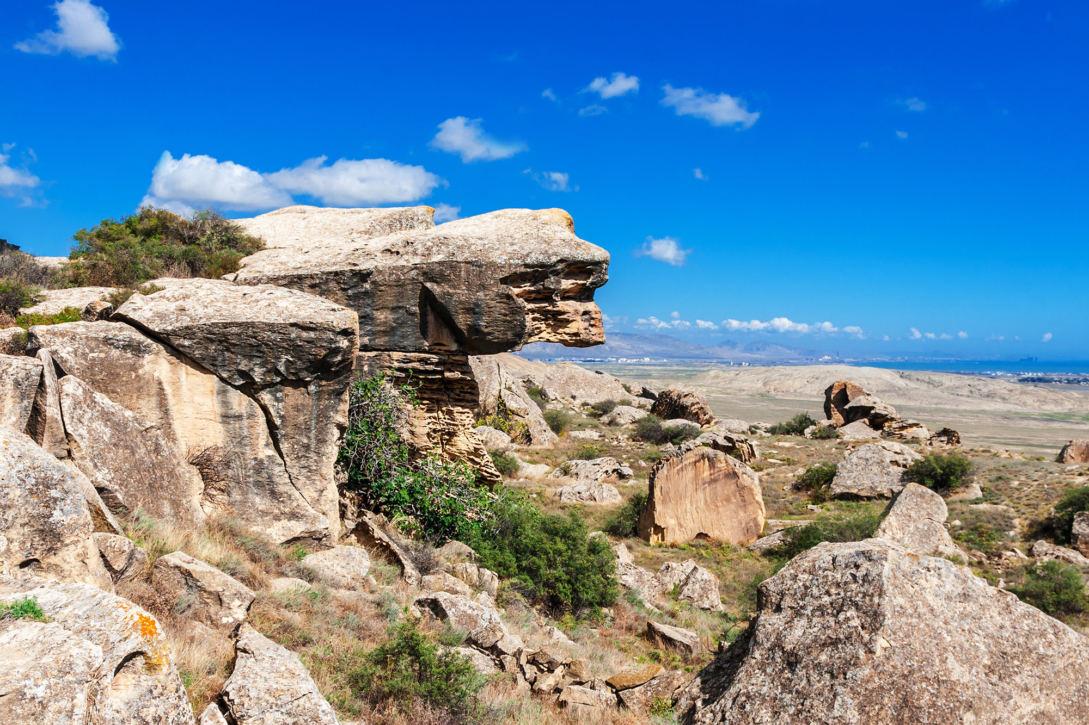
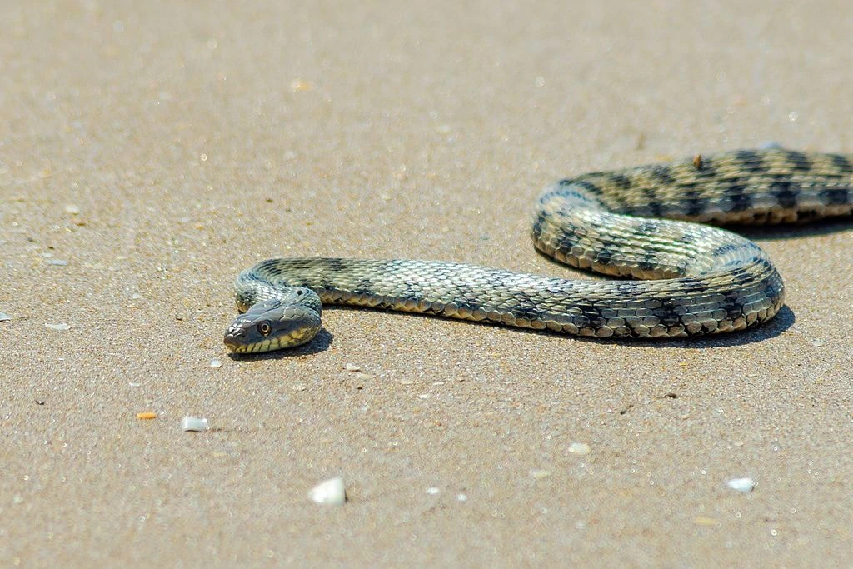
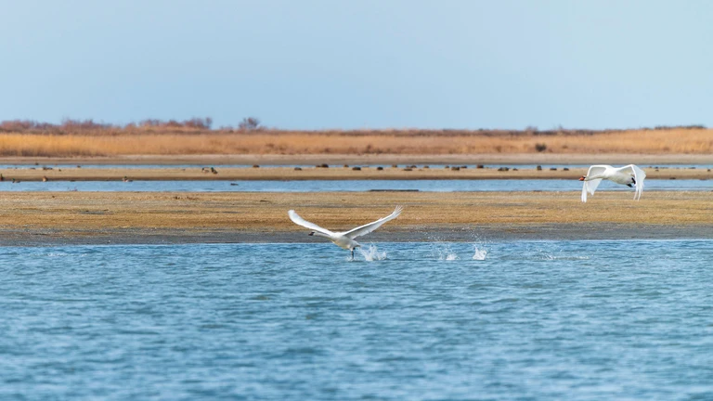
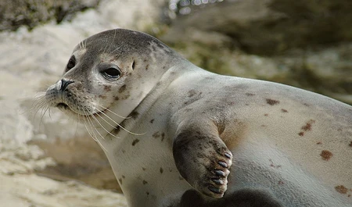
Absheron National Park
Notes:
Just over 60km (37mi) east of Baku sits Absheron National Park, whose arid plains caused by the semi-desert climate cover almost 2,000 acres (809ha). Stand inside and marvel at the rolling dunes against the clear, unpolluted waters of the Caspian. However, the mesmerising landscapes aren’t the main attraction. More than 50 species of animals call the steppes home, including the endangered Caspian seal and comb jellyfish, as well as gazelles, badgers and jackals.

Slide 10
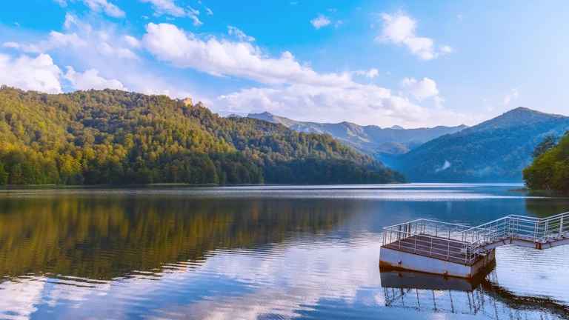
Lake Goygol
Notes:
Lake Goygol is one of the most beautiful places in Azerbaijan. The name means the Blue Lake, and it sits in the Murovdag foothills. Formed after an earthquake almost 1,000 years ago, Goygol has become a favourite tourist destination near Ganja

Slide 11
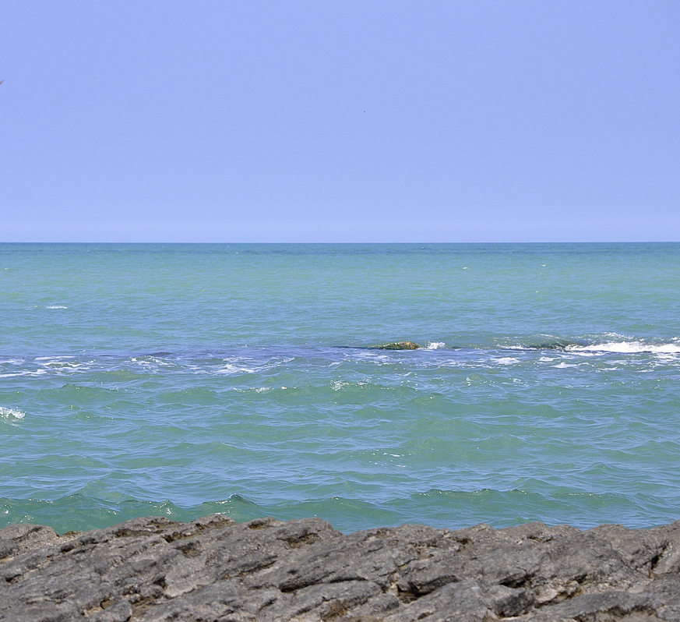
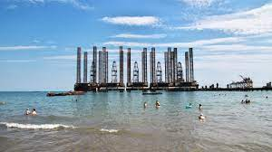
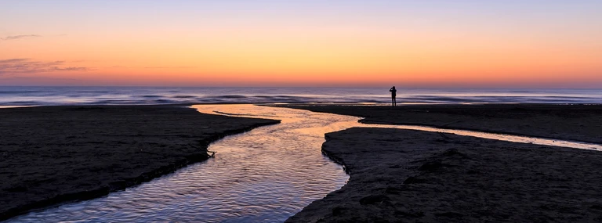
The Caspian Sea
Notes:
The Caspian Sea, the largest lake in the world, makes for one of the best places to visit in Azerbaijan. The Azerbaijani coastline stretches for more than 500km (310mi) from the southern border with Iran to Dagestan in the north. Despite some of the coast and beaches near Baku suffering from pollution, you can find beautiful resorts in Sumgait in the northern part of the Absheron Peninsula. Lankaran, four hours south of Baku, near the Iranian border, has some nice resorts too.

Slide 12
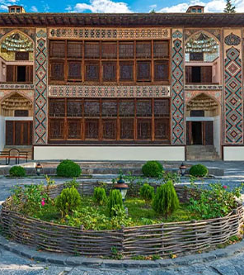
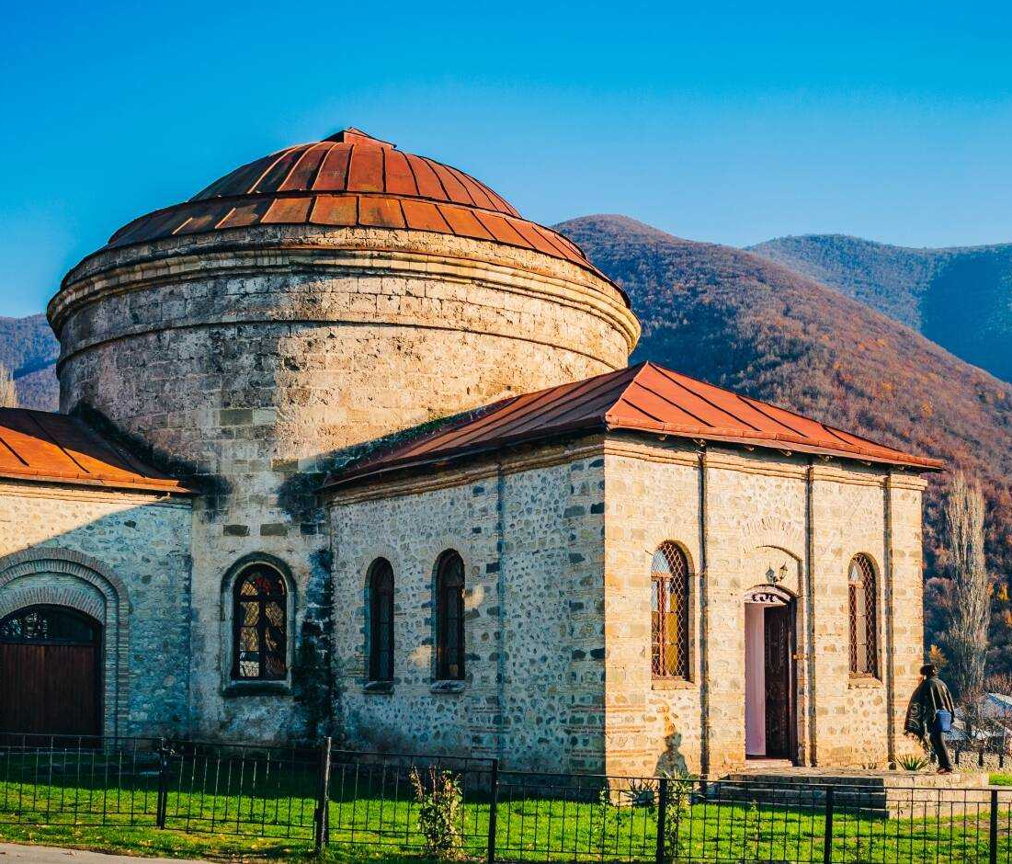
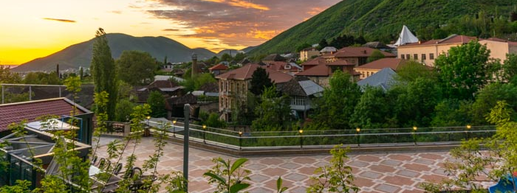
Sheki
Notes:
Nestled at the foot of the southern Greater Caucasus Mountains is a place called Sheki. The town of 60,000 people dates back 2,500 years, making it one of the oldest Caucasus settlements. Sheki’s claim to fame for millennia was silk, textiles and embroidery, which made it a significant point on the Silk Road. Today, the historical region with ancient mosques, castles and the 18th-century Palace of Sheki Khans forms the foreground against the majestic green mountains.

Slide 13
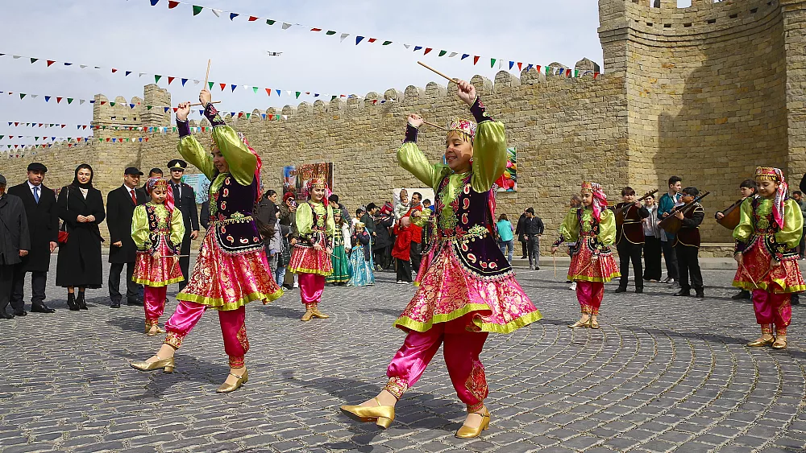
Novruz
Notes:
Novruz, which means “new day,” is celebrated on March 21, the date of the vernal equinox considered the end of winter and start of spring. The holiday is more than 3,000 years old. Nowruz later spread across the vibrant trade routes of the Silk Road, and along the way incorporated new "new social, religious and cultural influences.” It's now celebrated by a wide array of ethnicities and religious groups in countries beyond Iran, including India, Afghanistan, Turkey and Pakistan.

Slide 14
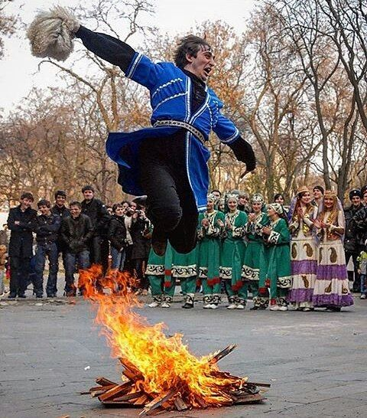
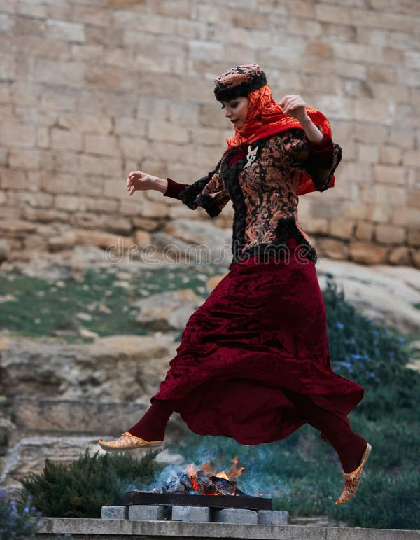
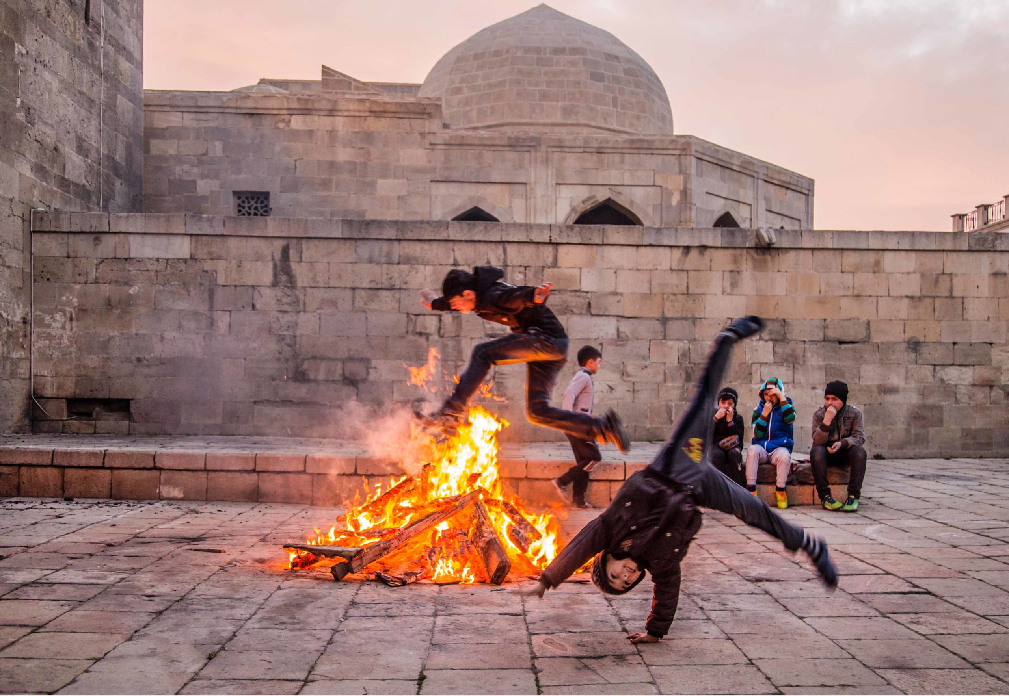

Slide 15
Notes:
Nature starts to wake in Novruz and Azerbaijan people demonstratively celebrate it a month ago. On Tuesdays, we celebrate Su Charshabnasi (water — Tuesday), Odlu Charshanba (fire— Tuesday), Torpag Charshanba (land — Tuesday) and Akhir Charshanba (final or wind — Tuesday). According to the folk belief water in the first Tuesday purifies and stirs, fire on the second Tuesday, land on the third Tuesday and wind on the fourth Tuesday awaken nature, the trees begin to blossom; all this symbolize spring's coming.
The second Charshanba relates to the element of fire. It is believed that the action of jumping over bonfires and lighting candles renews a person and purges them of illness, allowing them to start the spring with positivity.
Moreover, cultivation of a Semeni which is a small plant grown up from the malt is one of the main symbols of the Novruz, which represents the refreshment of the earth. The process of cultivation starts from the first week and ends up at the last week that is Novruz day. According to the ancient belief, if semeni grows well, then the year will be productive.

Slide 16
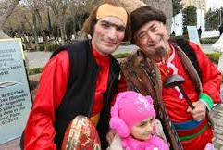
Kosa and Kecel
Notes:
One especially notable portion of the festival is the traditional comedic performance of the story of Kosa and Kecel – permanent characters in the holiday narrative. These personas and their fighting represent the conflict between Winter and Spring. At the end of the ceremony, Kecel wins the duel, indicating the victory of Spring over Winter.

Slide 17
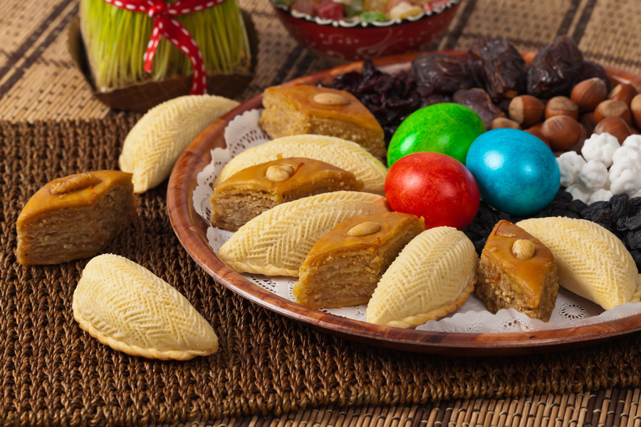
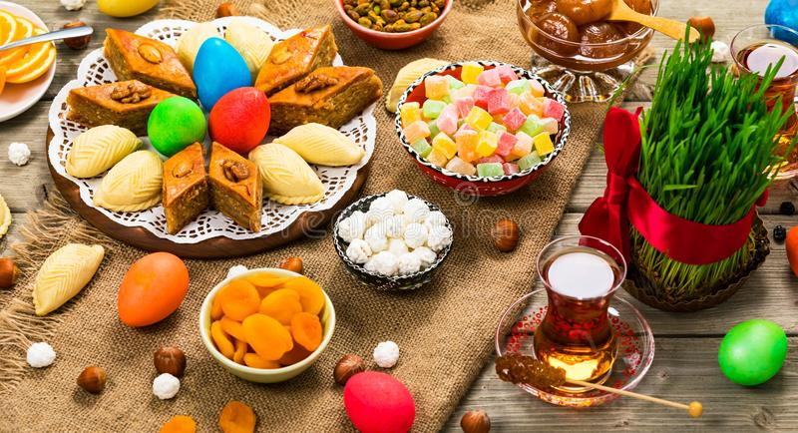
Notes:
The holiday table on this day is very special. It is essential on this day to have seven dishes whose names begin with the letter "s". Except for the listed dishes there should be a mirror, a candle and a painted egg on the table. All these have a symbolical significance: a candle means light or fire protecting a person from evil spirits. An egg and a mirror are symbolizing the end of the old year and beginning of the first day of the new. Azerbaijanis put the painted egg on the mirror. As soon as the egg moves the New Year begins. Everyone sitting at the table starts wishing a happy new year to each other.
Make a wish on the first day of Novruz, and stay awake until sunrise. If you can welcome the morning without having fallen asleep, your wish will come true within the next five years.

Slide 18
Semeni
Notes:
Moreover, cultivation of a Semeni which is a small plant grown up from the malt is one of the main symbols of the Novruz, which represents the refreshment of the earth. The process of cultivation starts from the first week and ends up at the last week that is Novruz day. According to the ancient belief, if semeni grows well, then the year will be productive.

Slide 19
Notes:
Novruz – a time when families are gathered at their homes and make wishes for divine blessings and abundance in the coming year. The last day of the old year is considered a special feast by Azerbaijanis. On the Novruz holiday eve entire family gather at home. On the last night of the old year all family members spray each other with water before going to bed "to wash off" all hardships of the old year.
Finally the holiday starts. Everyone puts on new clothes and begins partying. Nobody works on this day.

