Slide 1
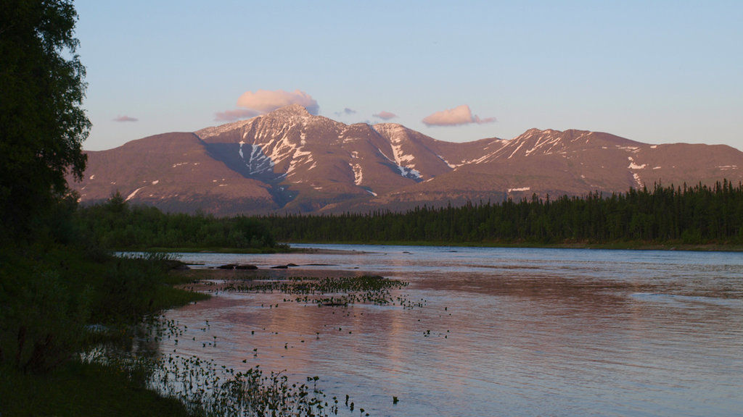
Komi Republic

Slide 2
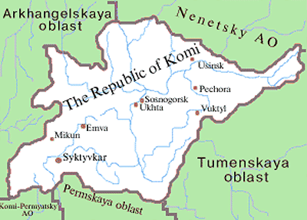
Notes:
The Komi Republic is not a country, but a northern region of Russia!

Slide 3
Notes:
This is the flag of the Komi Republic. The blue represents the sky, the green represents the earth, and the white represents the snow.

Slide 4
Notes:
Syktyvkar is the capital of the Komi Republic. Only 235,000 people live here.

Slide 5
Notes:
In the winter, the Komi Republic is covered in snow and looks like a Winter Wonderland!

Slide 6
Notes:
Komi women in Komi traditional dress

Slide 7
Notes:
Komi traditional dish (fish pie)

Slide 8
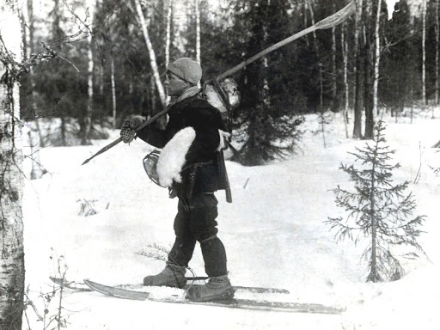
Notes:
Komi people use skis to get around in the snow. Komi people traditionally hunt elk to eat for food and use other parts of the elk for tools and material goods.

Slide 9
Notes:
Young Komi elk hunters

Slide 10
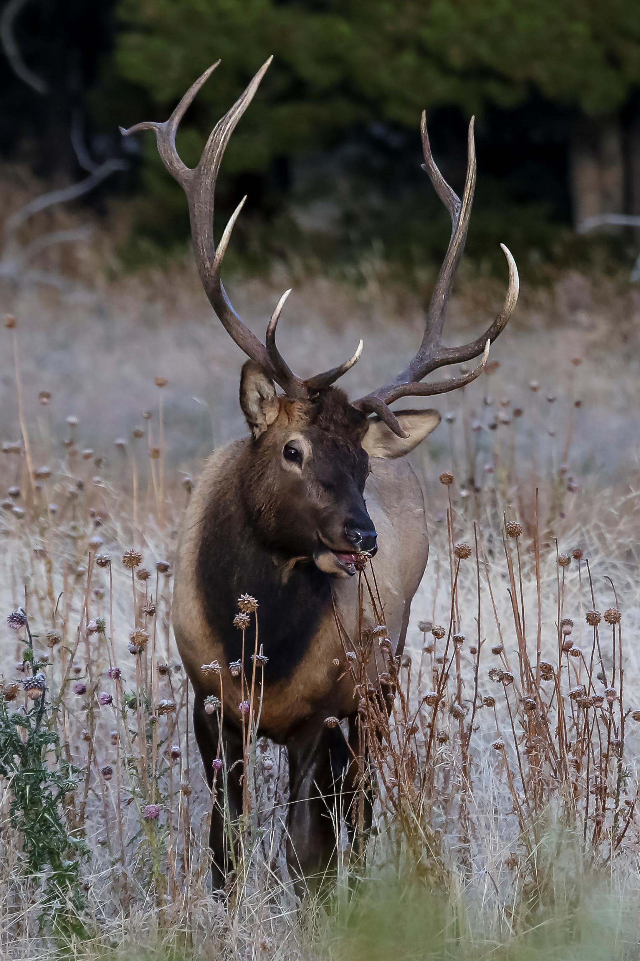
Notes:
This is an elk and the Komi Sun Elk. The Sun Elk is a Komi deity. They believe the Sun Elk represents the good in the world.

Slide 11
Notes:
There is one folktale of the Sun Elk where she runs across the night sky away from a hunter, but he can never catch her because she is a goddess.

