Slide 1
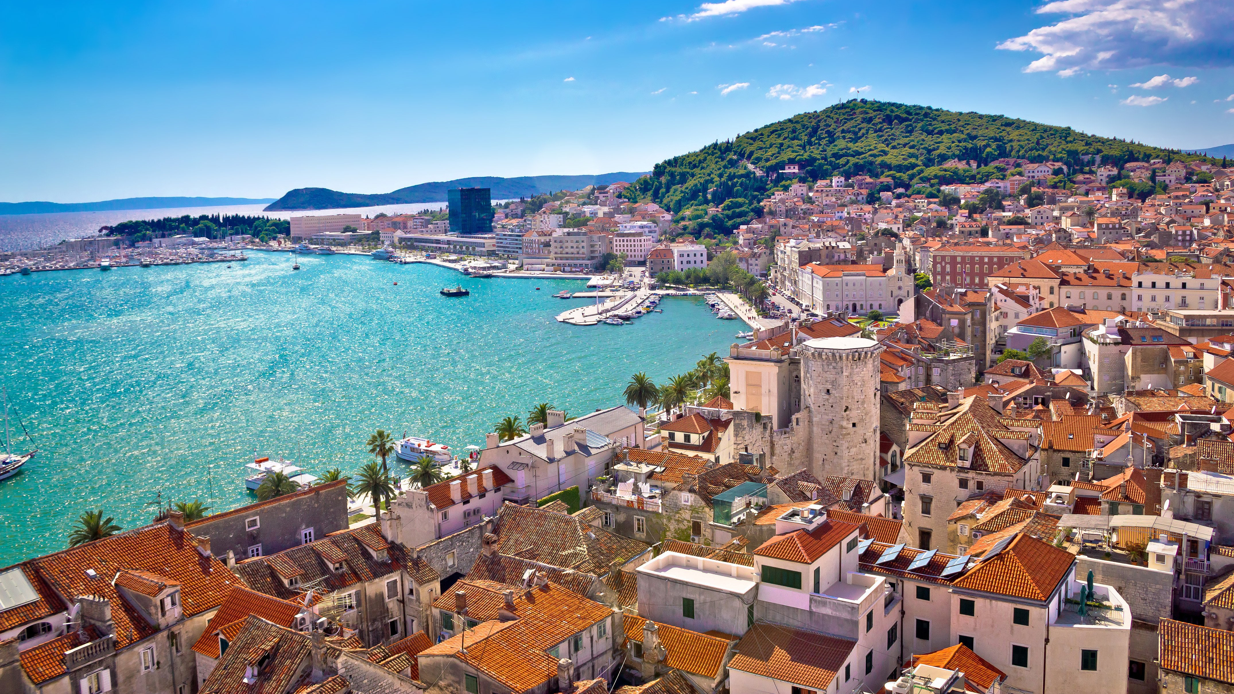
CROATIA

Slide 2
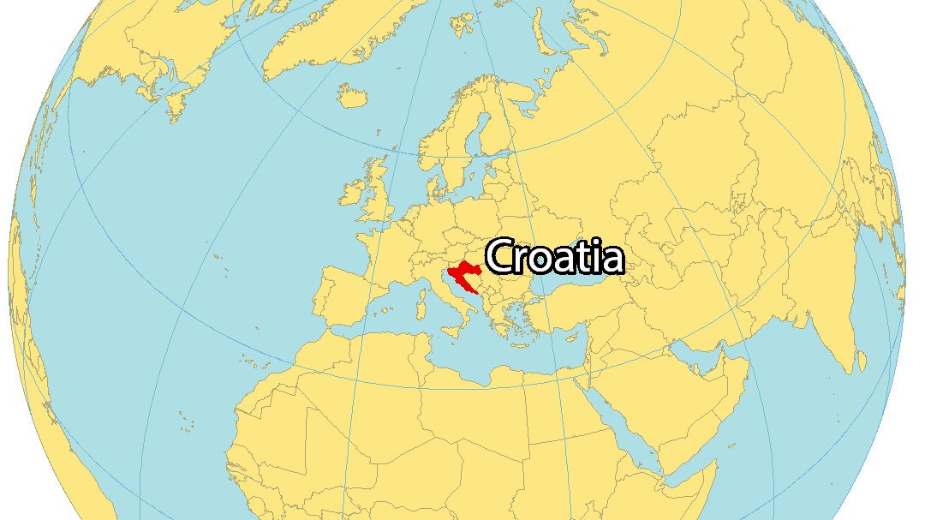
Notes:
Here is a map of the world. Croatia is the red highlighted country. Point out where you are located compared to Croatia.

Slide 3
Notes:
A closer map of Croatia. Bordered by Austria, Hungary, Serbia, and Bosnia.

Slide 4
Notes:
Croatian Flag

Slide 5
Croatian phrases
Hello….. Zdravo
Goodbye…Doviđenja
My name is…… Moje ime je

Slide 6
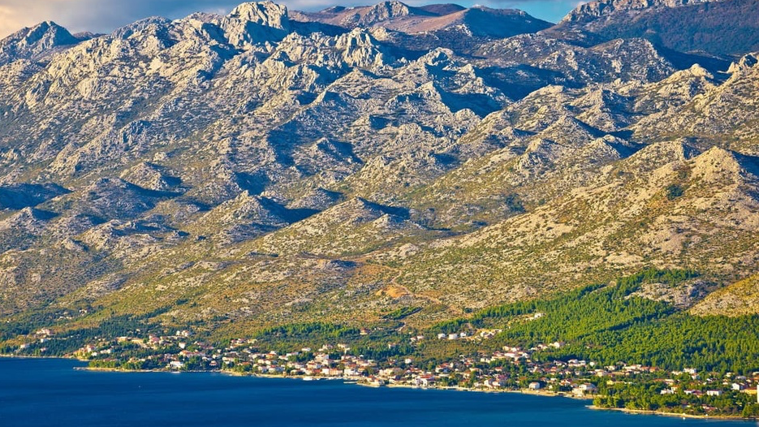
Dinaric alps
Notes:
Famous mountain range in Croatia

Slide 7
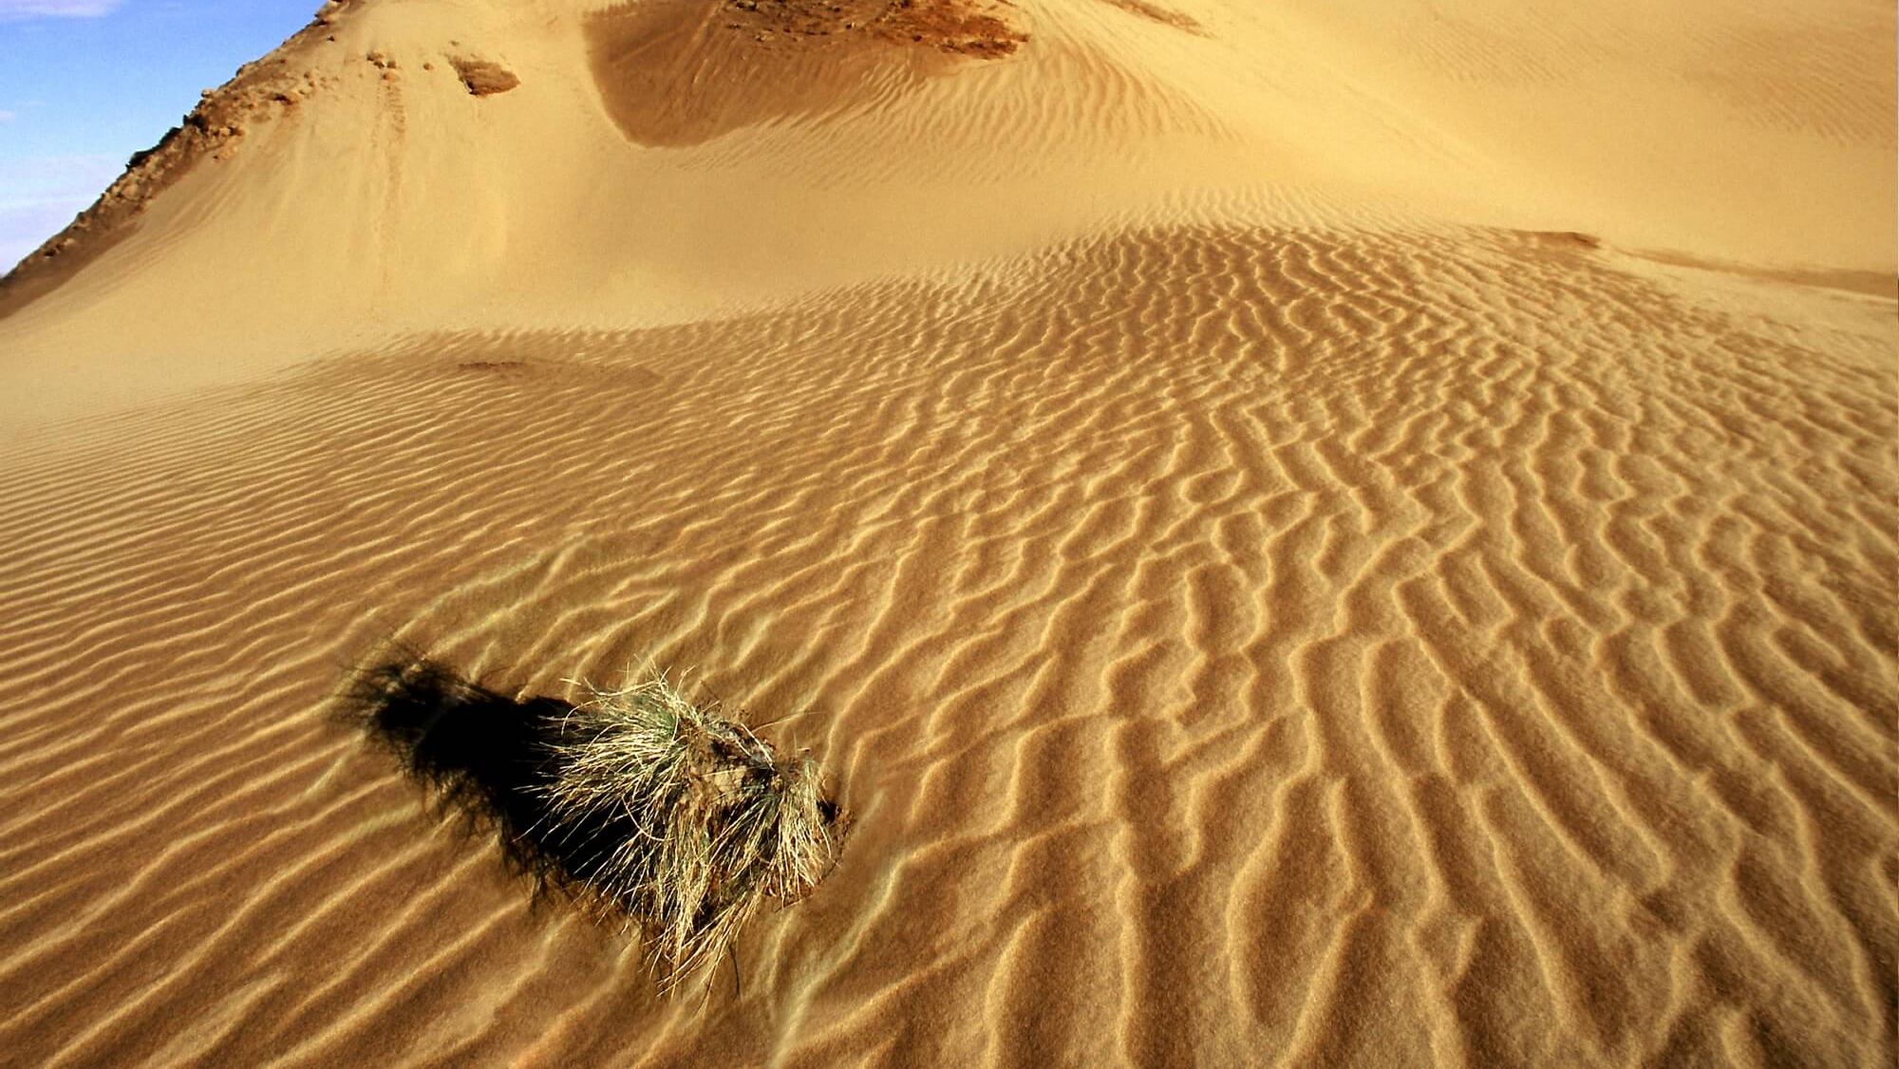
Đurđevački pijesci
Notes:
The only desert in Croatia

Slide 8
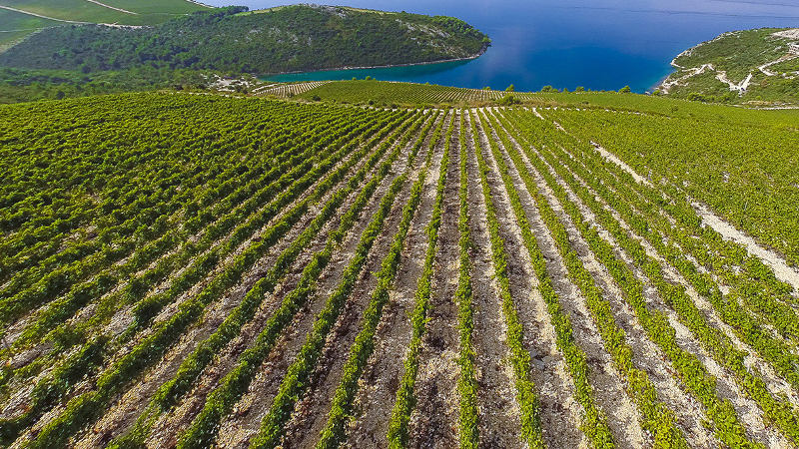
Vinogradi Volarević
Notes:
A wine vineyard region in Croatia

Slide 9
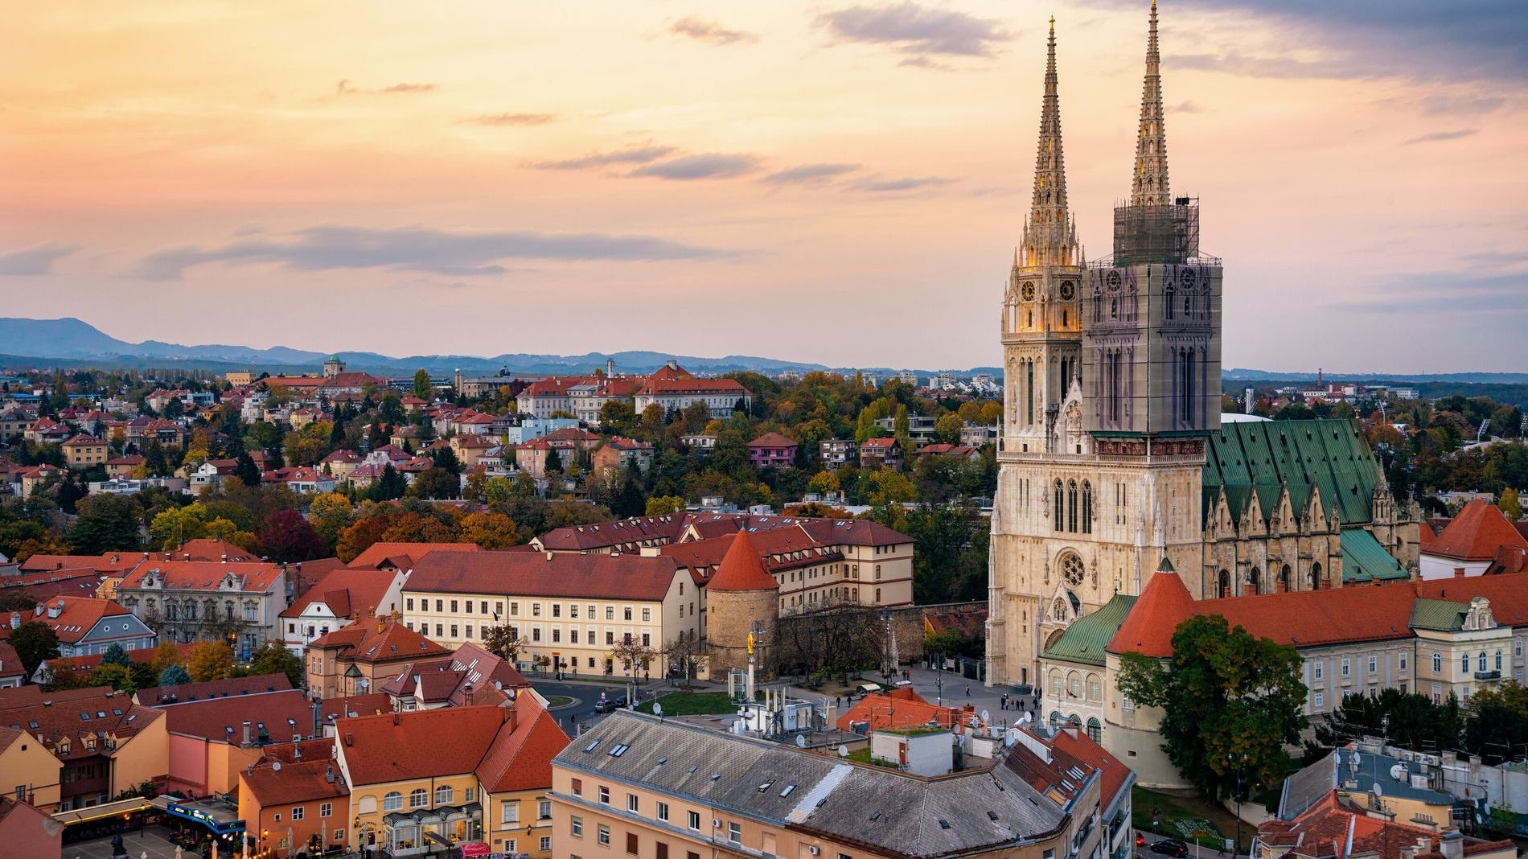
Zagreb
Notes:
The capital city of Croatia

Slide 10
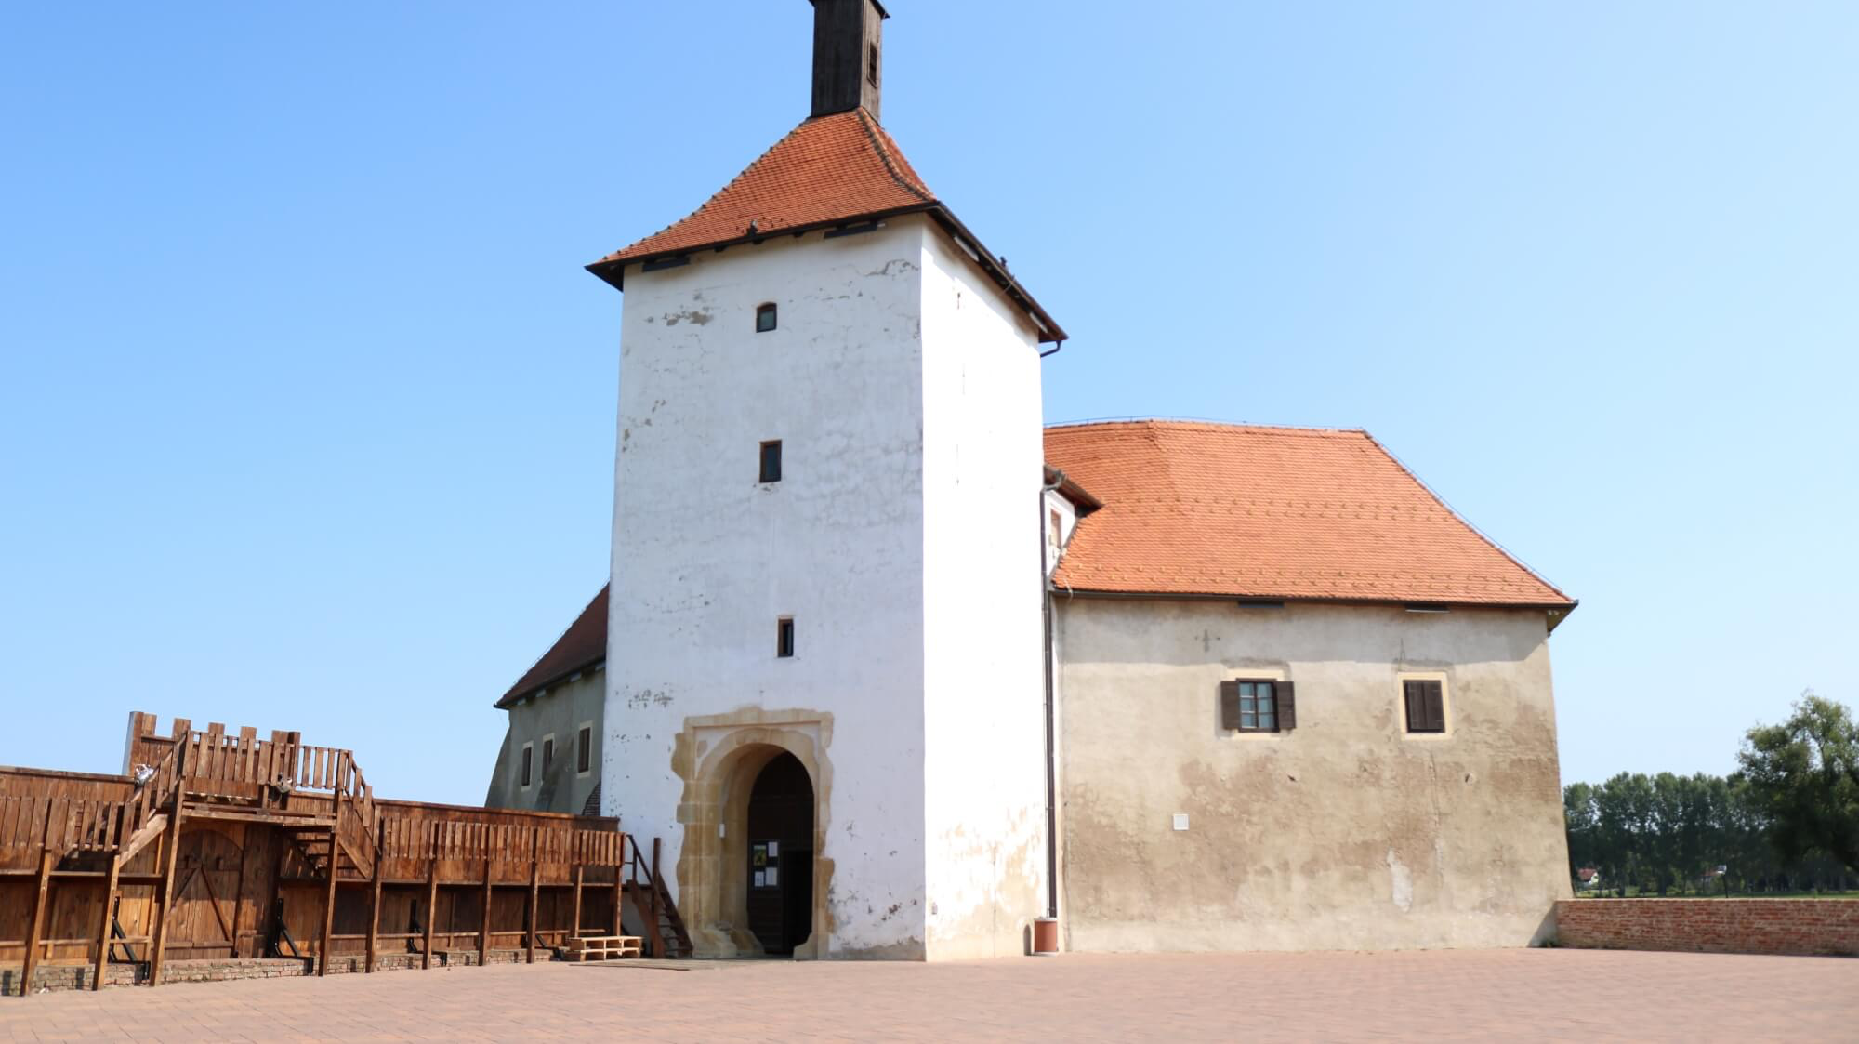
Old Town Đurđevač
Notes:
An old fort with a story. The Ottomans tried to siege this fort, but the fort inhabitants were strong. The Ottomans were staking out the fort and hoping they would run out of food. The fort only had one chicken left and decided to throw it over the fort wall. The Ottomans saw this act and believed that the fort had so much food because they had a chicken to spare. Then they left and this fort is nicknamed chicken because of this.

Slide 11
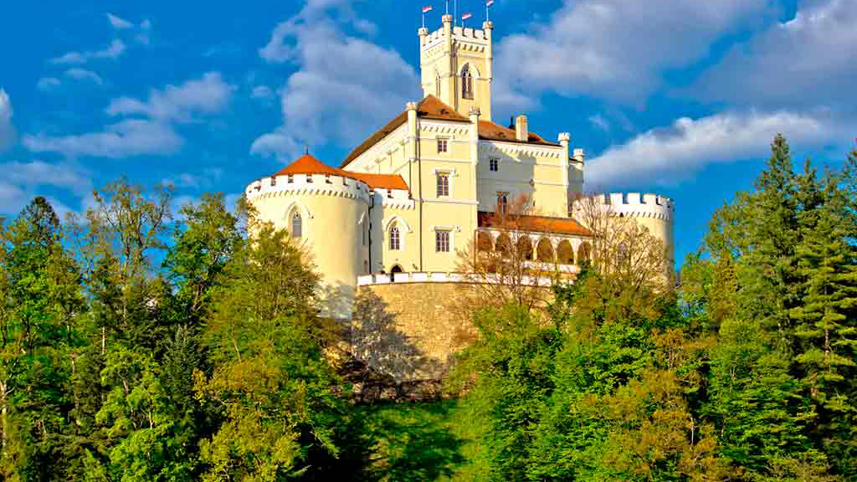
Trakoscan Castle
Notes:
Croatia is famous for having many old castles, like this one which is a national symbol

Slide 12
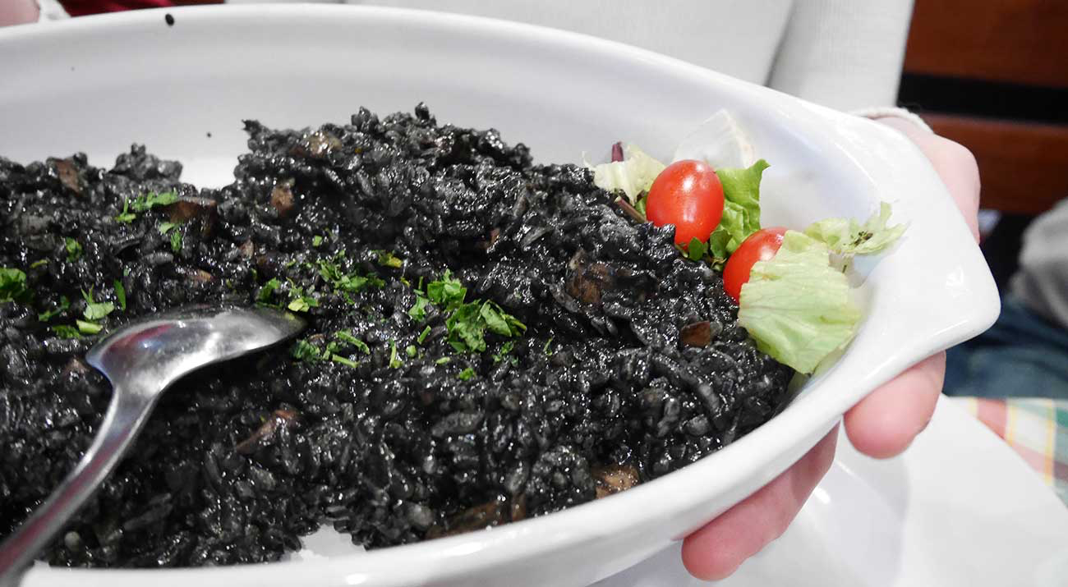
crni rizot (black risotto)
Notes:
This is a famous Croatian dish. It is a pasta with black ink from a squid in it.

Slide 13
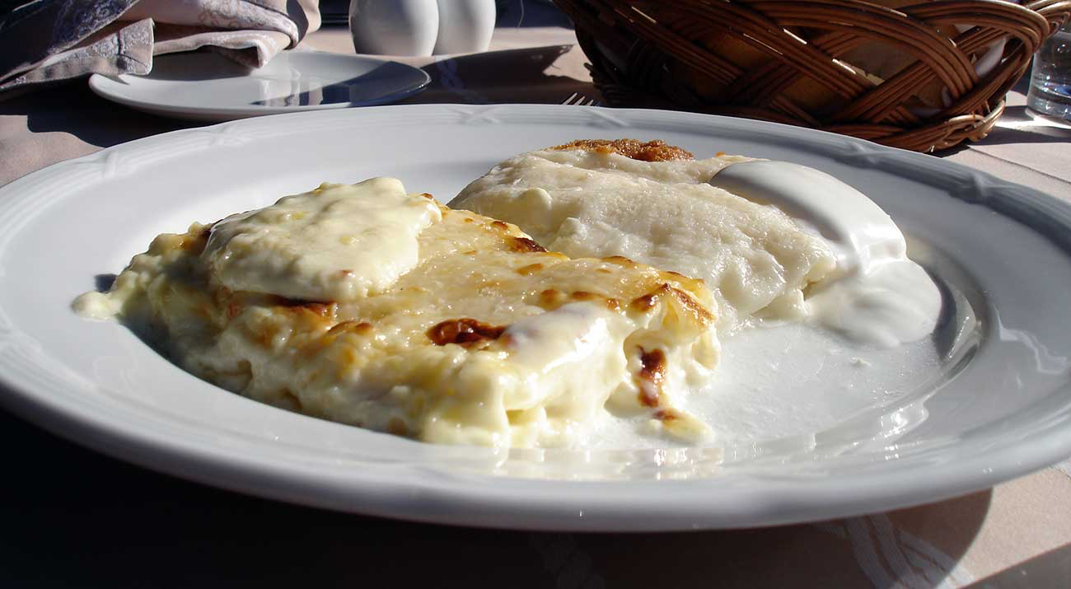
STRUKLI
Notes:
This is a famous Croatian pastry.

Slide 14
Traditional Croatian dress
Notes:
This is what Croatian women wear on festivals or holidays to celebrate their culture.

Slide 15
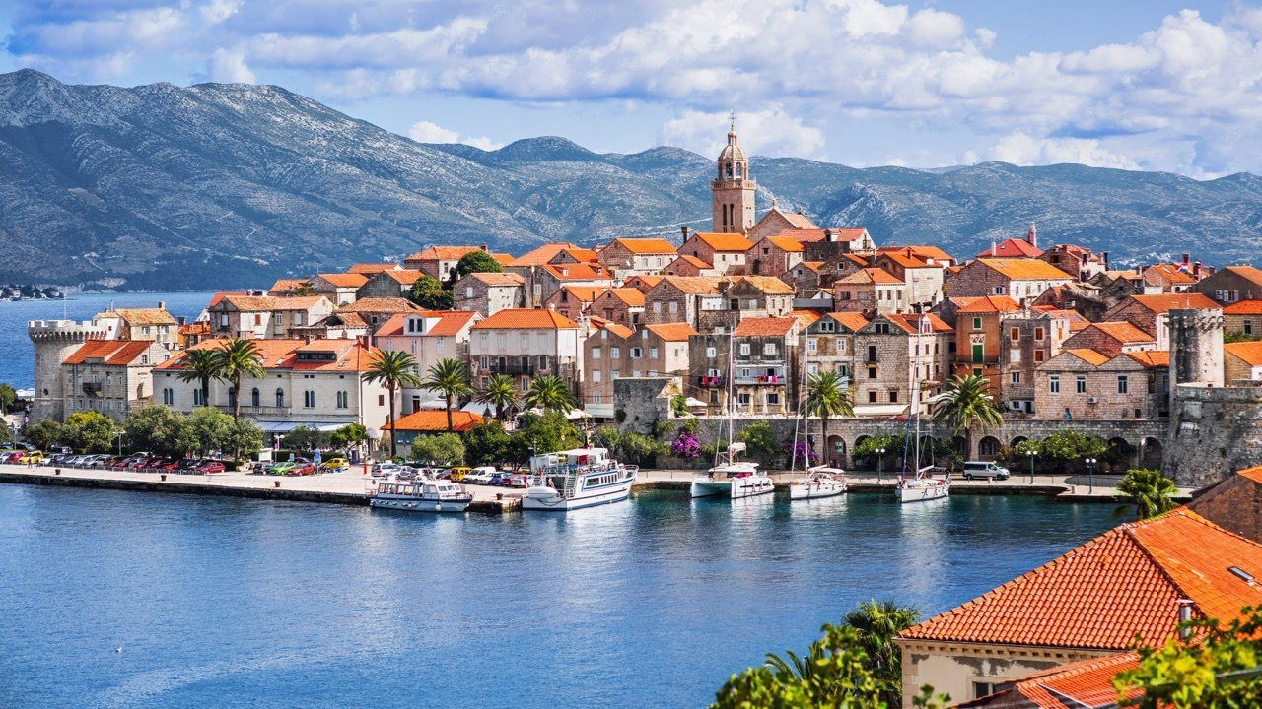
Korčula
Notes:
A small coastal island in Croatia

Slide 16
Moreška
Notes:
A old traditional sword dance on the island that can only be performed by people who were born on the island

Slide 17
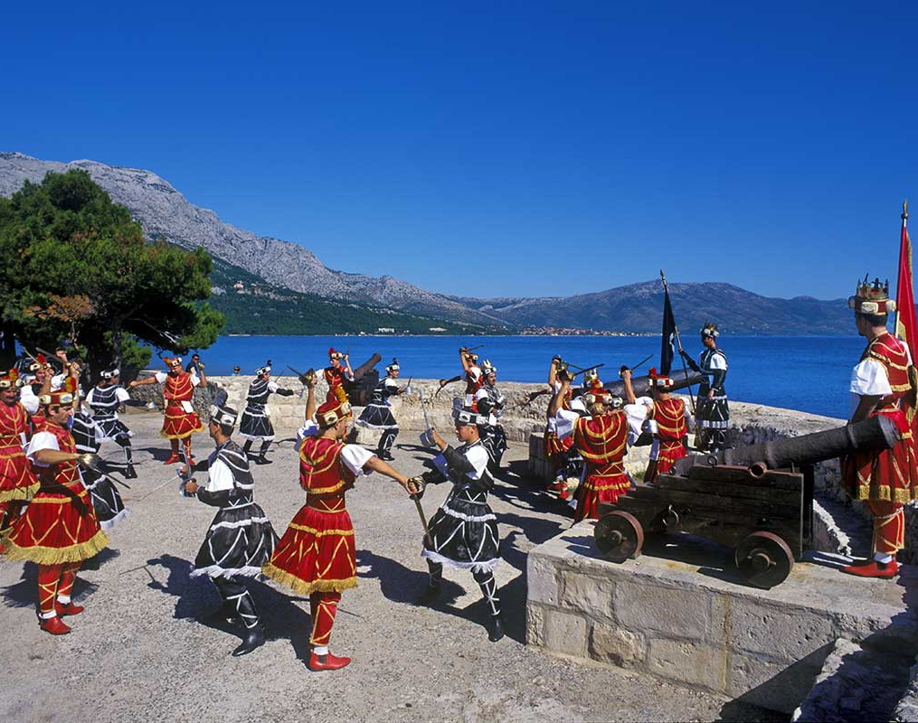
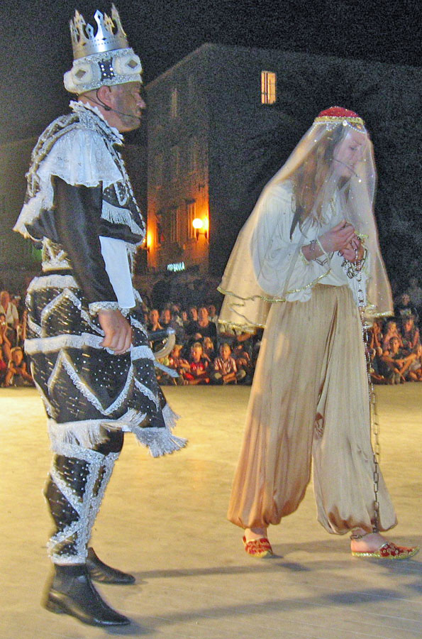

Slide 18
Martens
Notes:
National animal of croatia

Slide 19
Notes:
Craft of marten

