Slide 1
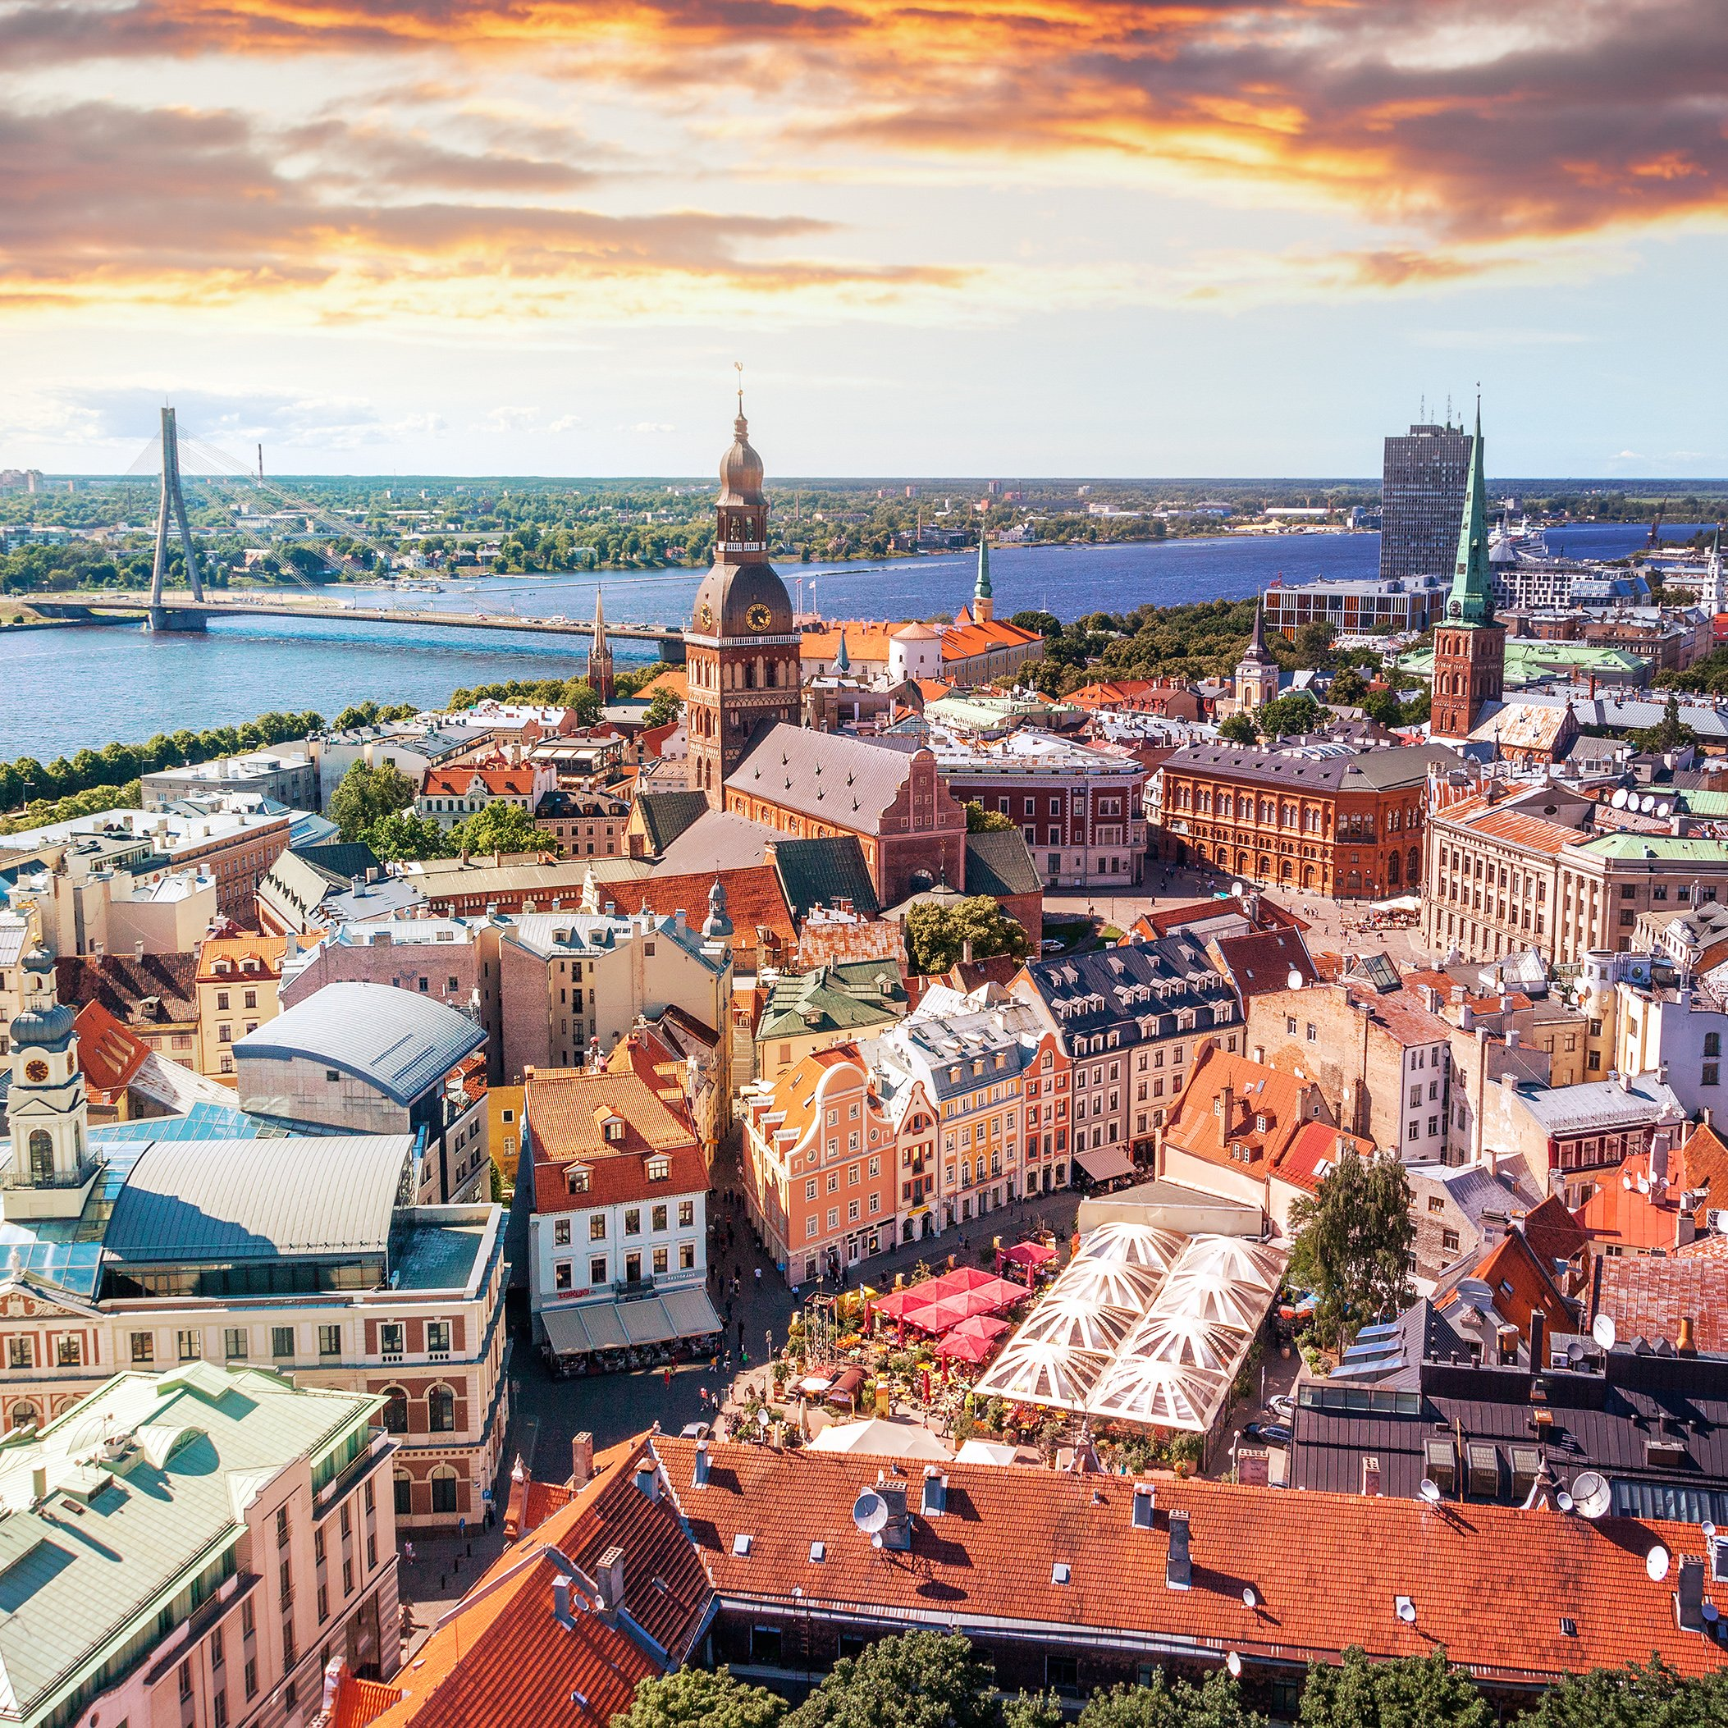
Latvia
Notes:
This is a photo from the capital of Latvia, Riga.

Slide 2
Notes:
Latvia is located in North Eastern Europe. It is on the Baltic Sea and a part of the Baltic Region.

Slide 3
Notes:
This is the flag of Latvia. It is one of the three oldest flags in the world. It dates back to 1279, even though Latvia didn’t officially become an independent state until 1918. The red in the flag represents Latvian’s pride in their freedom and readiness to defend their country.

Slide 4
How to say..
Hello….. Sveiki
Goodbye…… Ardievu
Notes:
How to say some words in Latvian

Slide 5
Notes:
This is one of the main squares in the capital, Riga. It has been used as a market since medieval times. It was destroyed during World War II and rebuilt to look like it did during medieval times.

Slide 6
Notes:
Latvia has a luscious landscape. Over half of Latvia is covered in forests, lakes, and rivers. This is a photo of the widest waterfall in Europe located in Latvia. It is called Venta Rapid. You can go here to see different fish jump over the rapids when swimming up stream in the Autumn and Spring.

Slide 7
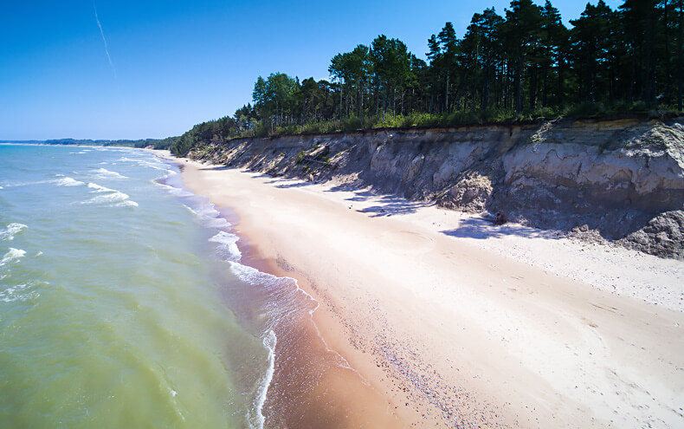
Latvia’s beaches
Notes:
Latvia has a huge coastline. It is on the Baltic Sea and the Gulf of Riga. Latvia is known for it’s beautiful beaches. People from all over Europe and Latvia take vacations to the Latvian beaches.

Slide 8
Notes:
Latvia is famous for it’s music. Latvians are known to be singers, dancers, and musicians. This is a photo of a Latvian folk band. Latvians also sing and dance at festivals.

Slide 9
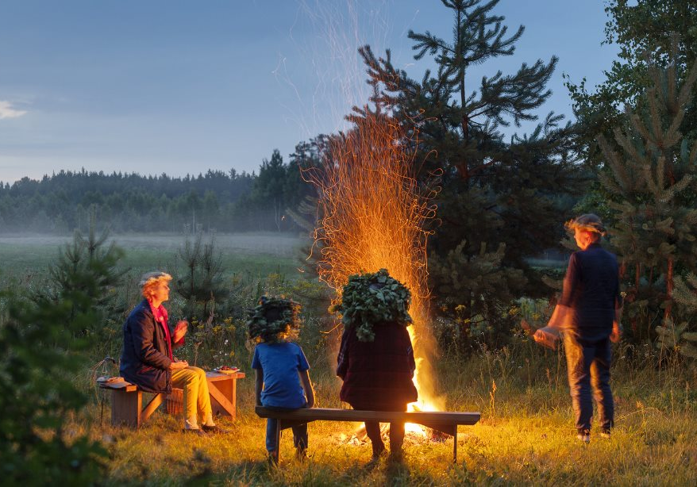
Jani
Notes:
One of the festivals that Latvians celebrate is called Jani. It is the Latvian Summer Solstice. Latvians will stay up all night to enjoy the longest day of the year. They will make flower crowns, wear them, and have feasts and bonfires.

Slide 10
Notes:
Now you get to make your own flower crowns to celebrate Jani!

