Slide 2
Notes:
Slovakia is located in Central Europe. It is a landlocked country. It is bordered by Poland, Czechia, Austria, Hungary, and Ukraine.

Slide 3
Notes:
This is the flag of Slovakia. The colors represent Slovakian harmony. The double cross represents Christianity and the honors the memory of saints.

Slide 4
Hello and Goodbye in Slovak
Hello…Ahoj
Goodbye…Zbohom

Slide 5
Notes:
This is a photo of the capital of Slovakia, Bratislava. Slovakia has not been an independent country for very long, but the Slovak people have identified as Slovak for a very long time.

Slide 6
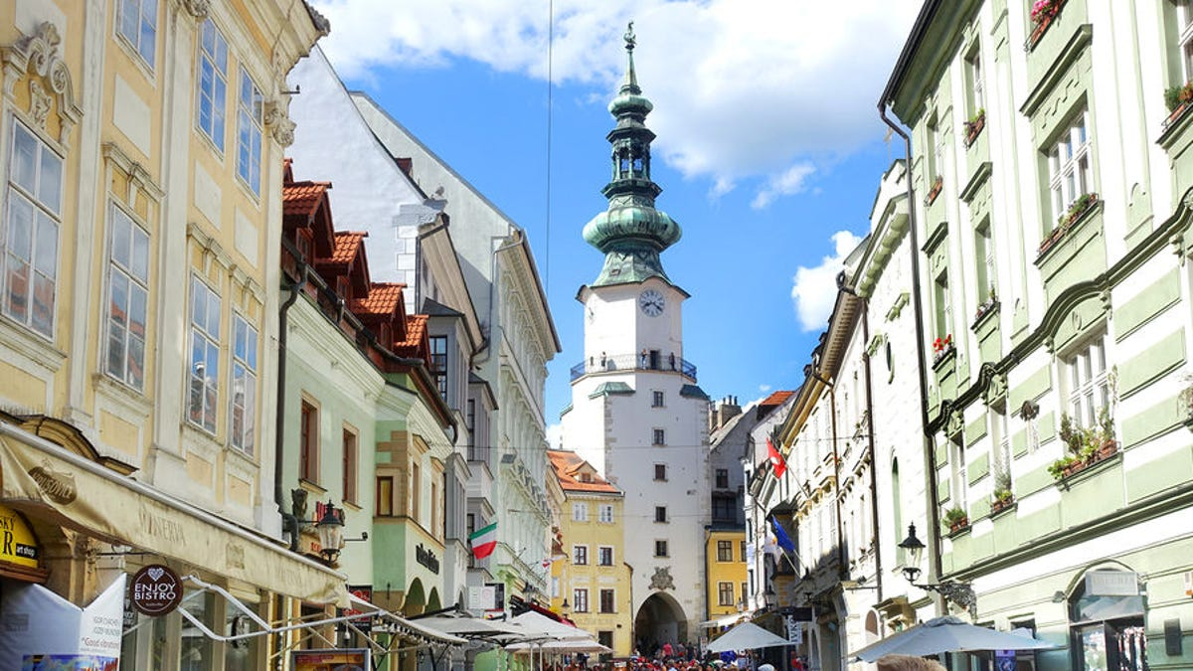
Notes:
This is a street in Bratislava and St. Martin’s Cathedral, one of the main symbols of the city.

Slide 7
Notes:
This is Bratislava Castle. It was built in the 9th century and today it is a museum.

Slide 8
Notes:
Traditional Slovak Clothes

Slide 9
Notes:
Traditional Slovak Dishes

Slide 10
Notes:
The Tatra Mountain Range in Slovakia

Slide 11
Notes:
There is a Slovak Folktale set in these mountains. It is called The Twelve Months. It is about a girl that lives with her step mother and step sister in a cottage in the mountains. Her step mother sends her out in the winter to retrieve strawberries, apples, and violets for her step sister as a gift. The girl finds twelve spirits that represent each of the months around a fire. She tells them about her impossible task and they give her what she needs. Her step mother and step sister set out to find the twelve spirits themselves, but never find them and instead get lost in the snow. The girl lives in the cottage in peace without her evil step mother and step sister.

Slide 12
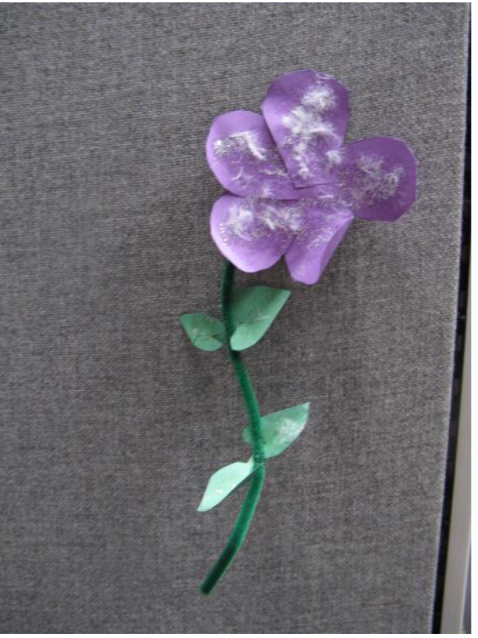
Notes:
An example of the violet flower craft with hints of snow on it.

