Slide 1
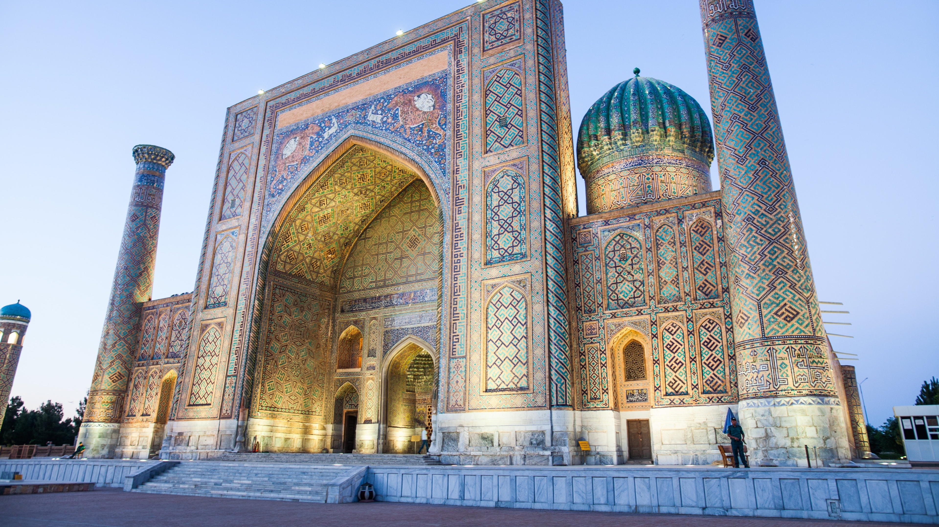
Uzbekistan
Notes:
https://www.expedia.com/Uzbekistan.dx11412?pwaDialog=mediaGallery

Slide 2
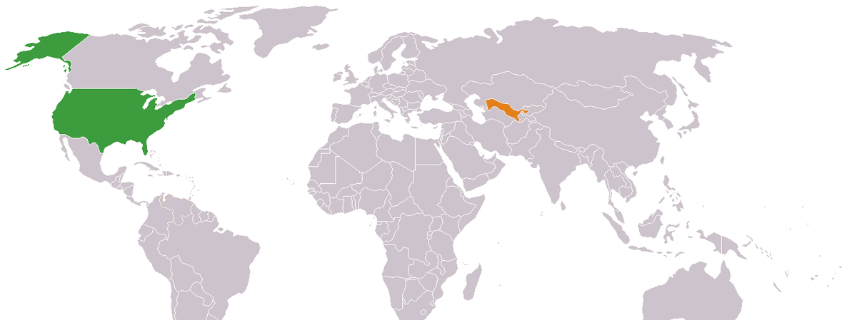
Notes:
This is a map of the world, with the United States (where we live) highlighted in green, and Uzbekistan in orange. You can see how far away the two countries are. They are almost seven thousand miles apart!

Slide 3
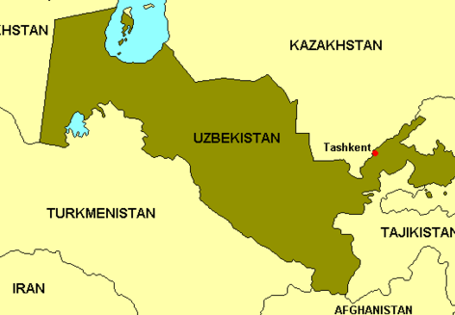
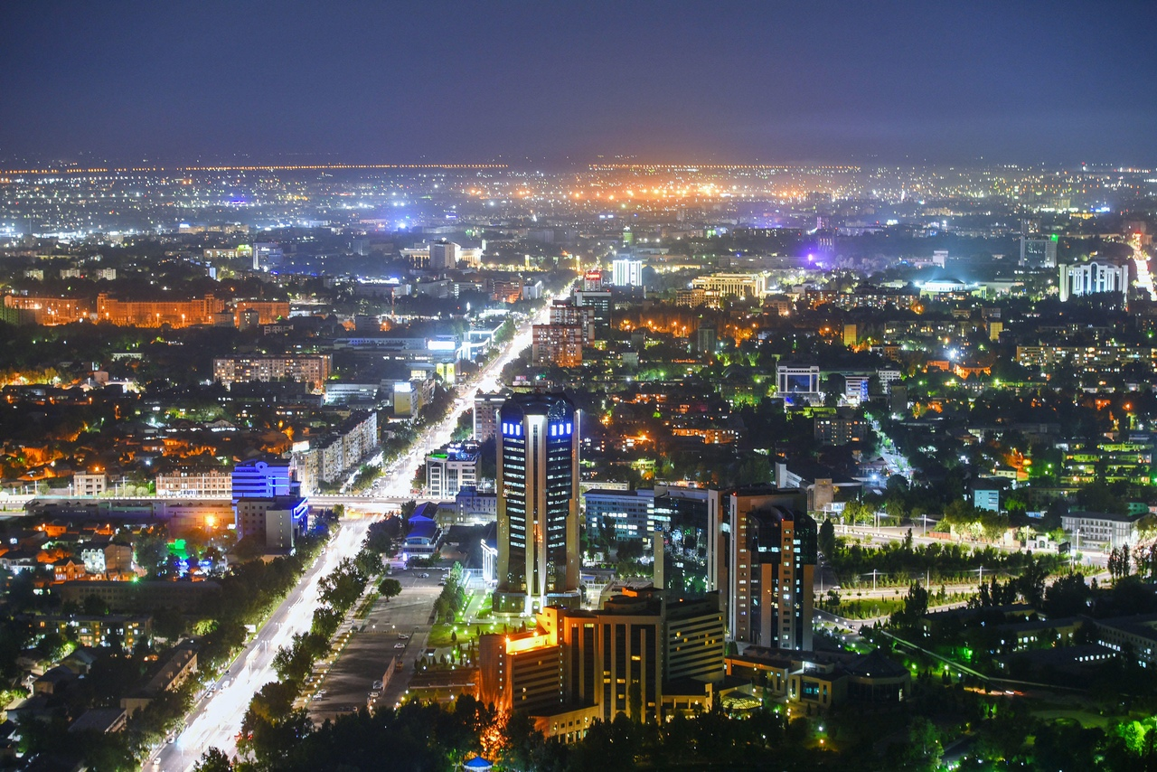
Notes:
Uzbekistan is located in a region called Central Asia. The map shows what countries border Uzbekistan, and where its capital city of Tashkent is. On the right is what the city looks like at night. Tashkent has a population of about 3 million people. The population of the whole country of Uzbekistan is about 36 million.

Slide 4
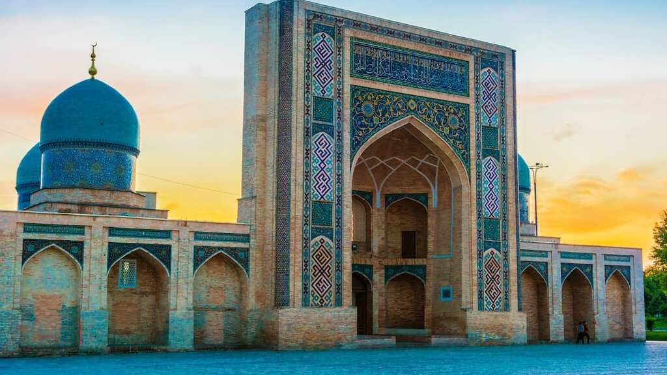
Notes:
This is the Barak Khan Madrasah (religious school), built in 1531. It is one of the beautiful buildings that make up the Hazrati Imam complex in Tashkent, which has mosques and a library. Uzbekistan is a mostly Muslim country, but has historically had a small Jewish population, as well as a small number of Christians and other religions.

Slide 5
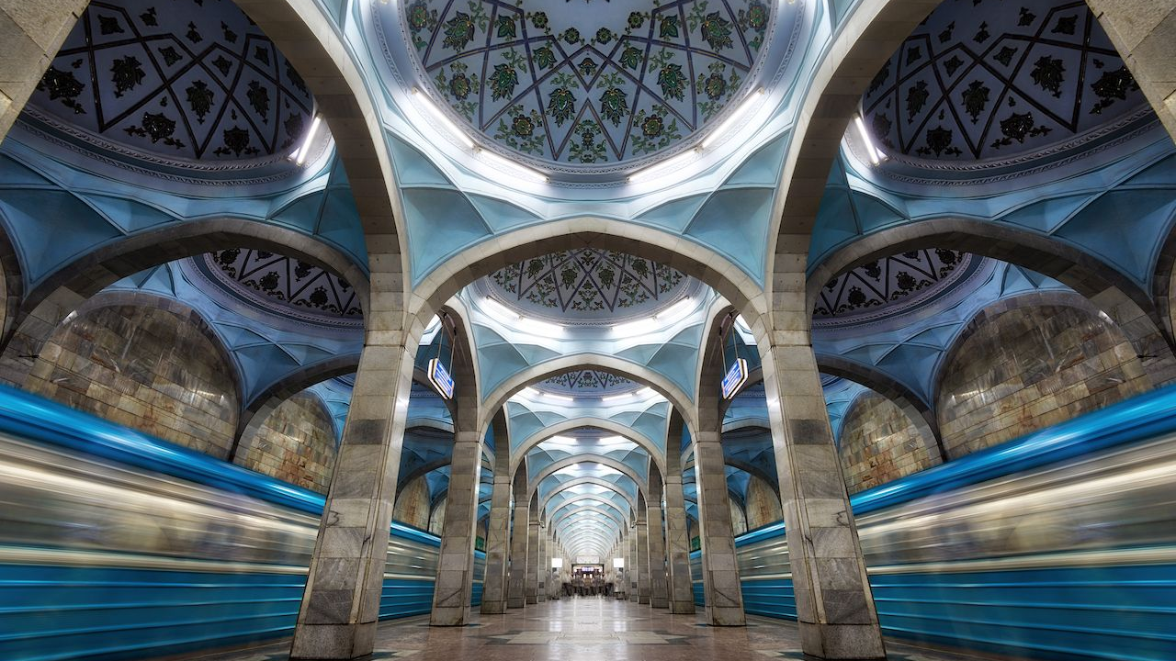
Notes:
This is a picture from an underground subway station in Tashkent. The whole subway system in Tashkent is full of beautiful art like this!

Slide 6
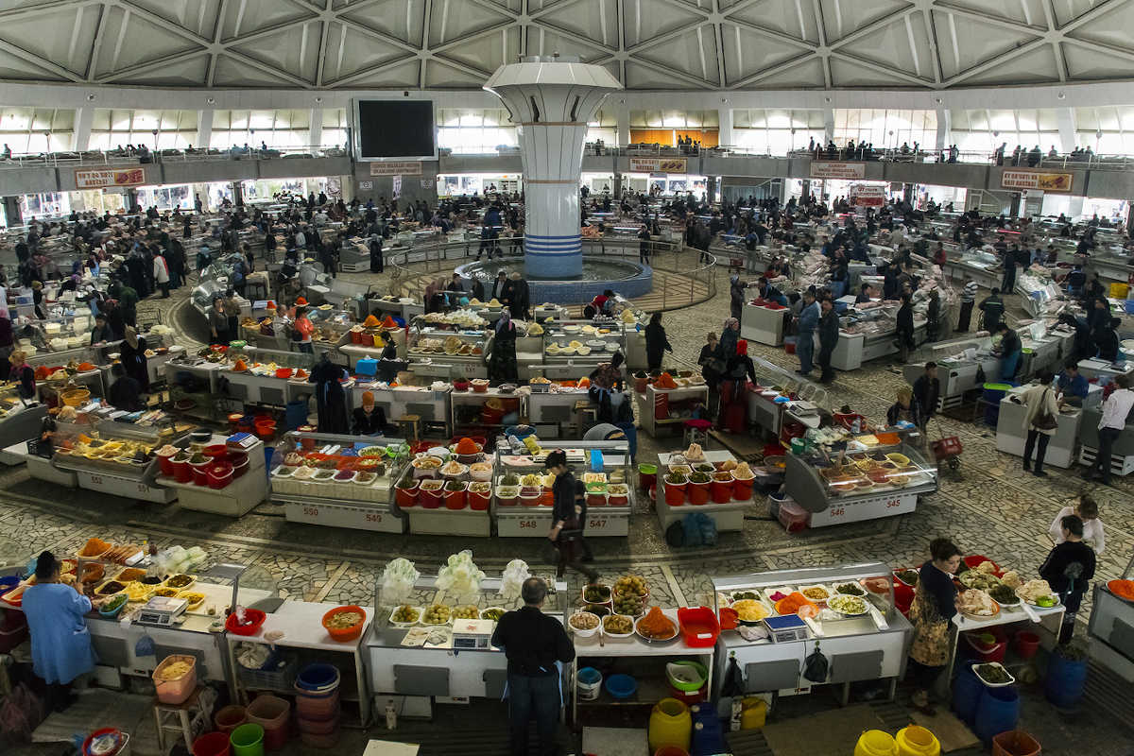
Notes:
This is the Chorsu bazaar, a big market where they sell all kinds of food and other items. It’s the largest and oldest bazaar in Tashkent!
https://www.turkestantravel.com/en/sights/chorsu-bazaar-in-tashkent/

Slide 7
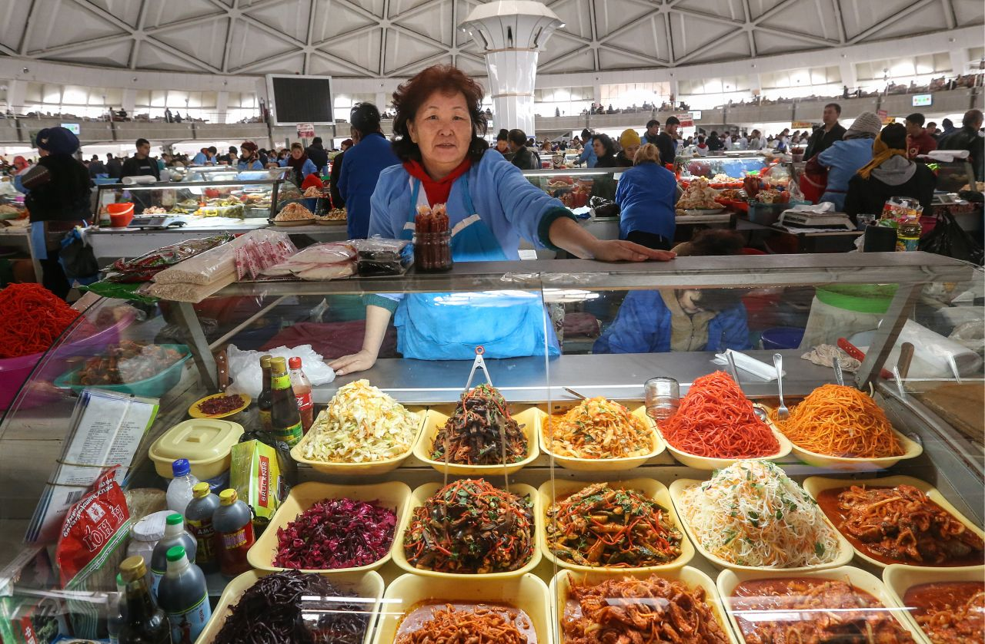
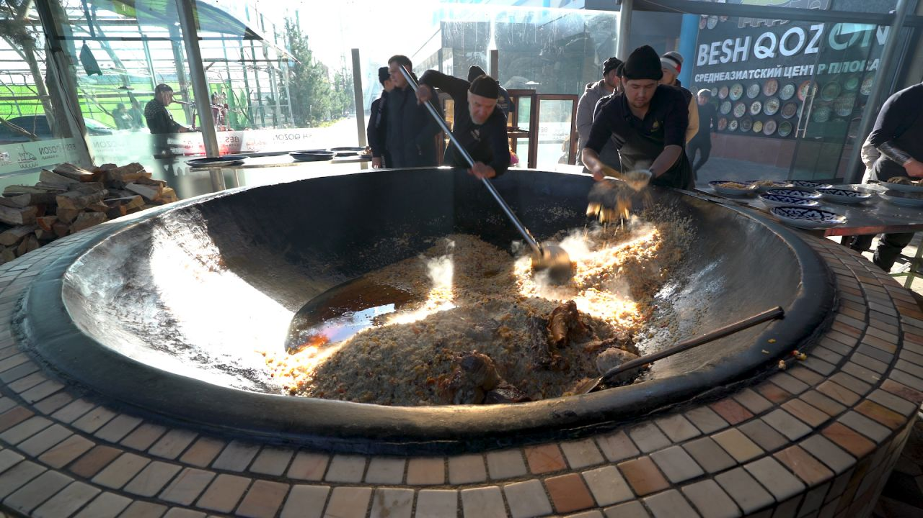
Notes:
Here is some Uzbek food in Tashkent! On the left is from the Chorsu bazaar. On the right is some men cooking a dish called plov, which has rice and meat.
https://www.cnn.com/travel/article/tashkent-uzbekistan-street-food-undergound-spc-intl/index.html

Slide 8
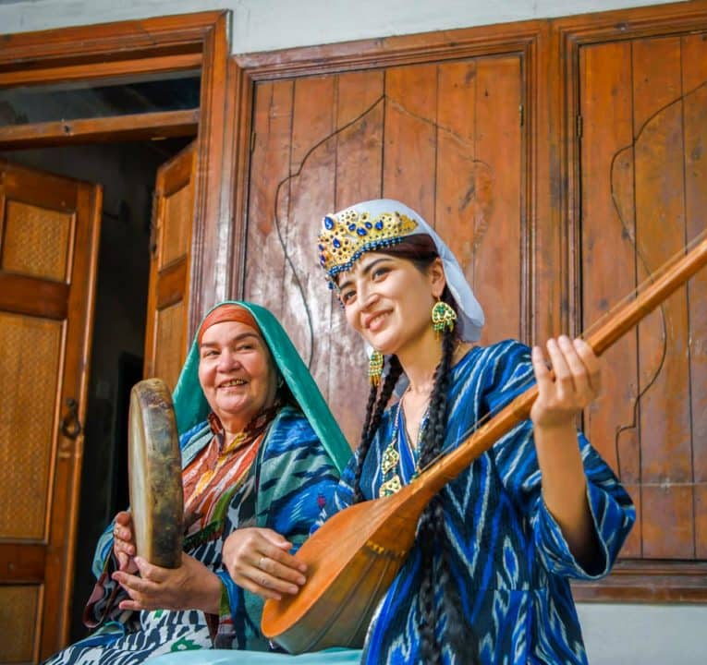
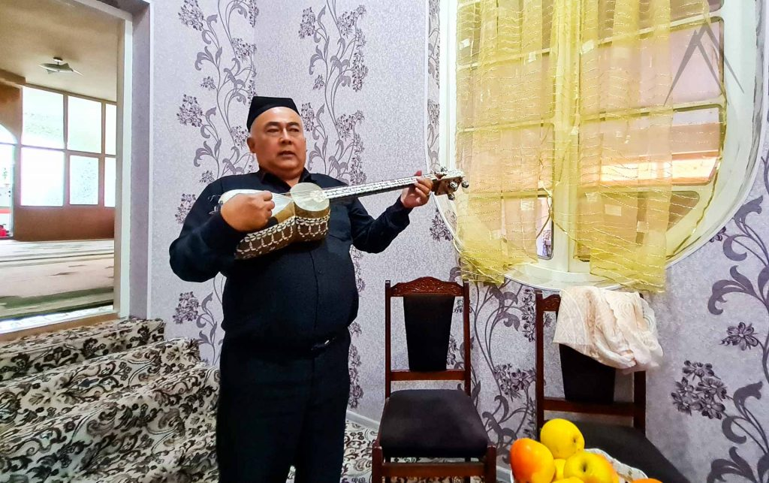
Notes:
These are pictures of people playing traditional Uzbek instruments. On the left is a drum called “doira” and a stringed instrument called “dotar”. On the right is a string instrument called “tar”. You can see them wearing traditional clothing. What do you notice about their clothing and instruments?

Slide 9
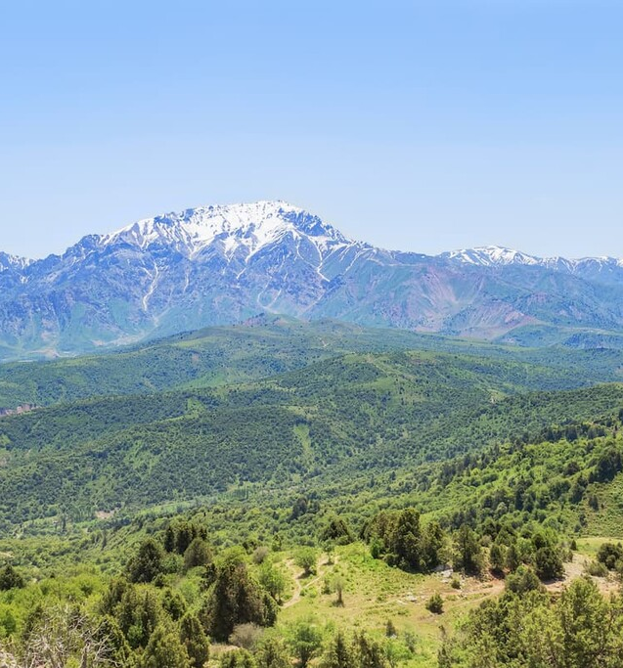
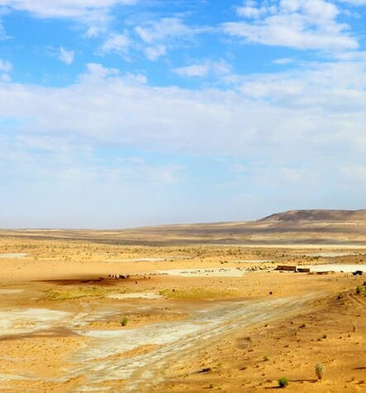
Notes:
Uzbekistan is a country with many different landscapes. There are snowy mountains, green forests, and desert!
https://peakvisor.com/adm/uzbekistan.html
On the left: Chatkal Range in the Western Tien Shan mountains (“Mountains of god/heaven”, aka “Tengir-too” or “Tengri Tagh”)
On the right: Kyzylkum Desert (“Red sand”)

Slide 10
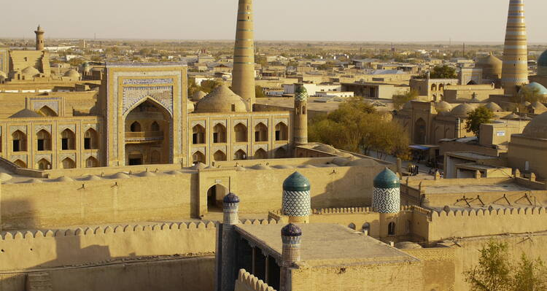
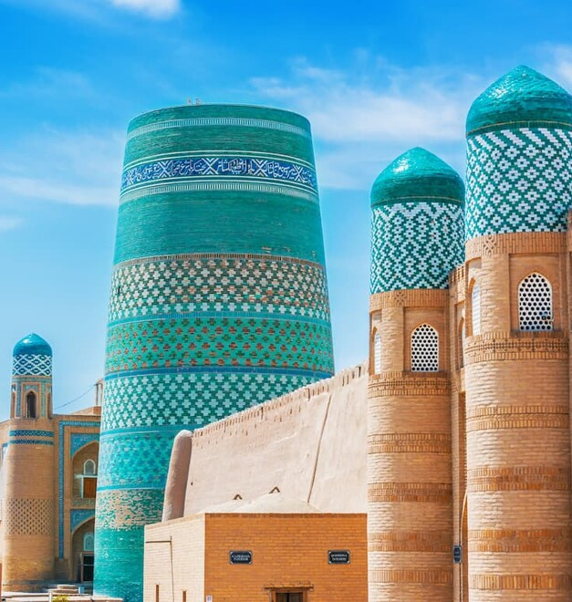
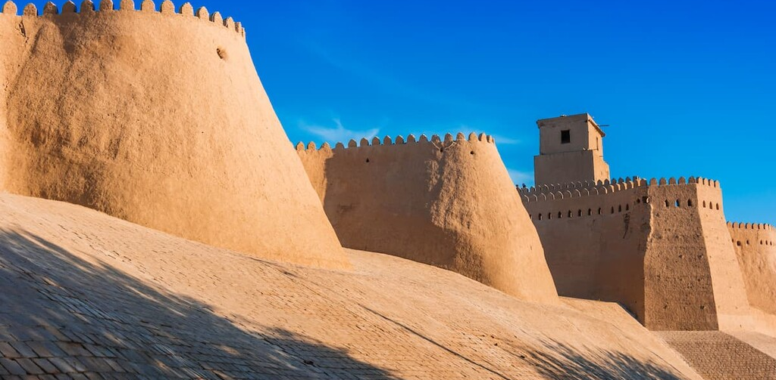
Notes:
Here are some interesting buildings from another place in Uzbekistan called Itchan Kala, which is the inner town of the city of Khiva. The town has an ancient wall around it to protect it. It has many very old and beautiful houses and buildings. Centuries ago, it was a resting place for caravans as they crossed the desert into Iran. The history of Itchan Kala spans over two thousand years!
https://peakvisor.com/adm/uzbekistan.html
https://whc.unesco.org/en/list/543/

Slide 11
Notes:
This is a special kind of Uzbek flat bread called “obi non” or just “non”. The dough is decorated with designs with a stamp called a “chekich” and baked in a stone oven over a fire. Today, you’ll be decorating clay with stamps to look like Uzbek stamped bread!

