Slide 1
Faberge Eggs

Slide 2
Faberge Egg: Made in St. Petersburg during Imperial Russia

Slide 3
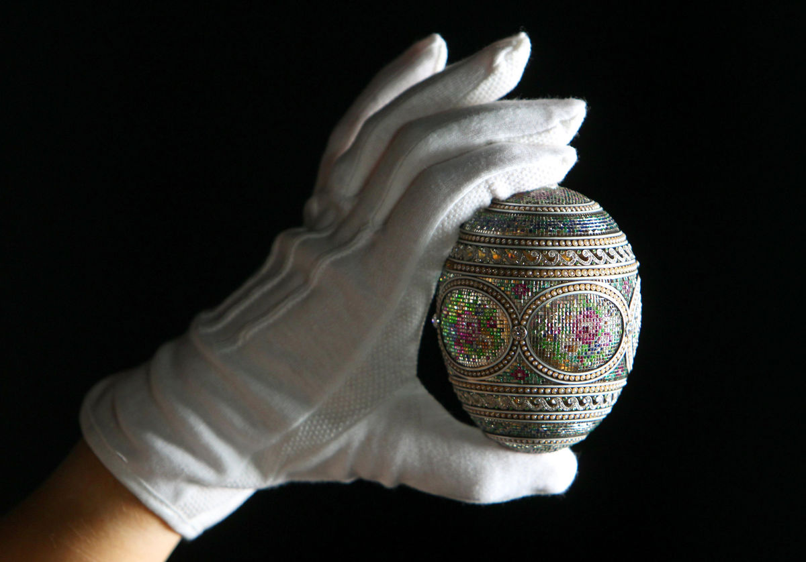
Only 69 (maximum) were made, 57 still exist today

Slide 4
50 of the eggs were made for the Romanov family

Slide 6
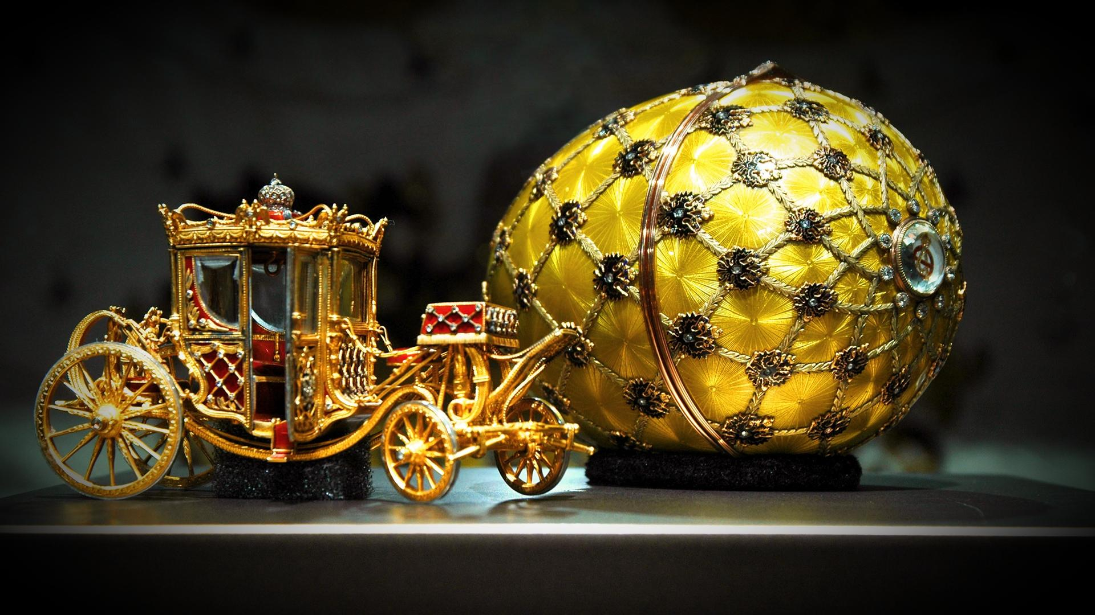
Imperial Coronation Egg: one of the most famous

Slide 7
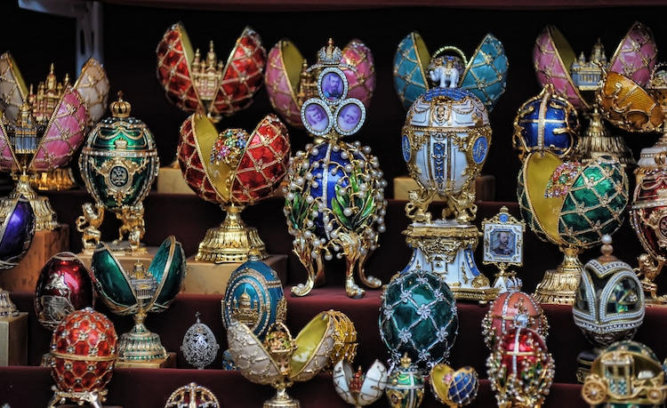
How much do you think they are worth?

Slide 8
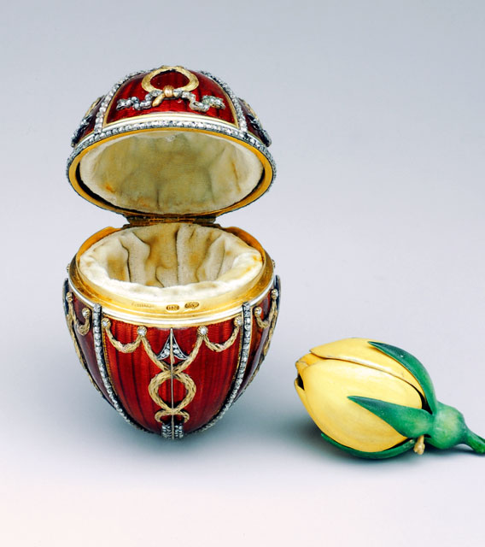

Slide 9
$9.6 million!

Slide 10
